Slide 1

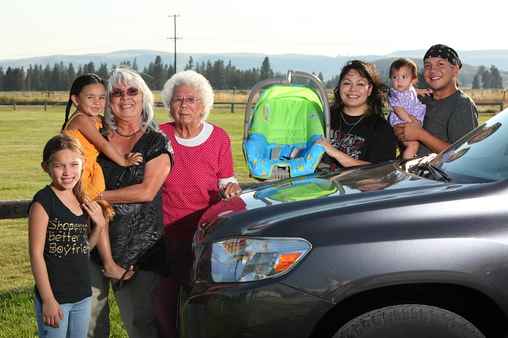
Safely Transport
Native Children Training
Adapted from the Indian Health Service Safe Native American Passengers (SNAP) Training for Child Passenger Safety
Notes:
This is a 3 to 3.5 hour Presentation based upon the 8-12 hour IHS SNAP training, developed by the Native CHILDREN ALWAYS RIDE SAFE (Native CARS) program. This presentation can also include optional training exercised that will include an additional 1 to 1.5 hours.
This training was developed to help people like yourself to transport children safely in American Indian and Alaska Native communities. Throughout this training I will be referring to American Indian and Alaska Native communities as either “Native American” or “tribal.” I will sometimes refer to a child restraint as “car seat” or “child restraint (CR).”
This training provides a basic overview of Child Passenger Safety. You are not expected to know all the answers. If a parent/caregiver asks a question you do not know the answer to, it is okay to tell them “I don’t know, but I will find out”. You can then contact your local child passenger safety technician for further information.
There is a National standardized CPS technician training which certifies individuals as Child Passenger Seat technicians and instructors. This in-depth training is usually 3-4 days long and combines classroom instruction, hands on exercises with CRs and vehicles, and a community safety seat checkup event. After this rigorous certification students are able to demonstrate proper use, installation of car seats, and safety belts; as well as teach these skills to caregivers.
For more information Visit http://cert.safekids.org
Training Estimate
Sign-in/Introductions/Pretest: 15-20 minutes
Simple steps to Child Passenger Safety video: 30 minutes (optional)
Power Point: 45-60 minutes (answering questions as you go)
Break: 10 minutes
Resuming Power Point: 45-60 minutes
Post test: 5 minutes
Evaluation: 10 minutes
Hands on exercise: 60 to 90 minutes
Total Time estimate without exercises: 3 to 3.5 hours
Time with exercises: 4.5 to 5 hours

Slide 2
Getting Started
Who you are?
Why are you interested in Child Passenger Safety?
Pre-Test
Notes:
Provide your introduction here: My name is ________________. I am an enrolled member of the _________ or I work with _________________. I have been a certified Child Passenger Seat Technician since _________________.
Go around the room and have participants introduce themselves. Have them give there names, occupations, experience with child passenger safety, and motivations for taking this training.
Administer Pre-test. Reassure the participants that this test is only to gauge how much their knowledge of child passenger safety changed from the beginning of the training to the end.

Slide 3
Expectations
What You Will Learn in the Classroom
  Why Child Restraints are important
  Seatbelts, LATCH, and Airbags
  Different Child Restraints
  Correct Installation Elements
  Identifying Misuse
Class discussions and hands-on exercises
Post Test
Notes:
This training covers the basics of:
● What happens in a crash
● Seatbelts, air bags and CR and how they work together
● Correct installation of CR and misuse of CR
You will see how several different CRs are installed and you will practice being able to tell when they are installed in the wrong way. You are encouraged to ask questions to make sure you understand the concepts.
Hands on exercises will take place in the classroom and outside in vehicles regardless of the weather.
There will be a short post test at the end of the training to evaluate how well you absorbed important elements of this training.

Slide 4
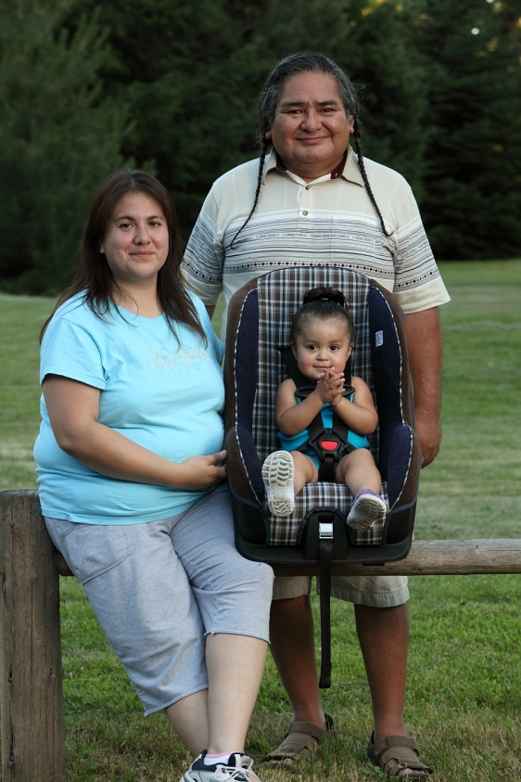
Why Use Restraints?
Studies show restraints cut down:
  Injury severity by 60%
  Hospital admissions by 69%
  Treatment costs by 66%
Use a seatbelt!
Use a child restraint!
YOU could save a life!
Notes:
Why should we use restraints? There are many reasons.
READ SLIDE
(http://stokes.chop.edu/programs/injury/)
Saving money is important! Funds used to care for MV injuries can be used for other programs such as diabetes care.
Use a seatbelt!
Use your CR!
You could save a life!

Slide 5
Car Seat
Recommendations
Rear-facing until two years of age or highest weight/height allowed by the restraint’s manufacturer.
Use each restraint type to the weight and/or height limit before progressing to the next type of restraint.
Never place a rear-facing restraint in front of an airbag.
Children under 13 should ride in the back seat.
Read car seat manual as well as the vehicle’s manual for important installation instructions.
Notes:
American Academy of Pediatrics (AAP) advises parents to keep kids in rear-facing restraints until two years of age or until they reach the highest weight or height allowed by their car safety seat's manufacturer.
National Highway Traffic Safety Administration (NHTSA) advises caregivers to keep children in each restraint type (rear-facing, forward-facing and booster seats) for as long as possible BEFORE moving them up to the next type of seat.
Children in rear-facing car seats should NEVER be placed in front of an active passenger air bag.
Children UNDER 13 should ride in the BACK seat.
ALWAYS read child seat manufacturer’s instructions and the vehicle owner's manual for important information on height and weight limits and how to install the car seat using the seat belt or the LATCH system.

Slide 6
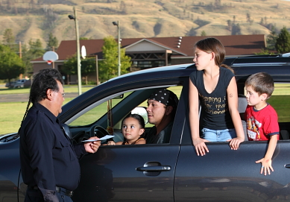
Child Safety Seat Laws
All 50 states have child restraint laws
Some Reservations have their own set of Passenger Transportation Safety laws.
What’s the law in your community or state?
Notes:
Do you know what your local law is for car seats and seatbelts? Does your tribe have a Primary, Secondary or no law?
Primary—Police can stop and ticket a driver or passenger for NOT wearing a seat belt, without any other traffic offense.
Secondary—Police CAN’T ticket a driver or passenger for not wearing a seat belt unless they have been stopped for another offense.
Car Seat/Seat Belt laws vary widely between States and reservations. While most states have laws that parallel NHTSA and AAP recommendations, several states have less rigorous safety laws. Understanding the laws from state to state will help understand the rate of CR/SB use in local communities. This in turn illustrates why different communities have different Car seat/Seat Belt success rates. Law understanding can also aid in the understanding of who enforces SB/CR use and the penalties for failing to follow the law. This is particularly apparent on reservations in states subject to PL 280. PL 280 gives Reservation law enforcement duties to the State. Due to lack of funding for law enforcement officers in states such as Oregon has resulted in inadequate enforcement of laws surrounding issues such as SB/CR use. In these cases, enacting a rigorous educational campaign for these communities might aid in rising rates of SB/CR use, despite lack of state law enforcement.

Slide 7
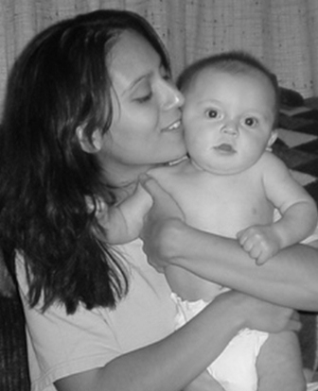
Best Practice and
Tough Choices
Best practice = gold standard
Tough Choices
  No clear answer
  Give options
TOUGH CHOICES ARE ALWAYS MADE BY THE PARENT/CAREGIVER!
Notes:
As you learn, practice and explain you will need to keep a couple of things in mind: Best Practice and Tough Choices.
Best practice is the gold standard of protection. It is the most acceptable way to transport a child safely on the basis of their age, weight, height, and body development. Often, parents/caregivers do not choose the best practice because they do not understand the reason for it. It is important to understand the reason for the best practice.
For Example: Many parents will think their 5 year old is too big for a “car seat”. Best practice for a 5-9 year-old child is to use a booster seat with a lap/shoulder belt in the vehicle.
Tough choices are made when there may not be a clear answer for the safest way to transport a child. Parent/caregivers will then need to decide among the options.
In many cases, there will be best practices related to the tough choices. You must provide parent/caregivers with available options. Then they can make the tough choices about how best to restrain their own child.
Another Example: Where do you put three children and a driver in a single cab pick-up truck that has three seatbelts? Some options:
● Use a different vehicle with more seating,
● leave the children at home or,
● tell the parent/caregiver “I can’t tell you a safe way to do this”.
TOUGH CHOICES ARE ALWAYS MADE BY THE PARENT/CAREGIVER

Slide 8
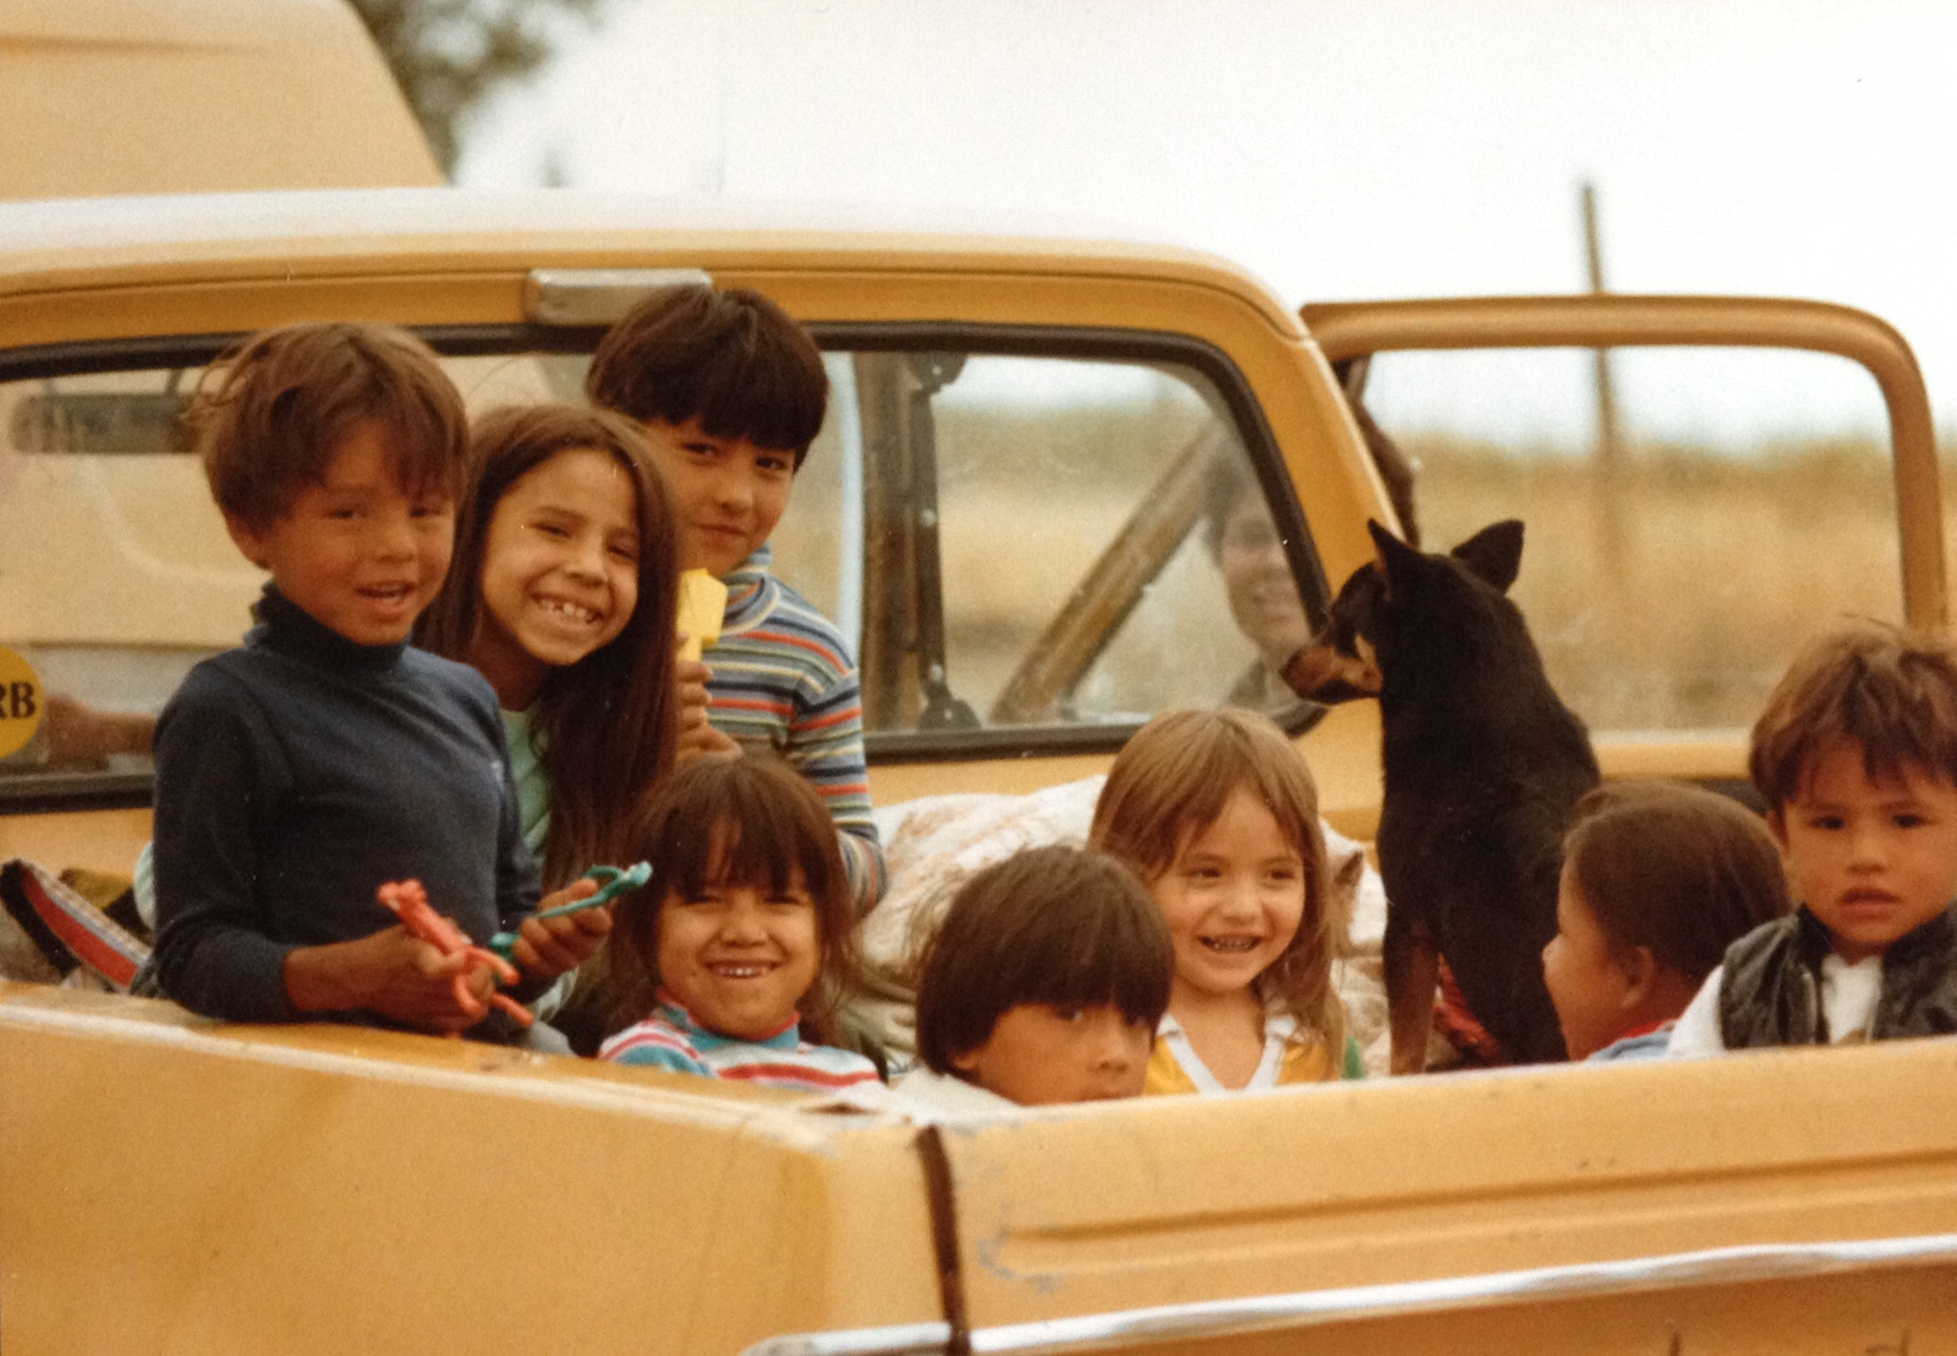
Best Practice
Seat belts or child restraint for everyone
  Pickup trucks
  Community vehicles
Use a Child Restraint
Every Trip, Every Time
Notes:
To be safe, everyone who rides in a vehicle needs to wear a seat belt OR a child restraint.
Many tribal communities use pick up trucks or community vans as their main way to travel. How many of you have seen people riding in the bed of pickup trucks? As a child, when I was with my grandpa, I remember bouncing around on the wheel well or standing up behind the cab. Remember, there is no safe way to ride in the bed of a pickup truck.
Some families also use community vans for travel to appointments without using a CR. The standards for pickup trucks and community vans are the same as passenger cars. So it is important to use a CR with these vehicles. This may mean the community van will need to have CR or the family will need to bring their own CR.

Slide 9
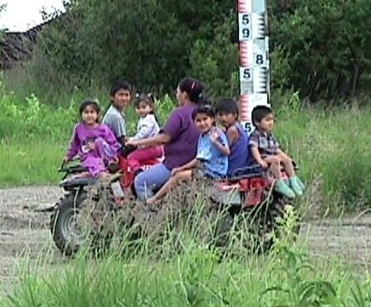
Tough Choices
Vehicles not designed for CR
  -- Off road vehicles (ATV’s)
  -- Snow mobiles
  -- Fan/Air boats
  -- Small airplanes
Safer choices
  Use another vehicle
  Limit travel time
  Check on the child
CR not approved for off road vehicles
Notes:
Some tribal communities are faced with a tough choice when transporting children. Sometimes their only option is to use vehicles that are not designed for Car seats.
Off road vehicles such as ATV’s, snow mobiles, fan/air boats and small airplanes are often used by Native Americans that don’t have a road system or live in an isolated area.
In these situations, there may not be a safe option to use a Car seat.
Safer choices may be:
● Use another vehicle
● Limit the amount of travel time and use the proper safety equipment (i.e. helmets)
● Frequently check to make sure the child is okay
No CR manufacturer approves their Car seat to be installed in vehicles that are not designed for them.

Slide 10
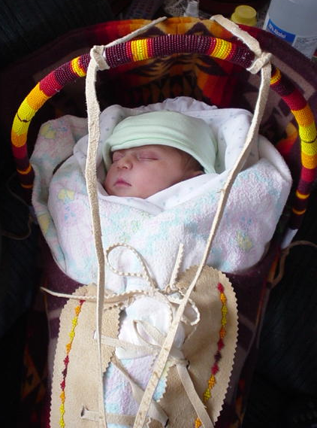
The Cradleboard
Important part of culture
Is fine for general use
Always use a child safety seat to transport children
Notes:
Many Native Americans have traditionally used cradle boards. They are an important part of some tribal cultures. Their main purpose is to serve as a bed. They were the first CPS devices used to protect the child when being moved by non-motorized vehicles in these communities.
Cradle boards are fine for general use at home or for traditional activities. However, using them to transport children in motor vehicles is not safe. Special crash tests were done to test cradle boards. Results showed they are not strong enough to protect a child in a crash.
http://www.youtube.com/watch?v=5Mgf5KJXX7I
Car seats are strong enough to keep an infant safe. So always use a CR that meets federal motor vehicle safety standards to transport children.
We honor and respect our children by keeping them safe.

Slide 11
Motor Vehicle Fatalities
According to the Centers for Disease Control and Prevention:
  Leading cause of death for Native Americans
  (ages 1-44)
  More children, ages 1-16, die from crashes than from any other cause.
Notes:
What do we know about motor vehicle crash fatalities?
According to the Centers for Disease Control and Prevention: www.cdc.gov/ncipc/wisqars/ motor vehicle crashes are the leading cause of death for Native Americans ages 1-44.
Additionally, more Native American children, ages 1-16, die from motor vehicle crashes than from any other cause.
There is a higher rate of MV related deaths in American Indians then in any other race.

Slide 12
Motor Vehicle Injuries
More injuries than deaths
Life-long effects
Burden on family, community and resources
Notes:
Deaths from crashes are only the tip of the iceberg. There are many more injuries than deaths every year.
For every child who dies from an injury, many more are put in the hospital, treated in emergency rooms, clinics and doctors’ offices.
Some injuries are very serious and can change a child’s life forever.

Slide 13
Crash Survival Challenges
Non-use
Misuse 73% to over 90%
Use decreases as children get older
Outdated or incorrect educational materials
Notes:
What are challenges to surviving a crash? Non-use of Car seats/safety belts remain a problem, especially in tribal communities. You can help educate your community about Car seats and seatbelt use.
Misuse rates vary from 73% to over 90%. In some tribal communities misuse rates are even higher. Sometimes correct installation and use of a Car seats can be difficult and leads to misuse.
Studies show correct restraint use drops as children get older. Most children are restrained during the first year of life because they appear to be more fragile and need more protection. However, there is a drop in use for children from 1 to 3 years of age and a bigger drop from 4 to 7. This age group is seen as too big for a CR. Yet they are too small for seat belts alone.
It is important to review educational materials every year to be sure you are providing accurate and current information. By understanding correct use of car seats and seatbelts, it will be easy to see misuse and offer education to correct it.

Slide 14

Why restrain children?
Larger head
High center of gravity
Smaller body
Soft skull bones
Rounded hip bones
Weak stomach muscles
Vehicles are built for adults
Notes:
Compared to adults they have a larger head compared to the rest of their body. They have smaller bodies, soft skull bones, rounded hip bones, and weak stomach muscles.
Most safety features in vehicles are built for adults not children. Therefore, children are at greater risk of getting hurt than adults. Young children’s rounded hips do not work well with the lap portion of the seat belt. These young children are too short for the shoulder belt to fit properly across the shoulder and chest.

Slide 15
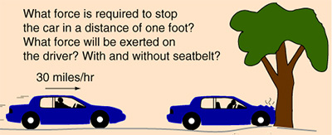
Crash Forces
Weight x speed = restraining force
10 lb. x 30 mph = 300 lbs
Notes:
One way to help the public understand crash forces is to explain that the strength needed to restrain a person roughly equals the weight of the person times the vehicle speed.
For example: A 10 lb. infant in a motor vehicle moving at 30 MPH would require at least 300 lbs. of strength to keep from moving forward.
It is important for parents/caregivers to understand that holding a child in their lap or unrestrained is dangerous to the child.
Can you hold 300 pounds?

Slide 16
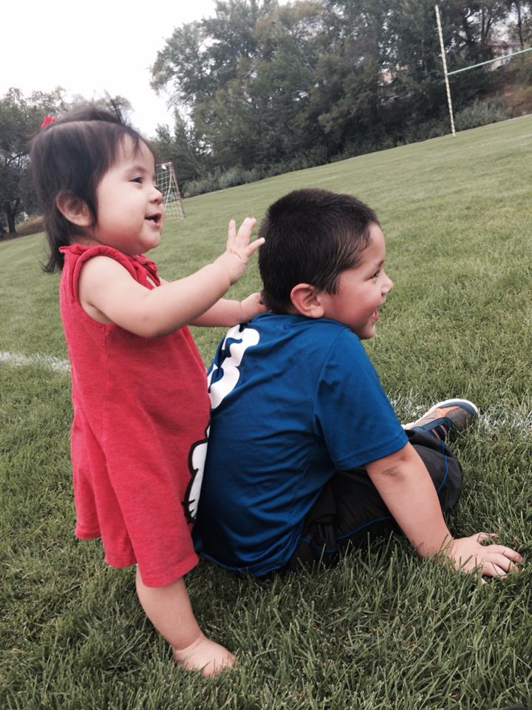
What Collides in a Crash?
Vehicle
People
Inside the body
Notes:
A quick change in speed is what causes people to get hurt.
There are three collisions which happen in a crash:
First, the vehicle hits an object such as a tree or another vehicle.
Second, the people in the vehicle hit the inside of the vehicle, each other, or other loose items in the vehicle.
Third, the organs inside a person’s body may hit other organs, bones, or even the inside of the skull. The person may look fine but the brain, heart, or other organs may be torn, bruised, or bleeding inside.

Slide 17
Four Crash Types
1. From the Front (most common)
2. From the Side
3. From the Back (rear-end)
4. Vehicle Rollover
Notes:
There are four types of crashes. If passengers are not restrained, certain injuries are common in each type of crash:
Front Crashes happen more than any other type. In this type of crash, people often have broken bones, cuts, and internal injuries.
Side Crashes don’t happen as often as those from the front but the people in the vehicle are more likely to be killed. In this type of crash, people’s heads may hit the window or the door post. They are also likely to have chest and pelvic injuries, broken bones in their faces or heads, and cuts.
In rear-end crashes, people’s necks are often hurt. The bones may break or the soft tissue, like tendons, can tear or stretch. People often have “whiplash” if there is no head restraint or if it is set in the wrong position.
In vehicle rollover crashes, the vehicle can roll onto its side, upside down or over. The more times the vehicle rolls, the more damage is done. Passengers in the vehicle are often thrown out and crushed.

Slide 18
Injuries Without a Crash
Skids, spins, swerves or sudden braking
Common causes of occupant injuries:
  Thrown out of windows or doors
  Collide with other occupants
  Hit the inside of the vehicle
Notes:
Sometimes people get hurt even when there isn’t a crash. When the driver skids or stops too quickly, unrestrained passengers can be thrown out of the vehicle if a door is not locked or around in the vehicle. They may collide with other occupants or hit the inside of the vehicle.

Slide 19
Restraints Prevent Injury
Keep people in the vehicle
Holds you where your body is strongest
Spreads out the force of the crash
Helps the body to slow down
Protects the head and spine
Notes:
A seatbelt or child restraint:
Keeps people from being thrown out People thrown from a vehicle are four times more likely to be killed than those who remain inside.
Holds you where your body is strongest For an older child or adult, the shoulders and hips are the strongest. For a baby, the Car seat supports the whole body.
Spreads out the force of the crash A lap/shoulder belt or CR harness, spreads the force across a large area of the body. This means the person is less likely to get hurt.
Lets the body or CR slow down with the vehicle This extends the time when the forces are felt by the person during a crash but only if they are held snug by a restraint. They are less likely to be hurt if they can slow down with the vehicle.
Protects the head and spinal cord A shoulder belt or Car seat harness helps to keep the head and upper body away from the hard inside of the vehicle. But they only work if they fit right.

Slide 20
You Can’t Survive
Every Crash
Some crashes are too violent to survive
Outcome is determined by many factors
Restraints and airbags give the best chance of survival
Notes:
We never know for sure what will happen in a crash. Some crashes are so violent that even properly restrained people are injured or killed.
Survival depends on many things such as:
the speed on impact
weight of the passenger
weight of loose objects inside the vehicle and
size of the vehicle.
We DO know, you or your child have a much greater chance of coming out alive if you use your seatbelt and Child restraint!
Seatbelts, airbags and Child Restraints work together to give the best chance of survival.

Slide 21
Common Myths
“I’m just driving to the store”
“It is better to be thrown out”
“I can hold my baby in a crash”
“Seat belts are uncomfortable”
“I’m a good driver, so I won’t get into a crash”
Notes:
Some people are misinformed about seatbelts and CR. Here are some common myths about using restraints and responses you can give.
“I’m not driving very far. I’m only going down the street to the store. I always buckle up when I drive on the highway.”
Response:
Most crashes happen close to home.
Roads and streets are more dangerous than highways because traffic is usually going two ways and there are many intersections and distractions.
“It is better to be thrown out. The car might burn or I might drown. I don’t want to be trapped in my belt.”
Response:
You are four times more likely to be killed if you are thrown from the vehicle.
Less than half of one percent of all crashes involve fire or water. It is better to be restrained during the crash so you are more likely to be conscious, uninjured and able to escape.
“I can hold my baby in a crash”
Response:
The forces in a crash are so great that it is impossible for any person to hold onto a baby’s body.
If the adult is also unrestrained, it is likely s/he will crush the child.
“Restraints are too uncomfortable for me and my child.”
Response:
It is a lot more uncomfortable to be injured.
People who get in the habit of buckling up find it uncomfortable to ride without them.
“I’m a good driver, so I won’t get into a crash.”
Response:
You can never predict or control what other drivers will do. The weather may have changed road conditions.

Slide 22
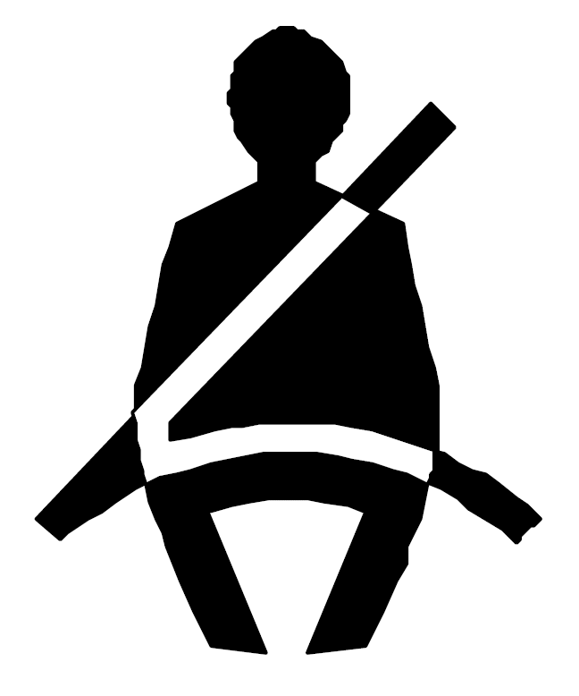
3 ways to secure a child restraint
Latchplate
Retractor
LATCH
Never combine these methods!
Notes:
There are three ways to lock a car seat in your car
Retractor
Latchplate
LATCH
However, remember to never combine any of these methods – aside using the top tether from the LATCH system.
ALWAYS READ THE VEHICLE MANUAL TO SEE WHAT LOCKING OPTIONS ARE AVAILABLE IN THE VEHICLE

Slide 23
Vehicle Systems
Pre-crash lock systems
Systems that don’t pre-crash lock
Both systems will either lock at the retractor, or the latchplate.
Notes:
Now that we know why it’s important to use child restraints, it is important to learn about seat belts, their various parts, and the different seat belt systems that could be used in a vehicle. Knowing this information will help you understand how they work to install car seats.
It is important to know that all seat belts are designed to lock in a crash. Some lock before the crash, and some lock during the crash.
A pre-crash lock system is locked all the time. If a system locks only during a crash, is not a pre-crash lock system.
A child restraint needs to be pre-crash locked at all times. That way the car seat is positioned correctly before a crash occurs. A pre-crash locked system, when used correctly, will keep a car seat from moving more than one inch side-to-side or front-to-back. It does not have to be so tight that it does not move at all.

Slide 24
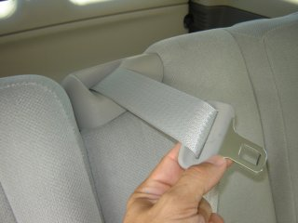
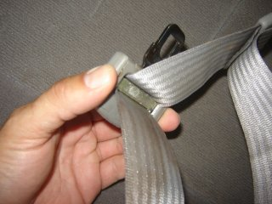
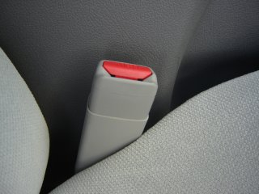
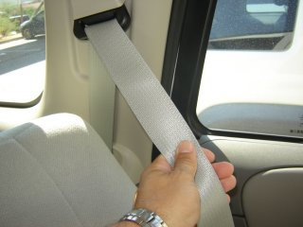
Seat Belt Components
Anchor
Webbing
Latchplate
Retractor
Buckle
Notes:
Both seat belt systems are made up of the same components; they different in the subtle differences in these components.
Anchors are where the seat belt or tether is attached to the vehicle or to the seat.
Webbing is the fabric of the belt. The webbing holds the person or CR to the vehicle during a crash. If a car has been in a crash, the webbing may have stretched. If so, it will not work as well in another crash. So after a crash, it should be replaced.
Latchplate is the seat belt part that connects the seat belt webbing to a buckle.
Buckle accepts the latchplate and holds the seat belt in place
Retractor gathers and stores extra webbing in the vehicle. They are usually located out of sight at an anchor point. Most lap-shoulder seat belts have one retractor at the shoulder. Some seat belt systems may have two retractors: one for the lap-belt and one for the shoulder-belt.

Slide 25
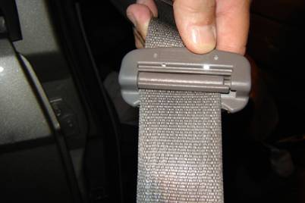
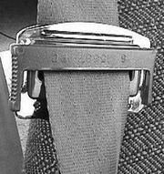
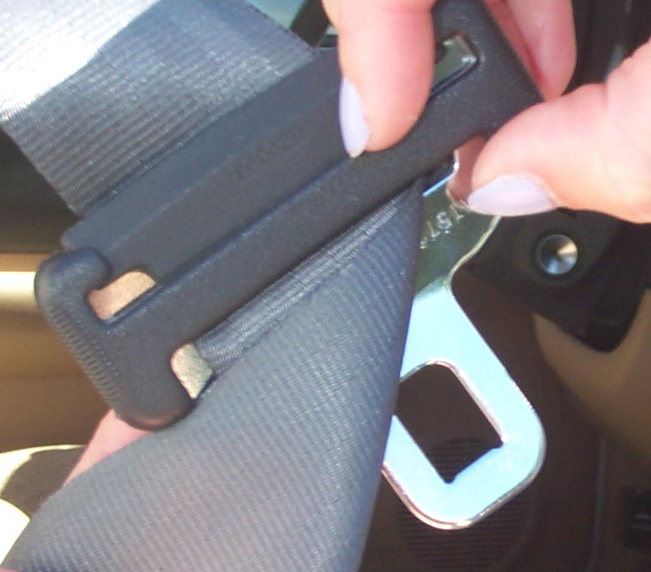
Pre-Crash
Locking Latchplates
Notes:
Here are some examples of pre-crash locking latchplates.
● Not all pre-crash locking latchplates look the same. Some have a movable bar; others have a sliding or moving plastic part.
● The locking piece clamps down on the lap portion of the seat belt when buckled.

Slide 26
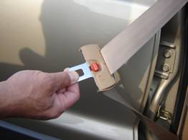
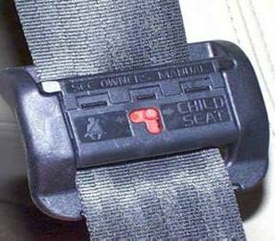
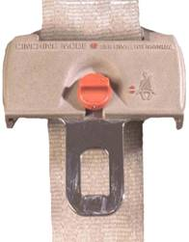
Pre-Crash Switchable Latchplates
ADULT Position
CHILD Position
Notes:
The second type of pre-crash locking latch plate is the switchable latchplate.
● A few vehicles have a switchable latchplate that uses a button to move from the adult pre-crash sliding position to the child pre-crash locking position.
To know if you have this type of latchplate, it is important to read the vehicle’s owners manual to determine if your vehicle has this type of latchplate.

Slide 27
Securing a CR With a Pre-Crash Locking Latchplate
Read vehicle owner’s and child restraint manuals
Determine vehicles latchplate type
Place belt through correct CR belt path, engage buckle
Apply weight in CR and pull webbing at the belt path to tighten lap belt
Check for tight installation
Notes:
Now let’s discuss how to secure a car seat with a pre-crash locking latchplate.
The CR should not move more than one inch at the belt path.
Note: CR belt paths will be covered in detail in later chapters.
(Optional: Instructor can now demonstrate in class how to use pre-crash locking latchplate)

Slide 28
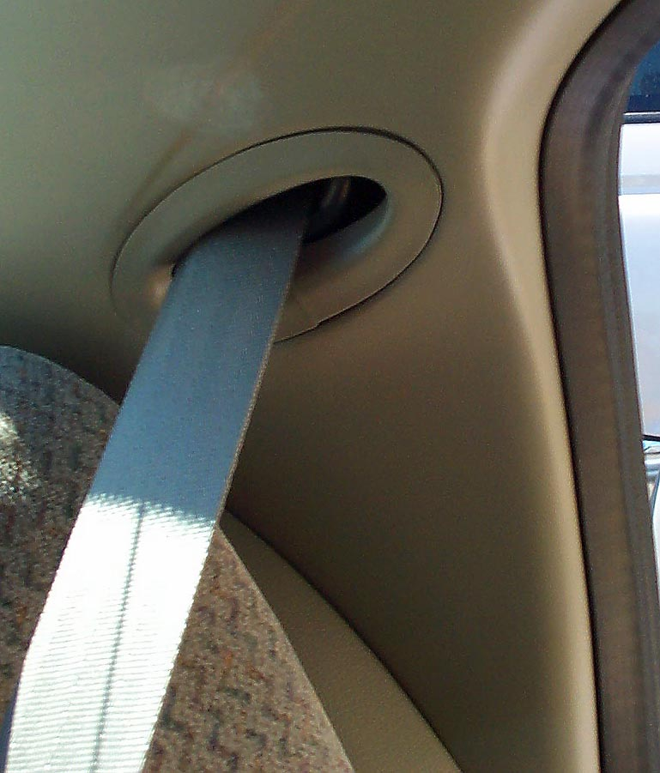
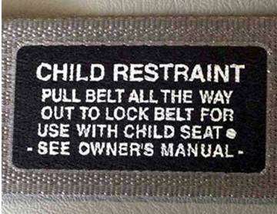
Retractors that
Pre-Crash Lock
Automatic locking
retractor (ALR)
  Always locked
  Test if you have an ALR
Switchable retractor
  Locks in an emergency
  Switches to ALR with your help
  Note some have a button to switch to ALR
Notes:
In some vehicles the retractor, not the latchplate, provides the pre-crash locking part needed to keep a Car seat in place at all times.
Remember: A retractor is the device that winds up extra webbing of unused seat belts to take up slack. It is vital to know what kind of retractor is in the vehicle.
The two pre-crash lock retractors are: automatic locking retractor (ALR) and switchable retractor
ALR retractors are always locked and easy to use with car seats. These are usually found on older vehicles.
To test if you have an ALR: Pull the webbing out slowly and gently. After you stop, if the seat belt can only get shorter it is an ALR.
Unless switched to the locked position, a seat belt with a switchable retractor will lock only in an emergency such as a crash, sudden stop or turn,.
To switch to ALR
Test slowly and gently
Pull belt all the way out to switch to ALR
● Look on the seat belt webbing for possible instructions on how to use the seat belt with the CR.

Slide 29
Installing a CR with a ALR/Switchable Retractor
READ Vehicle Owners manual
Route belt path and buckle
Pull webbing
Apply weight on seat
Tighten the seat belt
Return extra webbing
Check installation
Notes:
To install a CR with a switchable retractor:
● READ SLIDE
● Pull the webbing all the way out of the retractor and test gently
● Apply weight on the seat with your hand
● Tighten the seat belt
● Return extra webbing back into the retractor
● Check for tight installation at Car Restraint belt path--it should not move more than one inch.
● Show the parents/caregivers each installation. Take time with them so that they can learn how to best protect their children in a vehicle by using this seat belt system.
(Optional: SNAP teacher may demonstrate in class how to use a switchable retractor, if available.)
BREAK

Slide 30
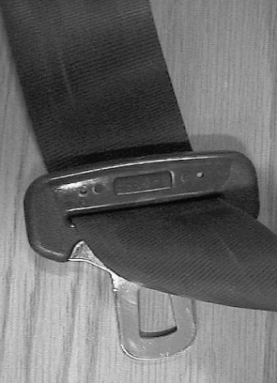
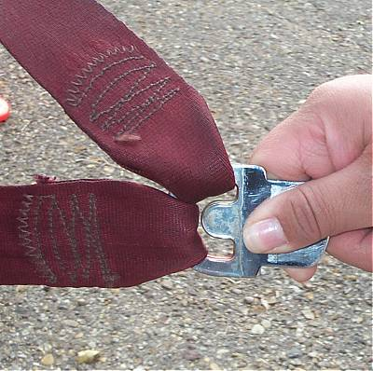
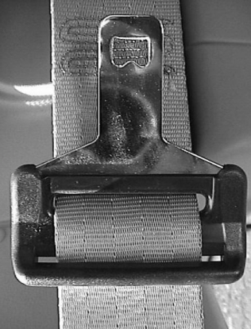
Latch Plates Without
Pre-Crash Locking
Features
Sliding Latch Plate
Sewn-on Latch Plate
Notes:
● Pictured on the left is a sliding latch plate. It has no locking feature and no moving parts.
● To test if this latch plate has a pre-crash locking feature; buckle the seat belt and pull up on the lap portion of the seat belt. The latch plate will grab the seat belt webbing if there is a pre-crash locking feature. If the seat belt webbing slides thorough the latch plate there is no pre-crash locking feature.
● The sewn-on latch plate shown on the right has no locking features and no moving parts.
● An approved additional “fix” may be needed with both of these latch plates.
● Read vehicle owner’s manual for CR instructions.

Slide 31

Retractor without Pre-Crash Locking Feature
Emergency locking retractor (ELR)
Locks in sudden stop or crash
Notes:
● The ELR retractor locks only in a sudden stop, turn or crash.
● It lets the belt extend or rewind freely. It does not keep the belt tight during normal driving but will lock in a sudden stop or crash.
● You cannot identify an ELR just by looking at the seat belt.
To test:
● Pull 24 to 36 inches of webbing slowly and gently
● Allow some of the webbing to go back into the retractor
● Try to pull the webbing out again very slowly
● If the webbing goes freely in and out of the retractor you might have an ELR
● Now slowly pull the webbing all the way out of the retractor. If the webbing does not switch to a locked position you have an ELR
Read the vehicle owner’s manual for CR instructions

Slide 32
What if Nothing Locks?
If nothing will lock in your vehicle, and you can’t use LATCH, try:
  Using locking clip or lock off
If locking clip or built-in lock off is not working, contact your local CPS Tech for further guidance and assistance.
Notes:
You should always check the vehicle and each seating position for pre-crash locking features.
If none are available, vehicle manufacturers have approved these additional steps when the retractor and the latchplate do not pre-crash lock.
● Use a locking clip/lockoff
● Use a belt shortening clip
● Flip the latch plate
● Twist the buckle stalk- check the vehicle owner’s manual to see if buckle twisting is allowed. Maximum of 3 twists.
These last two steps are done when the seat belt does not lie flat and allows webbing to slip.

Slide 33
Using a Locking Clip
ALL three conditions must be present:
Lap-shoulder belt is all one piece of webbing
ELR is in place
Sliding latch plate does not lock pre-crash
Notes:
A caregiver might need to use a locking clip if…READ SLIDE.

Slide 34
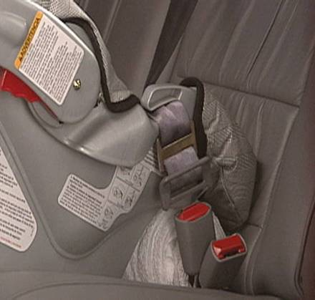
Lap-Shoulder Belt Only:
How to Use a Locking Clip
Route belt
Apply weight
Pinch webbing
Attach clip
Test
Notes:
Use a locking clip with a lap/shoulder belt only.
● Route the belt through the correct belt path and buckle
● Apply weight to the CR while pulling shoulder webbing to remove lap belt slack
● Pinch and hold both pieces of the webbing together and unbuckle
● Attach the locking clip within one inch of the latch plate and re-buckle
● Test for tightness
(Optional: Teacher to demonstrate in class how to use a locking clip.)

Slide 35
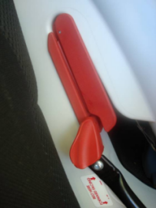
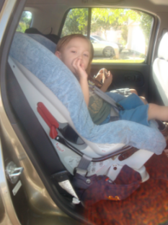
Child Restraint Lock-Off
Built in locking clip
Use when no pre-crash lock
Safe
Lock-offs and locking clips do the same thing
Notes:
Lock-offs are built-in locking clips that are part of the CR. They are used on the lap and shoulder seat belts that have a sliding latchplate (no pre-crash lock) and an ELR.
Some parents/caregivers may question the safety of lock-offs. Assure them that they are safe to use. Educate parents to use the lock off as directed by their Car seat manufacturer.
Ask a CPS technician if you need help.

Slide 36
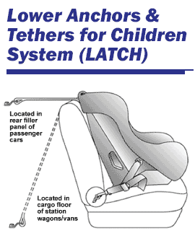

Lower Anchors and Tethers for Children (LATCH)
Easy install
2000 model year cars
Read the vehicle and CR manuals
Notes:
Lower Anchors and Tethers for Children (LATCH) is a system used to make Car seat installation easier in vehicles.
Since September 2000, all new cars, minivans and small trucks have tether anchors to hold the tops of Car seats.
Vehicles made after 2002 have at least three top tethers and two lower anchor sets.
Check the vehicle owner’s manual to know if a vehicle has LATCH and where each LATCH seating position is found.
Caregivers should not use the lower anchors of LATCH, if the combined weight of the child and the car seat is 65 pounds or more (NHTSA March 13, 2013.)

Slide 37
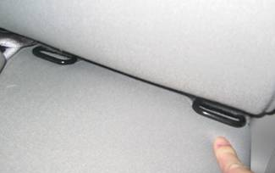
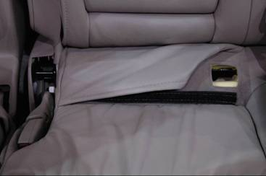
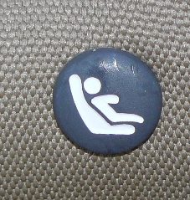
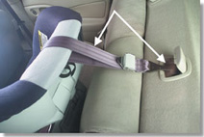
Using LATCH
Vehicle LATCH parts:
  One pair lower anchors
    Visible
    Hidden
    Labels/tags
  Top tether anchor
    Can be in many locations
    Read manual for location
Flap must be moved to see lower anchors
Notes:
To use LATCH--both the car seat and the vehicle must have the LATCH parts that work together. Each LATCH set in the vehicle is made up of two lower anchor bars found at the seat bight and one top tether anchor. If there are lower anchors in a seating position, there is a top tether anchor for that seating position too.
A seating position with only a top tether anchor is not called LATCH.
In a forward facing position, you should remind parents/caregivers to use top tethers whenever possible. The top tether keeps the child seat from going forward in a crash.
Lower anchors can be found in the bight of the vehicle seat.
● They can be visible or hidden. Like in the picture, you may need to move the flap to find the lower anchors.
● Look for labels or tags that identify where the lower anchors are located.

Slide 38
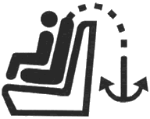
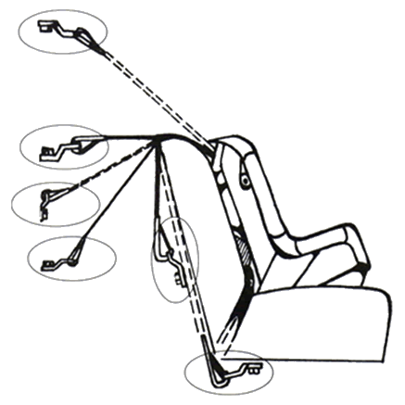
Possible Locations
Top Tether Anchors
Ceiling
Rear window shelf
Back of vehicle seat
Floor
Under vehicle seat
Notes:
Tether anchors can be found in several locations in a vehicle. Possible locations include: (refer to slide)
Sometimes the vehicle manufacturer has placed logos to identify the location of the tether anchor or lower anchor bar.
Always check the vehicle owner’s manual for correct location and retrofit instructions.

Slide 39
Common LATCH Misuse
Lower Anchors
  Not Attached
  Wrong spot
  Seatbelt and LATCH
  Two child restraints and one bar
Top Tether Anchors
  Not used
  Wrong spot
  Too loose
Notes:
Remember, for the LATCH system to work, it must be used correctly.
Lower Anchors are being misused if a Car seat is:
Not firmly attached to bars
Using a non-approved position
Using a seat belt and lower anchors at the same time (unless allowed by manufacturer)
Sharing the same anchor bar with another Car seat
Hooks are attached wrong—face up rather than face down
A Car seat is being misused when the top tether is:
Not being used when available
Not attached to the top anchor using the most direct route
Connected to the wrong anchor
Too loose
Are designed to be used on a forward facing car seat

Slide 40
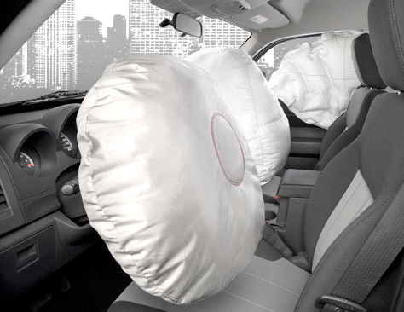
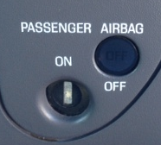
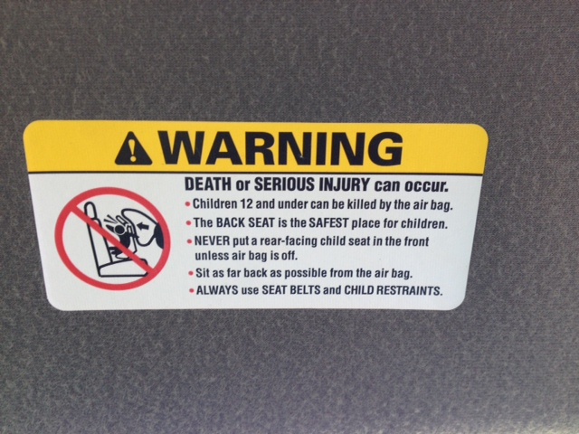
Airbag System
Reduce Injury
Used with seat belts
Children under 13
Turn off
Must stay “in position”
Notes:
Airbags are part of the restraint system that automatically inflates in a crash. Depending on vehicle size, they deploy between 150-250 mph
Important points to consider with airbags:
Airbags help reduce injuries in a crash when used correctly.
Airbags are designed to be used with seat belts.
Children 13 years and younger are safest in the back seat.
Some vehicles have airbag switches that allow you to turn the airbag off. If you must put a child or a Car seat in the front seat of a vehicle then make sure you can turn the airbag off. Many newer cars may have a sensor in the seat to turn the airbag on/off.
Children must be able to sit back against the vehicle seat in the correct position when seated in front of an airbag. Move the seat as far back as possible.

Slide 41

Exercise #1
Identification of restraint systems in vehicles
  Objectives:
      • Students will identify the different restraint systems
      • Students will identify the Lower Anchor and Tether locations
Notes:
READ SLIDE

Slide 42
Child Restraints Types
Rear Facing
Infant only
Convertible
Forward facing
Convertible
Forward facing
Combination
Booster Seats
Combination
High back
Backless
Other Restraint Types
Special needs restraints
Seat belts
Notes:
Choosing a Car seat can be overwhelming or confusing for parents/caregivers:
There are many brands and models, just as there are many makes and models of vehicles.
There are the basic types of Car seats, just as there are basic types of vehicles – cars, trucks, SUV’s, minivans.
These basic types are: READ Slide

Slide 43
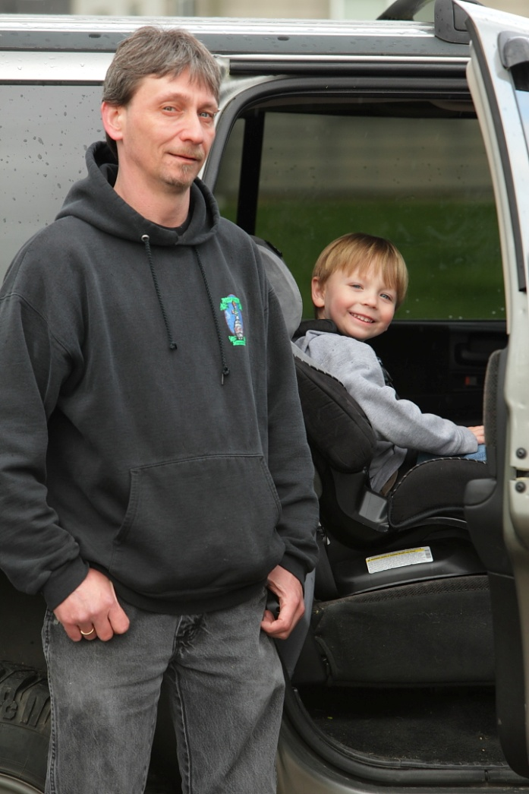
What is the Best CR?
Fits the child
Fits the vehicle
One you use correctly every time
Notes:
Parents/caregivers want the best for their children and they naturally want to know “what is the best CR?”
To help answer this question ask:
● Does the CR fit the child (age appropriate, weight, height and body development)?
● Does it fit the vehicle?
● Does it work well with the seatbelts or LATCH system?
● Can each parent/caregiver install it correctly each and every time?
The answer: The best Car seat is one that fits the child, the vehicle, your budget, and one that will be used correctly every time.
All CR’s go through the same crash testing. No matter the price of the CR, all CR’s are held to the same standards.

Slide 44
Correct Installation Elements
Selection – right seat?
Direction – front or rear-facing?
Location – where is the child safest?
Installation – is it the right belt path/LATCH?
Notes:
Before you can teach a parent/caregiver, you need to know the following:
● Selection: Is it the right Car seat for the child’s age, height, and weight?
● Direction: Should the child be rear or forward facing?
● Location: Where is the safest place to install the Car seat in the vehicle?
● Installation: If the Car seat has two belt paths are the belt or LATCH attachments routed through the correct path?
Does the harness lie flat and fit snug?
Always read the labels on the CR and the manufacturer’s instructions for the vehicle and CR.

Slide 45

Child Safety Seat Installation Checklist
Check that the car seat is correct for the child's weight and height
Place the car seat in the back seat of the vehicle
Select one method to install the car seat
Attach the car seat
Tighten the vehicle belt or lower anchor attachment (LATCH)
Buckle the baby into the car seat
Notes:
Important: This is a general checklist designed to be used in combination with your vehicle owner’s and your child care seat instruction manuals. To get the most out of this checklist, have those manuals handy for quick reference.
1) Check the car seat label to make sure it’s appropriate for your child’s age, weight and height. Like milk, car seats have an expiration date. Just double check the label on your car seat to make sure it is still safe.
2) Place the car seat in the back seat of the vehicle. If the vehicle is an SUV or van with three rows of seats, place the car seat in the middle row.
If possible, place the car seat in the center of vehicle seat (see vehicle owner’s manual for details). Note: You may not be able to get a tight fit in the center seat. If that is the case, place the car seat in the back seat on the left or right side near a window. The safest way for your baby to ride is in a tightly installed car seat. Children should remain in the back seat until they are 13 years old.
3) Important Only Select ONE method to install the car seat: You must check labels on the car seat and the car seat instruction manual for information on how to attach the car seat using either the lap belt only (usually found in middle of back seat); lap and shoulder belt, or LATCH system, or built in seats. Also check the vehicle owner’s manual for instructions, including whether you need to use a locking clip Do not use both the LATCH system and the vehicles belt system at the same time.
4) Attach the car seat.
5) Tighten the vehicle belt or lower anchor attachment (LATCH). The car seat must not move more than one inch from side to side or front to back at the point of attachment.
6) Buckle the baby into the car seat.
7) Check the harness straps. They should be snug and flat on the child’s shoulders. Check that the plastic harness retainer clip is at the child’s armpit level. If using blankets, always buckle the infant in the seat first, then place blankets over the harness. Now, with the chest clip placed at armpit level, pinch the straps at your child’s shoulder. If you are unable to pinch any excess webbing, you’re good to go.

Slide 46
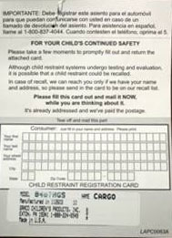
Important!
Read the CR Instruction book and the Auto Manufacturer’s manual for proper installation instructions
Fill out and mail in the registration card
Notes:
For any type of child safety seat, the best way to make sure it is used properly is to read the instruction book that comes with the seat and the auto manufacturers manual, and carefully follow the directions.
Make sure to fill out and return the registration card that comes with the seat to ensure you will be contacted in case of a recall.

Slide 47
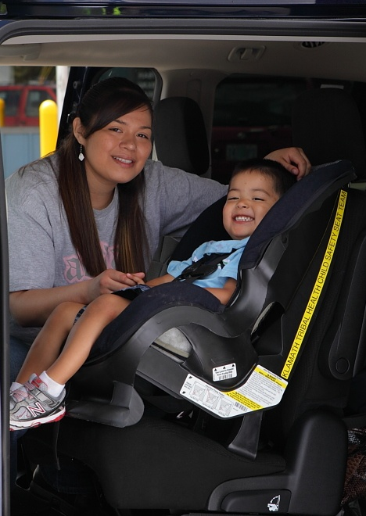
Issues to Consider
Safety
  Label
  Expiration
  History
  Recall
Compatibility
Convenience
Comfort
Notes:
Unsafe Car seats should be destroyed. That prevents an unsuspecting family from using it.
Other issues to remember include:
Safety:
● The Label – should meet Federal Motor Vehicle Safety Standards (FMVSS).
● Expiration date - Some Car seats have expiration dates. If there is no expiration date then the Car seat you select should be less than 6 years after the manufacture date.
● History - It should NOT have been in a crash (See NHTSA's criteria for assessing crash severity and CR replacement).
● Recall - The Car seat should not have had an uncorrected recall. A recall is notice of a problem from the CR manufacturer. Action must be taken by the manufacturer to correct. (A recall list can be found at www.nhtsa.gov) or www.1800buckleup.org
● Compatibility: All the parts (CR, seat belts, vehicle, LATCH) should work well together.
● Convenience: The Car seat should be easy to use so that each parent/caregiver will use it correctly every time a child rides in a vehicle.
● Comfort: Choose a Car seat with the comfort of the child in mind. To do this, sometimes the child may need to help choose their CR. You can negotiate about cup holders or a cool fabric patterns, but not about using a Car seat.

Slide 48
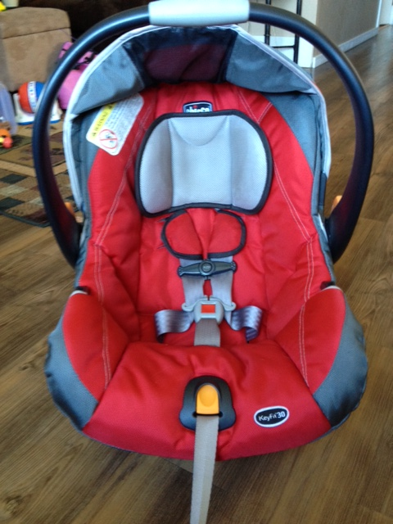
Parts and Functions
Shell/frame
Harness slots
Retainer clip
Belt path
Harness straps
Buckle
Harness adjuster
Notes:
To install a CR correctly it is important to know the common parts of a CR. Different CR may have parts not listed here. Read the manufacturer's instructions to learn about the parts and functions of each CR.
Shell/frame: The molded plastic structure of the CR
Retainer clip: The plastic tie or clasp that holds the shoulder straps together at the armpit line
Harness The straps that keep the child in the CR and spread out the crash forces
Buckle: Where the harness locks
Harness Slots: The part of the CR where the harness straps go through (at or above the shoulders for toddlers and at or below for infants)
Belt Path: Where the seat belt or lower anchor straps are placed to secure the CR in the vehicle
Harness Adjuster: This part is used to tighten or loosen the harness
Recline adjustment: Changes the angle of the CR (i.e. reclined for rear-facing or upright for forward facing)
Lock-offs and locking clips: The pre-crash device that holds the CR in the proper position during normal driving

Slide 49
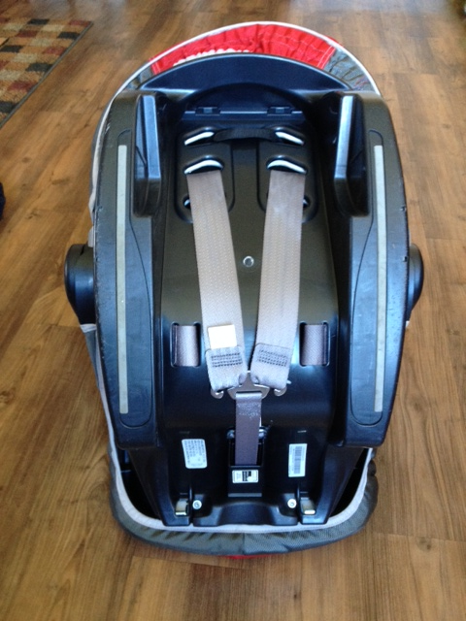
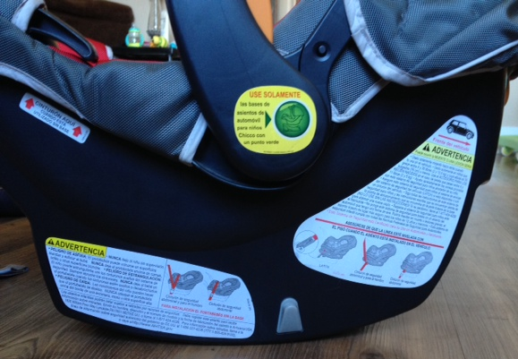
Parts and Functions
Harness slots
Harness adjuster bar
Labels
Level indicator
Notes:
These items are also found on a CR:
Tether: a piece of belt webbing that anchors the top of the CR to the vehicle.
Lower anchors: a piece of belt webbing that anchors to the lower anchors of the vehicle.
Harness adjuster: is removed and re-threaded to adjust the tightness of the harness on an infant CR.
Labels: are required on Car Seats made in the U.S and should include:
● Certification the CR meets federal motor vehicle safety standards
● The manufacturer’s guidelines for the size of the child and how to install the CR
● Manufacturer's information
● An air bag warning (rear facing and convertible CR)
● Belt path for the seat and lower attachments
● Manufacture date and model number
Level indicator: is found on some infant CR to help place the CR at the right angle. It only works if the vehicle is on a level surface.
Manufacturer’s Instruction manual: tells the reader how to use the CR safely.
Registration card: All new Car seats should include a recall registration card. Remind parents/caregivers to fill out this card and mail it in. Car seats can also be registered at the manufacture’s website, by calling the manufacturer’s toll free number or on the NHTSA website (www.nhtsa.gov). If you are giving out CR it is a good idea to have the parents fill this form out and mail it in for them (no postage necessary to send in).
STOP HERE and take a break

Slide 50
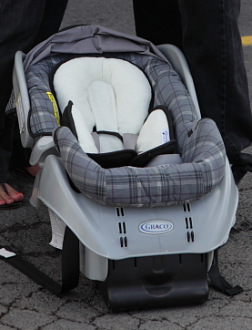
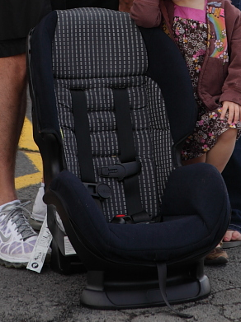
Rear-Facing CR
Notes:
There are two types of rear-facing child restraints. Infant only carriers and convertible child restraints.

Slide 51
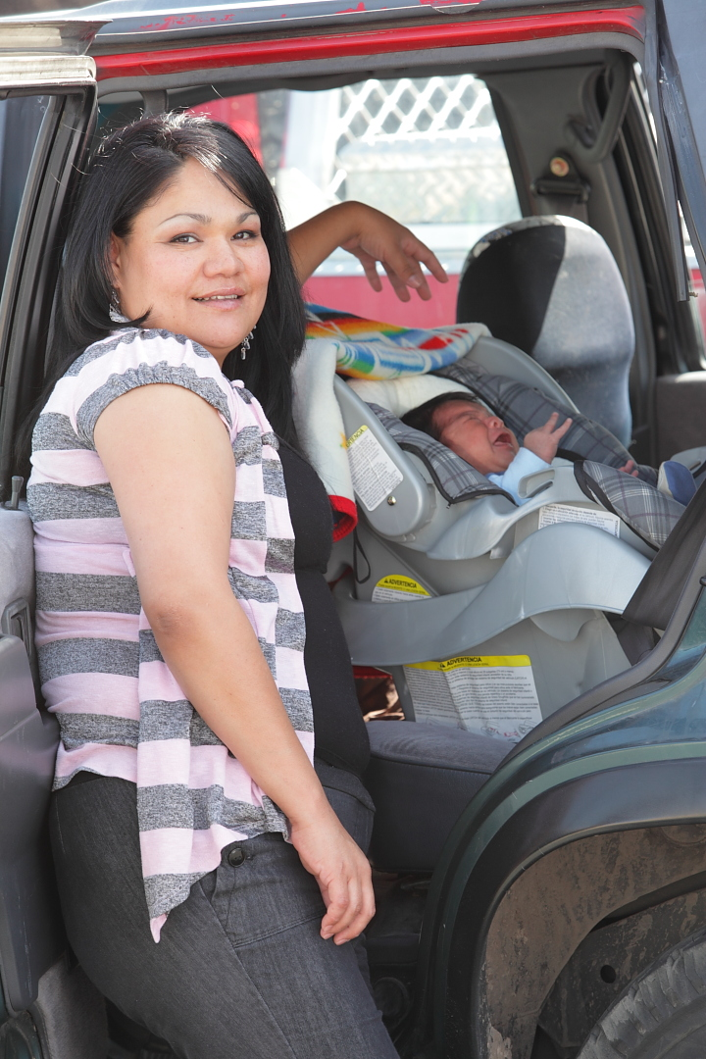
The Rear-Facing CR
Until at least two years old
Until the upper limit of the CR’s Height and Weight limit
3-pt. or 5-pt. harness
  At or below shoulder
Notes:
Now we are going to go over each type of car seat in more detail beginning with rear-facing only.
Best practice: Child under age 2 should always ride in a rear facing seat in the back seat. It has a harness and in a crash, cradles and moves with the child to reduce the stress on a child’s head, fragile neck and spinal cord. There are different types of rear-facing car seats. Infant only seats can only be used rear facing.
As of March 2011, both NHTSA and the American Academy of Pediatrics recommend using a rear-facing CR for infants until they are at least 2 years of age or until they reach the height and weight limits of their rear facing seat which varies by CR manufacturer.
Installed between 30-45 degree angle so child’s head won’t fall forward and cut off breathing airway.
Rear-facing CR can have a 3-point or 5-point harness. In the rear-facing position the harness should be at or below the shoulders.
For the convenience of parents/givers, some models have a base that comes off. Most can be used with or without the base.
Carrying handle should be in a locked position.

Slide 52
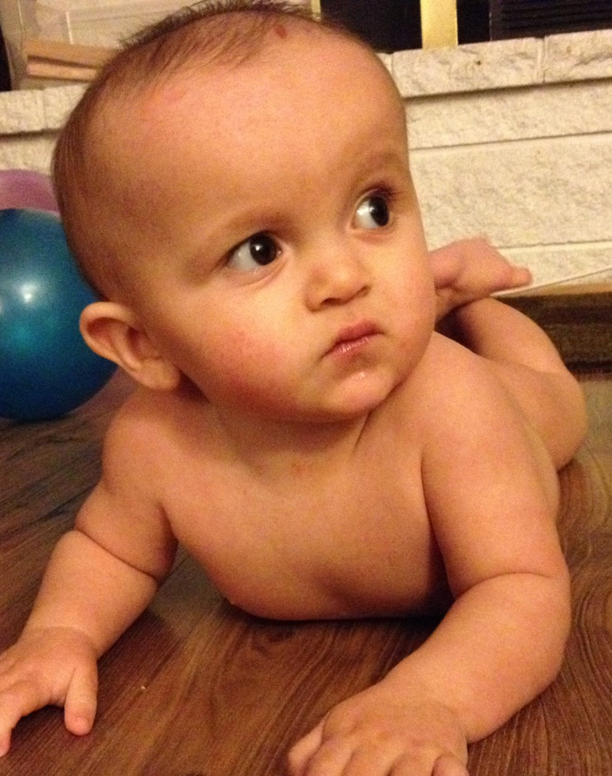
Why rear-facing until age 2?
Babies have large, heavy heads
Small, flexible shoulders
Bones not fully developed
Notes:
The rear-facing seat was developed to protect an infant in a crash. An infant’s neck and spinal cord are not strong enough to withstand forward facing crash forces. Their head is large and heavy and must be protected from falling forward in a crash, putting too much stress on the neck and spine.

Slide 53
Rear-facing increases protection
Seat absorbs crash forces
Protects head, neck, and spinal cord
Back of seat spreads crash forces along the entire torso
Notes:
The shell of the rear-facing seat will cradle and protect the infant’s entire torso, preventing injury to the neck and spinal cord. The rear-facing seat will move with the infant in a crash and provide additional protection.

Slide 54
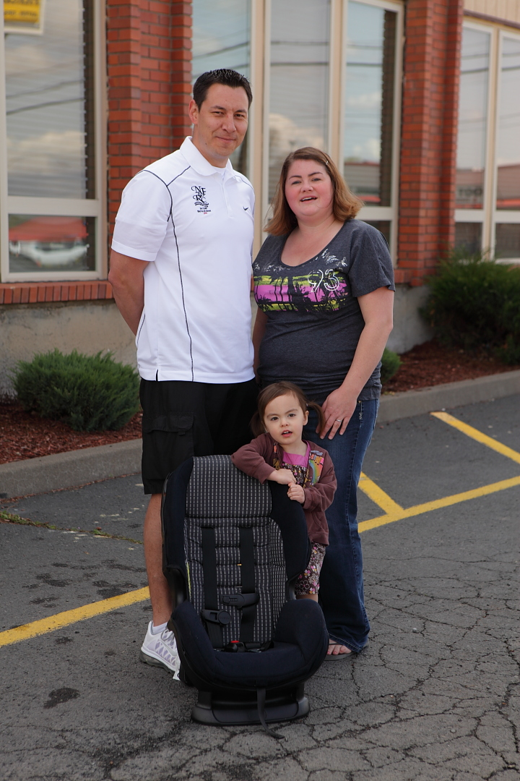
Rear-Facing Convertible
Rear-facing up to 30 pounds or more
Reclined position
Harness at or below shoulder level
Notes:
Another type of CR for rear-facing is the convertible CR – it “converts” from rear-facing to forward-facing depending on the needs of the child and the manufacturer’s recommendations. Convertible car seats offer the advantage of using one seat for both the rear-facing and then the forward facing position as the child grows.
Convertible – Car seat may be used facing rear for infants from birth to upper limits of the rear facing limit. Many are now approved rear-facing up to 30-35 lbs. The rear-facing position is safest, children should ride rear-facing as long as possible.
With these CR:
● Children should be rear-facing to the higher weight limit
● Use the harness slots that are at or below the shoulder level
*Don’t use car seats with tray shields for small infants. Their face or head may hit the shield in a crash or if the car turns or stops quickly.

Slide 55

Warning!
NEVER place a rear-facing seat in front of an active air bag
Notes:
Never place any type of a rear-facing seat in front of an active air bag. The infant’s head will be directly in the deployment zone of the air bag.
There has been no evidence that a properly positioned child is in danger from a side-impact air bag. However, always check the vehicle manufacturer’s instructions as well as the child safety seat instructions as to whether a child safety seat can be placed next to a side impact air bag.

Slide 56
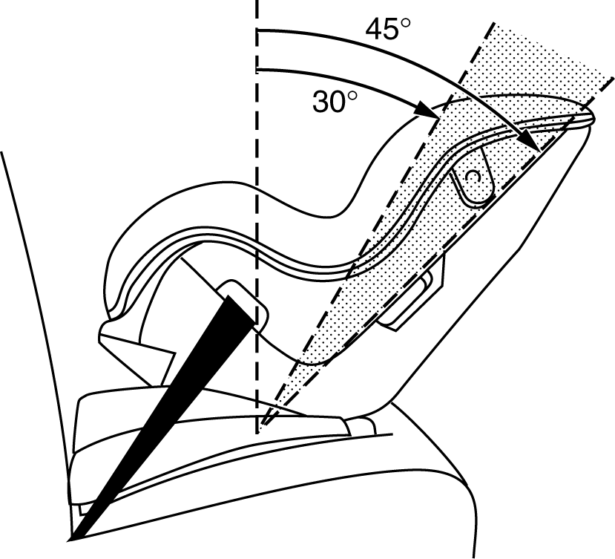
Rear–Facing Installation
Correct Belt Path
Recline angle (30-45 degrees)
Tight belt
Notes:
We are now going to discuss location and installation for the rear-facing CR:
Belt path:
● Identify the correct belt path. Look for the labels.
Recline angle (how far the CR tilts back):
● With a rear-facing CR, make sure the infant does not lay back more than 45° from straight up. To achieve the correct recline angle, you may use a rolled up towel, newspaper or pool noodle.
● The correct recline angle keeps the baby’s airway open so it can breathe. As infants grow, their necks get stronger, and they can be put into a more upright position.
● Some Car seats have a built-in device that shows the angle of recline.
● Rear-facing infant CR may have an adjustable base.
Tighten the seat belt or LATCH:
● The Car seat should not move more than one inch from side-to-side or front-to-back. To check, grip the Car seat at or near the belt path and pull on the CR. If the seat still moves more than one inch, tighten the seatbelt or LATCH. You may need to reinstall the car seat.
For liability reasons, you should NOT be the last person to touch the car seat or child. At check-ups, after I have demonstrated correct installation, I usually unbuckle the car seat and ask the parent/caregiver reinstall the child seat and put the child into the seat.

Slide 57

Securing the Infant
No extra padding
Snug harness
Flat harness
Retainer clip position
Notes:
When securing the infant:
● No extra padding: Do not use padding that did not come with the Car seat. Padding can be clothing or things you buy after the seat. Place blankets around the infant after the harness is snug.
● Snug harness: Tighten the harness straps snuggly and do the pinch test-at the infant’s shoulder. Pinch the webbing up and down, your fingers should slide off.
● Flat harness: The harness straps should lie flat against the child’s body. Twisted straps could actually cut a child in a crash.
● Retainer clip position: Place the harness retainer clip at the child’s armpit level. Having the retainer clip too low could allow the child to be ejected from the Car seat.
● If the baby’s head is within one inch of the top of the shell, Don’t use a rear-facing CR.
(Teacher to demonstrate how to place an infant in a CR)

Slide 58
Reasons for Incorrect Installation
Some may not understand the dangers
Don’t take time
Missing instructions
Don’t read instructions
Restraints don’t fit
Notes:
Parents/caregivers want to keep their children safe.
Unfortunately:
● Some may not understand the dangers of what really happens in a crash.
● Many don’t take the time to install the CR correctly.
● Used Car seats may be missing their instruction manuals.
● Many choose not to read instructions except “as a last resort”.
● Some Car seats don’t fit the vehicle.

Slide 59

Rear-Facing Misuse
Retainer clip not at armpit level
Harness straps not at or below shoulders
Frayed/damaged webbing
Loose harness
Restraint has been in a crash
Bulky clothing
Placing an infant facing-forward
Placing rear-facing infant in front of airbag
Notes:
Common types of misuse include:
● retainer clip NOT at armpit level. Having the retainer clip too low could allow the child to be thrown out from the Car seat.
Harness straps should be at or below shoulder level to reduce amount of slack in the webbing.
● Frayed or damaged harness webbing. Make sure the harness is not twisted.
● loose harness--the harness should fit snug enough so that you cannot pinch the webbing together.
● A CR that has been in a significant crash needs to be replaced.
● When a child wears bulking clothing while in a CR, the harness system can’t be tightened enough to be effective in a crash situation.
Turning a child forward facing before the age of two can result in catastrophic injuries due to under developed head, neck, and shoulder muscles.
Placing a rear-facing CR in front of an airbag can result in placing the infant directly in the airbag blast area.

Slide 60
Exercise #2
Installation of rear-facing child restraints
  Objectives:
    • Students will identify the different features that are found on rear-facing child restraints
    • Students will identify the correct child restraint based on the child’s weight, age, size and behavior needs
Notes:
READ SLIDE

Slide 61



Forward-facing CR
Notes:
Children can ride forward-facing in a variety of ways. They can ride in a convertible seat, turning the seat from rear-facing to forward facing after the child has reached the seats limits for height and weight for the rear facing position. They can also ride in an exclusively forward facing 5 point harness child restraint. Another type of forward facing child restraint is the combination seat; one that is a forward facing 5 point harness system and a belt position booster seat. After a child has out grown a 5 point harness system they can transition to a booster seat, which come in high backed models and backless models.

Slide 62

Forward-facing 5 pt harness
Convertible, forward facing only, and Combination
Child is at least 2 years of age
Child has outgrown rear-facing seat
Depending upon manufacturer, weight limits vary between 22-85 pounds
Use until the child’s ears have reached the top of the seat
Notes:
Convertibles and Forward-facing CR:
Do not use this seat unless your child is 2 years old and/or has reached the height and weight limit of their rear-facing seat.
Forward-facing convertible seat: May be used until the child’s ears reach the top of the seat, when shoulders are above the top slots, or when the child reaches the weight maximum of the seat (between 22-85 pounds). Height and weight limits vary by manufacturer; check labels on the car seat for specific limits. When the child reaches the weight and height limits on the car seat, the child should move to a booster seat.
Use the right harness slots. Harness straps should be at or above the child’s shoulders for forward-facing. Some convertible car seats require the top slot for forward-facing – see the car seat instruction manual for information.

Slide 63

Securing the Toddler
Back and bottom flat
Harness at or above shoulders
Snug
Retainer clip armpit
Pinch test
Notes:
Choose the CR that is right for the toddler’s weight, height, physical development and behavioral needs.
When securing the toddler:
Sometimes you will need to fit the child in the Car seat first, before the Car seat is installed in the vehicle.
Place the toddler’s bottom and back flat against the back of the Car seat. The child’s ears should not be over the top of the shell.
Put the harness straps at or above the shoulders and buckle at the crotch.
Tighten the harness straps snuggly.
Place the harness retainer clip at armpit level.
Do the pinch test at the toddler’s shoulder. Try to pinch the webbing up and down, your fingers should slide off.

Slide 64

Forward-facing Installation
Not in front of an airbag
Back seat
Correct belt path
Tight belt
Use a Tether
Notes:
We are now going to discuss location and installation for the forward-facing Car seat.
When selecting a location in the vehicle, make sure the Car seat is not in front of an active airbag--The back seat is safer for children.
We need to Identify correct belt path: or LATCH on the Car seat. Look for the label on the Car seat that shows the correct belt path for the direction the Car seat will face.
Determine if the Car seat has a recline adjustment. An upright position eases the force of the crash. Some manufacturers allow the Car seat to be installed in a reclined position.
Tighten the seat belt or LATCH:
To ensure the Car seat does not move more than one inch from side-to-side or front-to-back, tighten the seatbelt or LATCH. To check for a tight fit, hold the Car seat at or near the belt path and pull on it.
Most forward-facing Car seats will require the use of a tether.
Follow the manufacturer’s instructions.

Slide 65

Combination:
Forward-Facing + Booster
Notes:
Combination Car seats are forward-facing only. These use a harness that change to belt positioning booster seat by removing the harness at around 40 to 65 lbs.

Slide 66


Vests and Integrated Seats
Harness/vest
Integrated seat
Notes:
Vests: may be used without a tether for children 25-30 lbs. and others may be used up to 168 lbs with a tether. These are commonly used in small buses similar to the ones used by Head Starts, daycares, etc.
● Vests may be a good choice when other car seats can’t be used for children with behavior issues, weak muscles, or excess weight.
Integrated seats: are built into the vehicle and are forward facing only (some convert to boosters). These are commonly found in SUV’s, minivans, and some sedans.

Slide 67

Forward-Facing Misuse
Retainer clip not at armpit level
Frayed/damaged webbing
Loose harness
Using wrong belt path
Restraint has been in a crash
Moved to booster seat or seat belt too soon
Notes:
Common types of misuse include:
● retainer clip NOT at armpit level. Having the retainer clip too low could allow the child to be thrown out from the Car seat.
● Frayed or damaged harness webbing. Make sure the harness is not twisted.
Securing the CR into the vehicle through the wrong belt path.
● loose harness--the harness should fit snug enough so that you cannot pinch the webbing together.
● A CR that has been in a significant crash needs to be replaced.
● children using a booster seat or an adult seat belt too soon.

Slide 68


Belt Positioning Boosters
Lap/shoulder belt only
Head restraint
Shoulder belt positioners
Use the 5 Step Test
Notes:
Booster seats are for children who outgrow their forward-facing CR. They use the seatbelt systems by raising up the child so that the seatbelt comes across the child’s hips, not the belly and the shoulders, not the neck. They have a lower weight limit of 30-40 lbs. and an upper limit of 80-100 lbs.
All boosters must be used with a lap and shoulder belt only.
If the vehicle seat backs are low or do not have head restraints you must use a high back booster.
If the vehicle seat backs are high or have head restraints you may use either a backless or high back booster. See examples above.
The child’s ears should not be above the back of the vehicle seat or the top of the head restraint.
Most boosters come with a shoulder belt positioner to adjust the shoulder belt height on the child.
Some newer boosters have the option to use the tether or lower anchors.
Children should stay in a booster until they can pass the 5-Step Test.

Slide 69
Exercise #3
Installation of forward-facing child restraints
  Objectives:
    • Students will identify the different features that are found on forward-facing child restraints
    • Students will identify the correct child restraint based on the child’s weight, age, size and behavior needs
    • Students will install child restraints correctly
Notes:
READ SLIDE

Slide 70
The 5-Step Test
Does the child sit all the way back against the vehicle seat?
Do the child's knees bend comfortably at the edge of the vehicle seat?
Does the belt cross the shoulder between the neck and arm?
Is the lap belt as low as possible, touching the thighs?
Can the child stay seated like this for the whole trip?
If “No” → Booster seat is needed
If “Yes” → Ready for the vehicle seat belt
Notes:
Children are ready to transition from using a child restraint to a seat belt when they can pass a 5-step test.
According to SafetyBeltSafe USA*, this is the 5-Step test:
READ Slide
If you answered "no" to any of these questions, your child needs a booster seat.
If you answered “yes” to all of these questions then your child is ready for a seat belt.
A lap/shoulder belt offers the best protection. A lap belt is a poor second choice but is better than no restraint.
*SafetyBeltSafe U.S.A. P.O. Box 553, Altadena, CA 91003

Slide 71
Misuse issues for all types of CR’s
Recalled child restraint or too old
Loose harness
Loose seat belt
Wrong belt path
Wrong angle
Unknown history
Missing parts
Not buckling child into child restraint
Not anchoring child restraint to vehicle
Notes:
Almost 4 out of every 5 people have installed their CR incorrectly. Misuse may make the CR unsafe.
Some common misuse you might see:
● Not buckling the child into the CR.
● Not anchoring the CR to the vehicle.
● Placing an infant in a forward-facing position. Rear-facing infant CR should always face the back of the vehicle and infants should be rear-facing as long as possible. Remember, it is now recommended that children ride rear-facing to age 2.
● Placing a rear-facing infant CR in front of an active passenger airbag.

Slide 72

Seat Belt Misuse
Shoulder belt
Under arm/behind head
Lap belt
Too high/across neck
Shoulder belt
behind back
Notes:
If the child is too small for the seat belt s/he will be uncomfortable. When the seat belt does not fit the child correctly, they may put the shoulder belt under the arm, behind their back, or loosen the seat belt or slide forward to bend their knees. This puts the lap belt too high.
Use the 5-Step Test to see if the child is ready for the seat belt.

Slide 73

Non-Regulated Products
Added to a vehicle or Car seat after purchase:
  Padding
  Toys
  Belt tightening tools
  Seat belt adjusters
Notes:
Non-regulated products are items that are added to a vehicle or Car seat after you have already bought them. These products are not approved by the Car seat manufacturer but are marketed to improve the comfort, fit, or installation of a Car seat or seat belt.
They include:
● Head-positioning pads
● Toys
● Belt tightening tools
● Seat belt adjusters
There are no safety rules for non-regulated products. Most manufacturers warn against using “extras” with their products.
Carefully read all CR and vehicle manufacturer’s instructions to ensure these products are approved for use.

Slide 74
Wrap Up
Low restraint use in communities
Everyone should buckle up
Selection, direction, location and installation are important
Best CR
Learn correct use, recognize misuse
Practice, help with confidence
Notes:
We have learned a lot today about child passenger safety.
We learned that :
● Restraint use is low in Native American communities
● It is important to buckle up everyone in the vehicle because even crashes at lower speeds are dangerous
● Selection, direction, location, and installation of a Car seat are important
● The best Car seat is one that fits the child, the vehicle, and will be used correctly every time on every trip.
● If we work to learn correct use of Child Restraints, we will more easily recognize misuse
● The more we practice what we have learned, the more confident we will be when helping others in Child Passenger Safety

Slide 75




Additional Resources
www.nhtsa.gov
www.safekids.org
www.carseat.org
www.nsc.org
Notes:
Use updated and correct information when you teach it to anyone who transports children. The use of outdated or incorrect teaching material can have deadly consequences. These websites offer the latest information in CPS. Some sites also lead to other CPS links.

Slide 76
(Your contact information here)
Questions?
Thank you
Safe Journey Home
Notes:
Administer Post Test and then Evaluation

