Slide 1
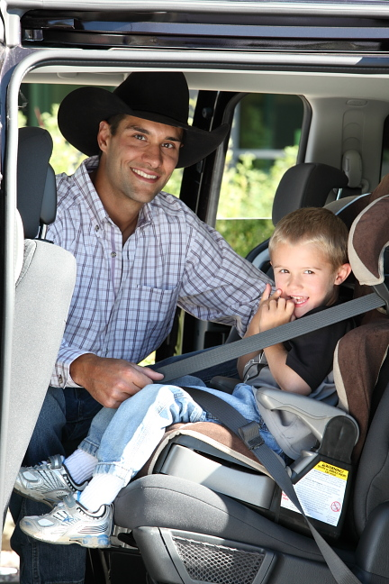
Safely Transport
Native Children Training:
Booster Seats
Adapted from the Indian Health Service Safe Native American Passengers (SNAP) Training for Child Passenger Safety
Notes:
This is a 15 minutes presentation based upon the 8-12 hour IHS SNAP training, developed by the Native CHILDREN ALWAYS RIDE SAFE (Native CARS) program.
This training was developed to help people like yourself to transport children safely in American Indian and Alaska Native communities. Throughout this training I will be referring to American Indian and Alaska Native communities as either “Native American” or “tribal.” I will sometimes refer to a child restraint as “car seat” or “child restraint (CR).”
This training provides a basic overview of Child Passenger Safety, specifically booster seat use. This is a very quick introduction, and you, as the trainer are not expected to know all the answers. If a parent/caregiver asks a question you do not know the answer to, it is okay to tell them “I don’t know, but I will find out”. You can then contact your local child passenger safety technician for further information.
There is a National standardized CPS technician training which certifies individuals as Child Passenger Seat technicians and instructors. This in-depth training is usually 3-4 days long and combines classroom instruction, hands on exercises with CRs and vehicles, and a community safety seat checkup event. After this rigorous certification students are able to demonstrate proper use, installation of car seats, and safety belts; as well as teach these skills to caregivers.
For more information Visit http://cert.safekids.org
Training Estimate
Sign-in/Introductions: 5-10 minutes
Power Point: 15 minutes (answering questions as you go)
Wrap up: 5 minutes
Total Time estimate: 30 minutes

Slide 2
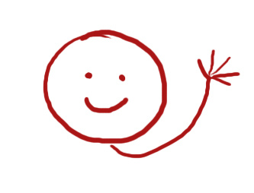
Getting Started
Who you are?
Why are you interested in Child Passenger Safety?
Notes:
Provide your introduction here: My name is ________________. I am an enrolled member of the _________ or I work with _________________. I have been a certified Child Passenger Seat Technician since _________________.
Go around the room and have participants introduce themselves. Have them give there names, occupations, experience with child passenger safety, and motivations for taking this training.

Slide 3
Expectations
What You Will Learn in the Classroom
What is your state law?
Why should you use a child restraints?
Booster seats for school aged children
How long should a child use a booster seat?
Identifying Misuse
Wrap-up
Notes:
This training covers the basics of:
State laws
Why should you use a child restraint
Booster seats for school aged children
How long should a child use a booster seat
Identifying Misuse

Slide 4
Child Safety Seat Laws
All 50 states have child restraint laws
Some Reservations have their own set of Passenger Transportation Safety laws.
What’s the law in your community or state?
Notes:
Do you know what your local law is for car seats and seatbelts? Does your tribe have a Primary, Secondary or no law?
Primary—Police can stop and ticket a driver or passenger for NOT wearing a seat belt, without any other traffic offense.
Secondary—Police CAN’T ticket a driver or passenger for not wearing a seat belt unless they have been stopped for another offense.
Car Seat/Seat Belt laws vary widely between States and reservations. While most states have laws that parallel NHTSA and AAP recommendations, several states have less rigorous safety laws. Understanding the laws from state to state will help understand the rate of CR/SB use in local communities. This in turn illustrates why different communities have different Car seat/Seat Belt success rates. Law understanding can also aid in the understanding of who enforces SB/CR use and the penalties for failing to follow the law. This is particularly apparent on reservations in states subject to PL 280. PL 280 gives Reservation law enforcement duties to the State. Due to lack of funding for law enforcement officers in states such as Oregon has resulted in inadequate enforcement of laws surrounding issues such as SB/CR use. In these cases, enacting a rigorous educational campaign for these communities might aid in rising rates of SB/CR use, despite lack of state law enforcement.

Slide 5
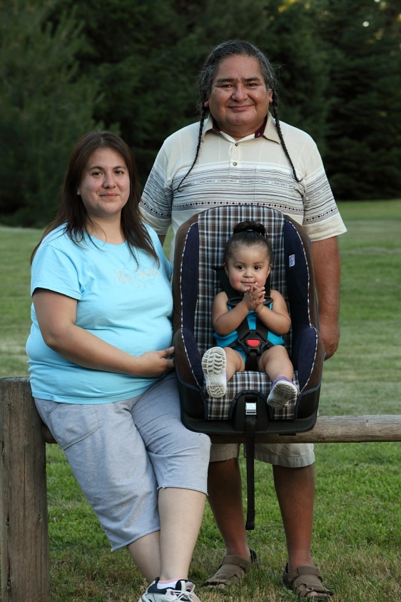
Why Use Restraints?
Studies show restraints cut down:
Injury severity by 60%
Hospital admissions by 69%
Treatment costs by 66%
Use a seatbelt!
Use a child restraint!
YOU could save a life!
Notes:
Why should we use restraints? There are many reasons.
READ SLIDE
(http://stokes.chop.edu/programs/injury/)
Saving money is important! Funds used to care for MV injuries can be used for other programs such as diabetes care.
Use a seatbelt!
Use your CR!
You could save a life!

Slide 6
Car Seat Recommendations for School Aged Children
Use each restraint type to the weight and/or height limit before progressing to the next type of restraint.
Children under 13 should ride in the back seat.
Read car seat manual as well as the vehicle’s manual for important installation instructions.
Notes:
American Academy of Pediatrics (AAP) and National Highway Traffic Safety Administration (NHTSA) advises caregivers to keep children in each restraint type (rear-facing, forward-facing and booster seats) for as long as possible BEFORE moving them up to the next type of seat.
Children UNDER 13 should ride in the BACK seat.
ALWAYS read child seat manufacturer’s instructions and the vehicle owner's manual for important information on height and weight limits and how to install the car seat using the seat belt or the LATCH system.

Slide 7
Best Practice and Tough Choices
Best practice = gold standard
Tough Choices
No clear answer
Give options
TOUGH CHOICES ARE ALWAYS MADE BY THE PARENT/CAREGIVER!
Notes:
As you learn, practice and explain you will need to keep a couple of things in mind: Best Practice and Tough Choices.
Best practice is the gold standard of protection. It is the most acceptable way to transport a child safely on the basis of their age, weight, height, and body development. Often, parents/caregivers do not choose the best practice because they do not understand the reason for it. It is important to understand the reason for the best practice.
For Example: Many parents will think their 5 year old is too big for a “car seat”. Best practice for a 5-9 year-old child is to use a booster seat with a lap/shoulder belt in the vehicle.
Tough choices are made when there may not be a clear answer for the safest way to transport a child. Parent/caregivers will then need to decide among the options.
In many cases, there will be best practices related to the tough choices. You must provide parent/caregivers with available options. Then they can make the tough choices about how best to restrain their own child.
Another Example: Where do you put three children and a driver in a single cab pick-up truck that has three seatbelts? Some options:
● Use a different vehicle with more seating,
● leave the children at home or,
● tell the parent/caregiver “I can’t tell you a safe way to do this”.
TOUGH CHOICES ARE ALWAYS MADE BY THE PARENT/CAREGIVER

Slide 8
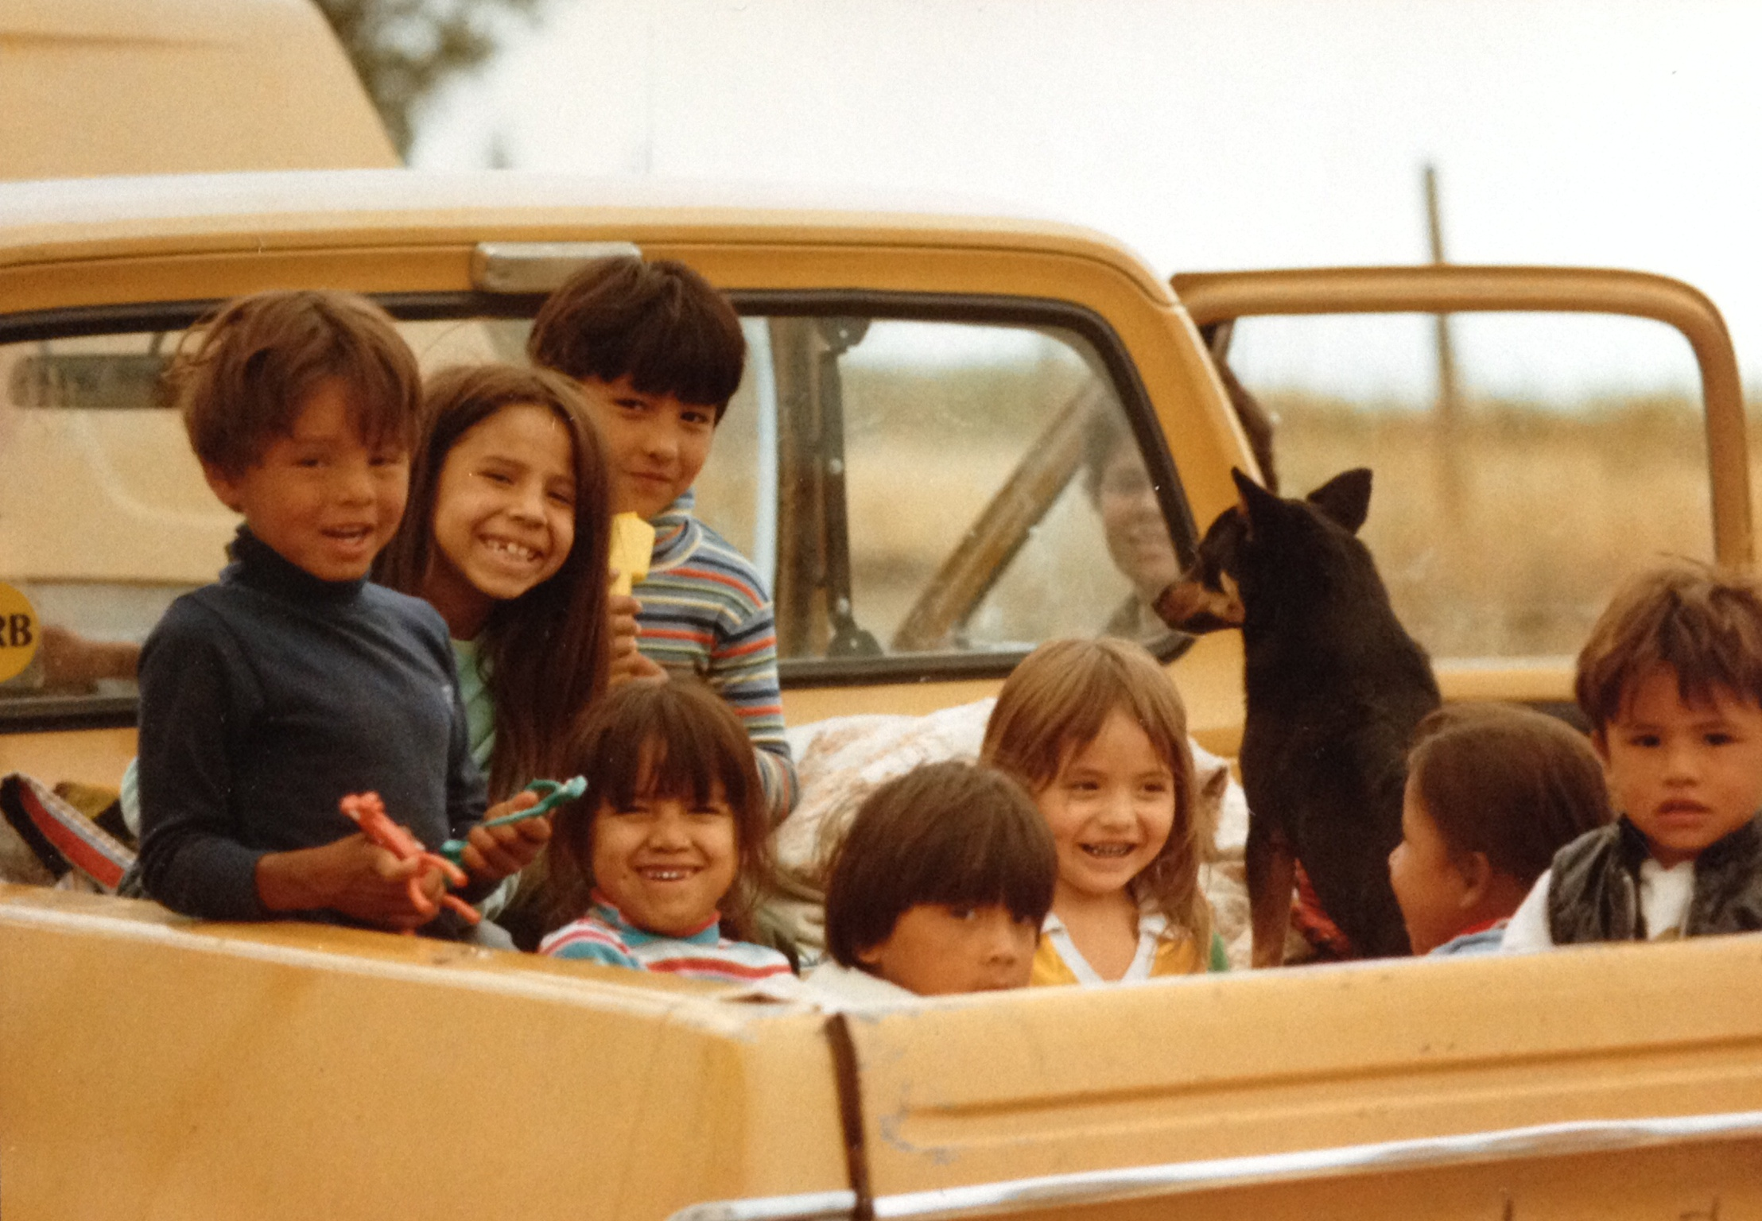
Best Practice
Seat belts or child restraint for everyone
Pickup trucks
Community vehicles
Use a Child Restraint
Every Trip, Every Time
Notes:
To be safe, everyone who rides in a vehicle needs to wear a seat belt OR a child restraint.
Many tribal communities use pick up trucks or community vans as their main way to travel. How many of you have seen people riding in the bed of pickup trucks? As a child, when I was with my grandpa, I remember bouncing around on the wheel well or standing up behind the cab. Remember, there is no safe way to ride in the bed of a pickup truck.
Some families also use community vans for travel to appointments without using a CR. The standards for pickup trucks and community vans are the same as passenger cars. So it is important to use a CR with these vehicles. This may mean the community van will need to have CR or the family will need to bring their own CR.

Slide 9
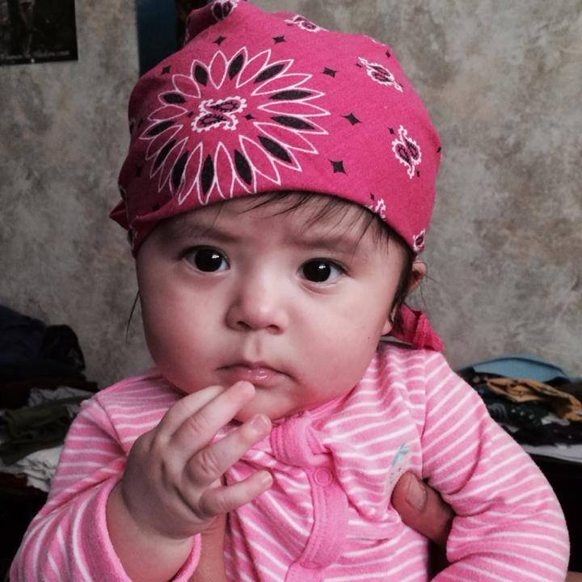
Why restrain children?
Larger head
High center of gravity
Smaller body
Soft skull bones
Rounded hip bones
Weak stomach muscles
Vehicles are built for adults
Notes:
Compared to adults they have a larger head compared to the rest of their body. They have smaller bodies, soft skull bones, rounded hip bones, and weak stomach muscles.
Most safety features in vehicles are built for adults not children. Therefore, children are at greater risk of getting hurt than adults. Young children’s rounded hips do not work well with the lap portion of the seat belt. These young children are too short for the shoulder belt to fit properly across the shoulder and chest.

Slide 10
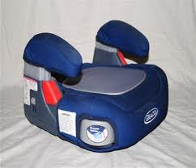
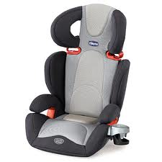
Belt Positioning Boosters
Lap/shoulder belt only
Head restraint
Shoulder belt positioners
Use the 5 Step Test
Notes:
Booster seats are for children who outgrow their forward-facing CR. They use the seatbelt systems by raising up the child so that the seatbelt comes across the child’s hips, not the belly and the shoulders, not the neck. They have a lower weight limit of 30-40 lbs. and an upper limit of 80-100 lbs.
All boosters must be used with a lap and shoulder belt only.
If the vehicle seat backs are low or do not have head restraints you must use a high back booster.
If the vehicle seat backs are high or have head restraints you may use either a backless or high back booster. See examples above.
The child’s ears should not be above the back of the vehicle seat or the top of the head restraint.
Most boosters come with a shoulder belt positioner to adjust the shoulder belt height on the child.
Some newer boosters have the option to use the tether or lower anchors.
Children should stay in a booster until they can pass the 5-Step Test.

Slide 11
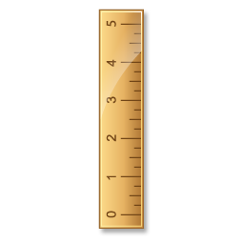
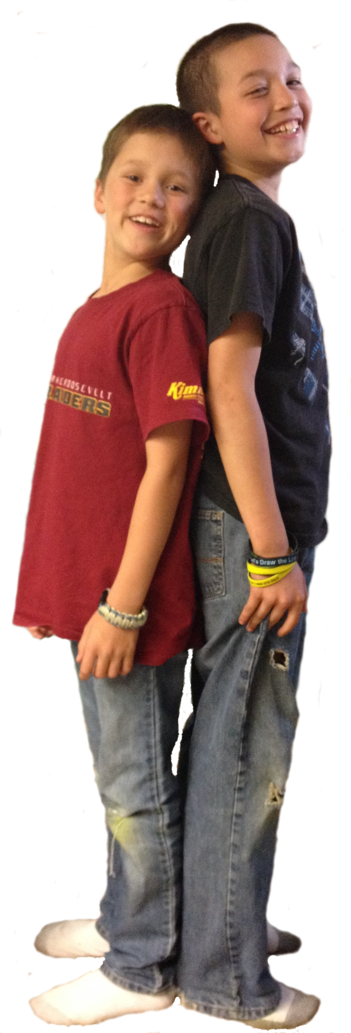
Who needs a booster seat?
Children over the age of 4 years.
Most children between the ages of 10-12 years.
Children under 4’9” tall.
Notes:
Read slide.
Young children who are placed in vehicle belts rather than booster seats are twice as likely to suffer devastating injuries, including severe damage to the brain, liver, spleen, stomach, and spinal cord. Most children need to use a booster seat until age 10-12 for maximum protection and improved comfort in the car.

Slide 12
Common Booster Seat Questions
My child is eight years old. Isn't she old enough to use a regular safety belt now?
How can I tell when my child has outgrown his safety seat?
What about children who outgrow their safety seats before age four?
Why is it important for a child who has outgrown a regular safety seat to use a booster?
What about cars with only lap belts in the back seat?
Notes:
Q-My child is eight years old. Isn't she old enough to use a regular safety belt now?
A-No. Vehicle seats and belts are designed for adult bodies. For children who have outgrown a safety seat with a harness, a booster seat is needed to keep the lap belt on the upper thighs and the shoulder belt centered on the shoulder and chest.
Q-How can I tell when my child has outgrown his safety seat?
A-Children should ride in a safety seat with a complete harness system as long as possible. Most current models fit up to 50 lbs. or more, but some fit only up to 40 lbs. Check the weight limit on the labels or in the instruction booklet and make sure the shoulders are at or below the top strap slots.
Q-What about children who outgrow their safety seats before age four?
A-Most 2-year-olds and many 3-year-olds are too immature to sit still in a booster with a lap and shoulder belt, which allows them to lean forward or sideways. Parents should consider getting a larger seat or a harness system for younger or more active children who outgrow their safety seats.
Q-Why is it important for a child who has outgrown a regular safety seat to use a booster?
A-Older children have a higher rate of injury than younger ones for several reasons. Many of them place the shoulder belt under the arm or behind the back. They tend to ride out of position, either sliding forward to the edge of the vehicle seat or slouching downward. Older children are less likely to be buckled up, perhaps because vehicle seats and belts are not comfortable for them.
Q-What about cars with only lap belts in the back seat?
A-Never use a booster with only a lap belt! Although two shoulder belts have been required in vehicle back seats since 1989, many families have cars with lap-only belts in the center or older cars with no rear shoulder belts. With the wide variety of products with harnesses certified above 40 lbs. now available, there are excellent options for lap belt only locations.

Slide 13
The 5-Step Test
Does the child sit all the way back against the vehicle seat?
Do the child's knees bend comfortably at the edge of the vehicle seat?
Does the belt cross the shoulder between the neck and arm?
Is the lap belt as low as possible, touching the thighs?
Can the child stay seated like this for the whole trip?
If “No” → Booster seat is needed
If “Yes” → Ready for the vehicle seat belt
Notes:
Children are ready to transition from using a child restraint to a seat belt when they can pass a 5-step test.
According to SafetyBeltSafe USA*, this is the 5-Step test:
READ Slide
If you answered "no" to any of these questions, your child needs a booster seat.
If you answered “yes” to all of these questions then your child is ready for a seat belt.
A lap/shoulder belt offers the best protection. A lap belt is a poor second choice but is better than no restraint.
*SafetyBeltSafe U.S.A. P.O. Box 553, Altadena, CA 91003

Slide 14
Misuse issues for all types of CR’s not just booster seats
Recalled child restraint or too old
Loose harness
Loose seat belt
Wrong belt path
Wrong angle
Unknown history
Missing parts
Not buckling child into child restraint
Not anchoring child restraint to vehicle
Notes:
Almost 4 out of every 5 people have installed their CR incorrectly. Misuse may make the CR unsafe.
Some common misuse you might see:
● Not buckling the child into the CR.
● Not anchoring the CR to the vehicle.
● Placing an infant in a forward-facing position. Rear-facing infant CR should always face the back of the vehicle and infants should be rear-facing as long as possible. Remember, it is now recommended that children ride rear-facing to age 2.
● Placing a rear-facing infant CR in front of an active passenger airbag.

Slide 15
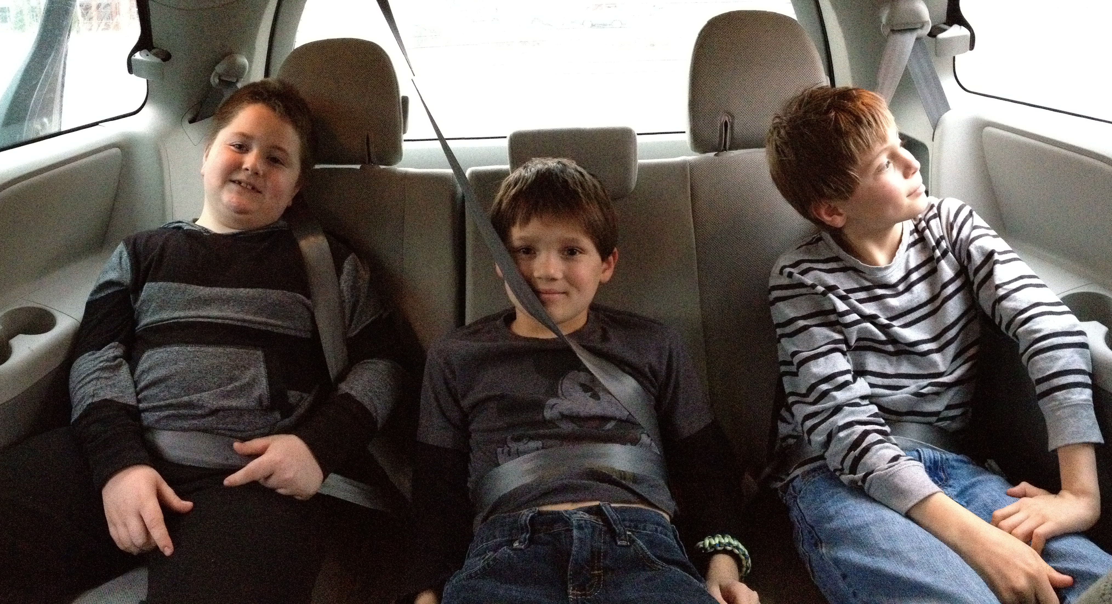
Booster seat/seat belt Misuse
Shoulder belt
Under arm/behind head
Lap belt
Too high/across neck
Shoulder belt
behind back
Notes:
If the child is too small for the seat belt s/he will be uncomfortable. When the seat belt does not fit the child correctly, they may put the shoulder belt under the arm, behind their back, or loosen the seat belt or slide forward to bend their knees. This puts the lap belt too high.
Use the 5-Step Test to see if the child is ready for the seat belt.

Slide 16
Wrap Up
Low restraint use in communities
Everyone should buckle up
Selection, direction, location and installation are important
Best CR
Learn correct use, recognize misuse
Practice, help with confidence
Notes:
We have learned a lot today about child passenger safety.
We learned that :
● Restraint use is low in Native American communities
● It is important to buckle up everyone in the vehicle because even crashes at lower speeds are dangerous
● Selection, direction, location, and installation of a Car seat are important
● The best Car seat is one that fits the child, the vehicle, and will be used correctly every time on every trip.
● If we work to learn correct use of Child Restraints, we will more easily recognize misuse
● The more we practice what we have learned, the more confident we will be when helping others in Child Passenger Safety

Slide 17
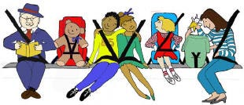
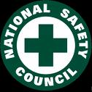
Additional Resources
www.nhtsa.gov
www.safekids.org
www.carseat.org
www.nsc.org
Notes:
Use updated and correct information when you teach it to anyone who transports children. The use of outdated or incorrect teaching material can have deadly consequences. These websites offer the latest information in CPS. Some sites also lead to other CPS links.

Slide 18
(Your contact information here)
Questions?
Thank you
Safe Journey Home
Notes:
Administer Post Test and then Evaluation

