Slide 1
How to use CDC WONDER to make this motor vehicle fatality chart
Notes:
There are several data sources you can use to make a motor vehicle fatality chart. The CDC WONDER stands for Wide-ranging Online Data for Epidemiologic Research. It gives access to public health information for professionals and the public. You don’t need to do any data user agreements or create user accounts to login.
This tutorial will show you how to make a graph using CDC WONDER, which is free and available to the public online.

Slide 2
List of clicks to make the chart
https://wonder.cdc.gov/
Underlying Cause of Death
1999-2020:Underlying cause of death by bridged race categories
Group Results by Year
Group by Race
Click “Age Adjusted Rate”
Select State
Select Years
Cause of death: ICD-10 113 Cause List
MV accidents
Send
To alter the chart, click:
Chart
Chart options
Age-adjusted rate
Line graph
Vertical
Change chart
This gives us unintentional motor vehicle traffic and non-traffic deaths
Notes:
This is the list of clicks to query unintentional motor vehicle traffic and non-traffic fatalities, by race, over time.
We included traffic and non-traffic fatalities because this is the most common request we get from tribes. A traffic fatality occurred on an public roadway. A non-traffic fatality may have occurred on a dirt or gravel road, off-road, on private property, or in a parking lot. Tribes sometimes request intentional motor vehicle deaths, which includes vehicular homicide and suicide, but we have yet to see a death recorded this way on a death certificate.

Slide 3
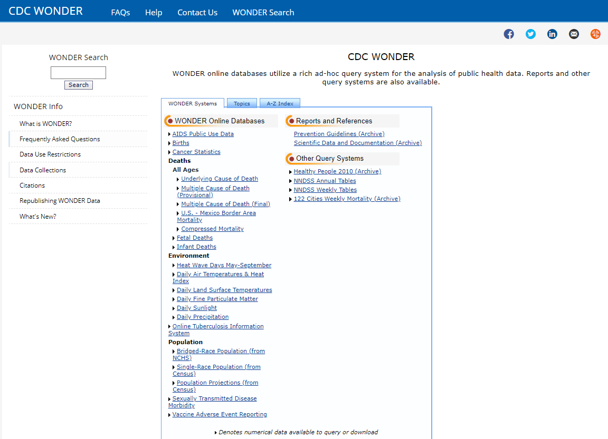
Notes:
CDC WONDER has lots of data that may be of interest to you – birth, cancer, environmental data, as well as population data. We use Bridged-Race population data when we calculate rates. You can explore that as well as census population data here.
Under Deaths, There are multiple options to choose such as fetal or infant deaths or deaths due to multiple causes. For our purposes, motor vehicle fatality rates by race and year, Underlying Cause of Deaths will have the most recent available data as well the options we need to create this chart. Click on Underlying cause of death to proceed.

Slide 4
Notes:
We are interested in the most recent time period, 1999-2020 with CD10 codes for Bridged– Race categories. You can get more information on Bridged race categories here: Bridged-Race Population Estimates United States, 1990 - 2020 (cdc.gov).

Slide 5
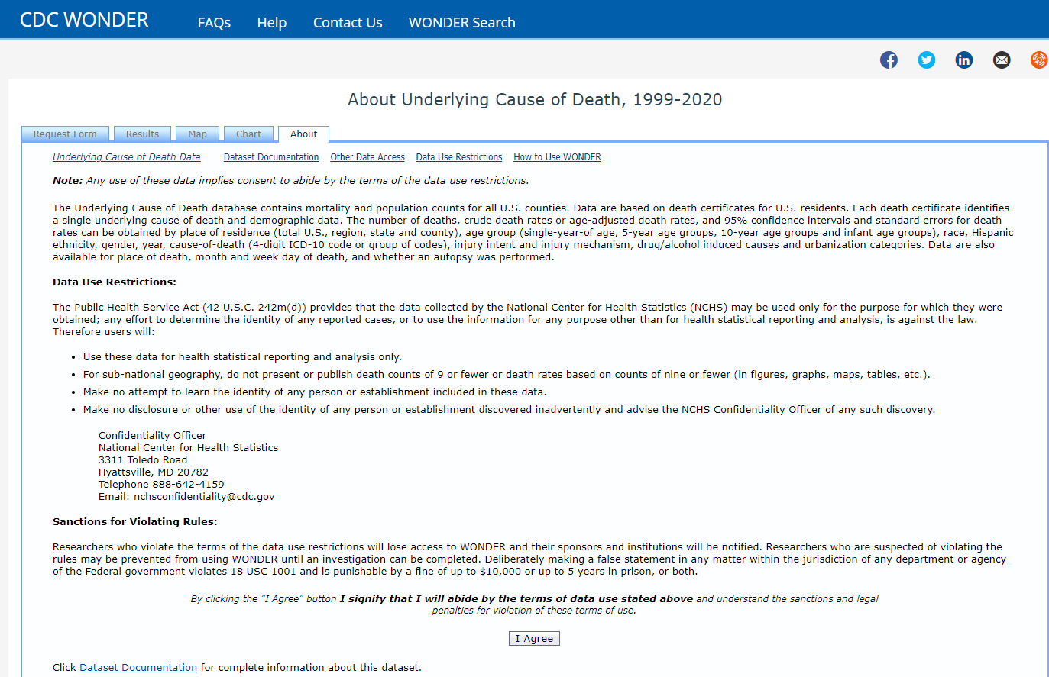
Notes:
Go ahead and agree to the terms to use the data. We’re agreeing not to try to use the data to identify a person or establishment, or to present or publish death counts or rates based on counts of nine or fewer individuals.

Slide 6
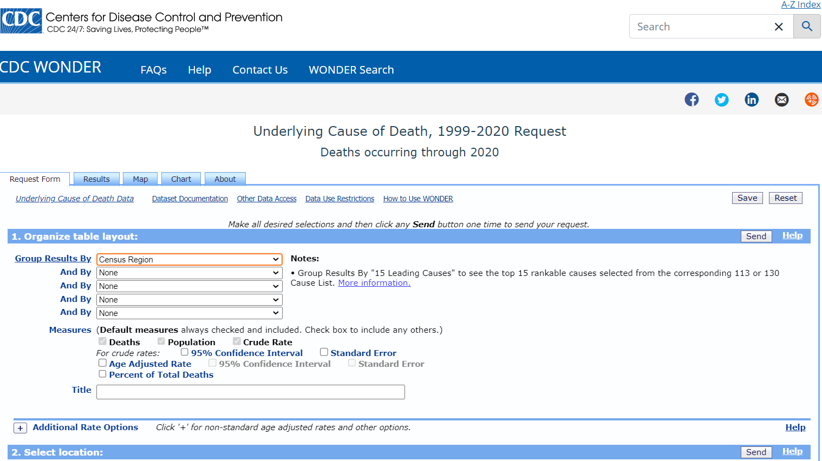
Notes:
I will show you two ways to graph race comparisons. First, we will let CDC WONDER create the graph for us.
Start by clicking the arrow in the drop down box of the first “Group Results By” box.

Slide 7
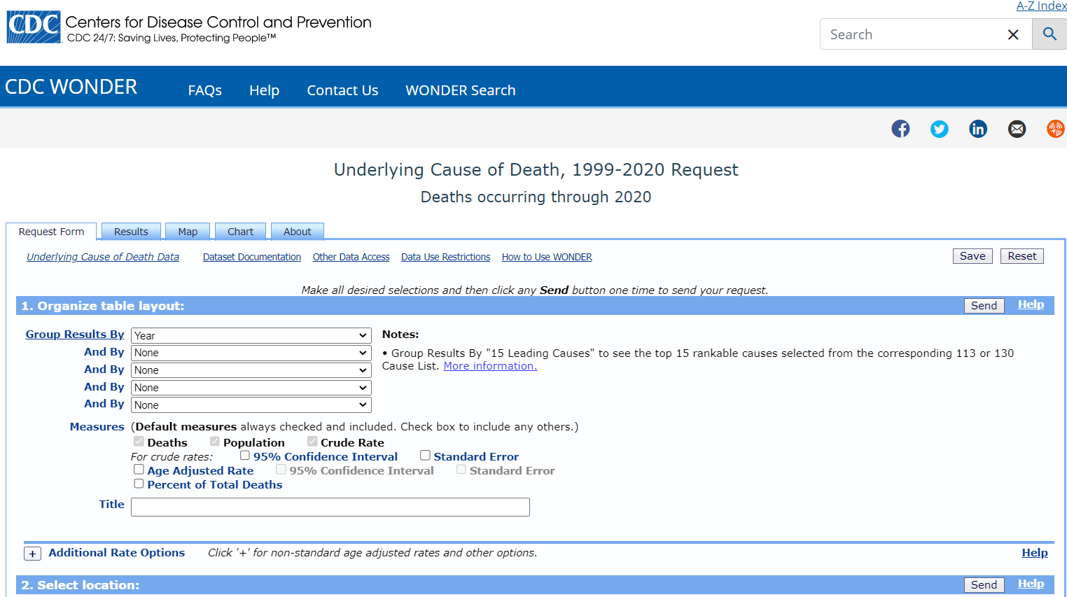
Notes:
You can group the results in multiple ways. The factors you choose here will report data for each level of the factor. If you choose county, you’ll get a rate reported for each county. Same for age groups. You will get a rate for each age group. Selecting “Gender” will give you a rate for male and a rate for female. You can choose up to five ways to split or layer the data. Since I am interested in creating a line graph comparing motor vehicle fatality rates by race over time, I’m going to select “Year.”

Slide 8
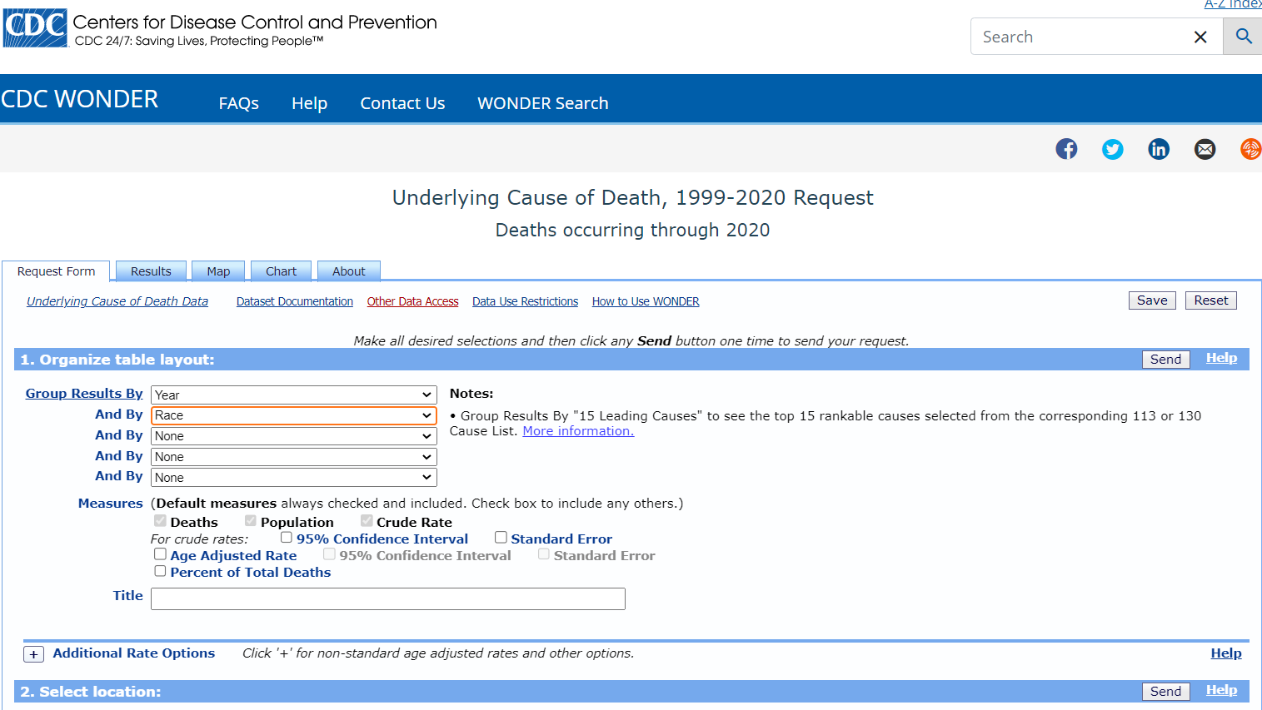
Notes:
In the second “Group Results By” menu, select “Race”.

Slide 9
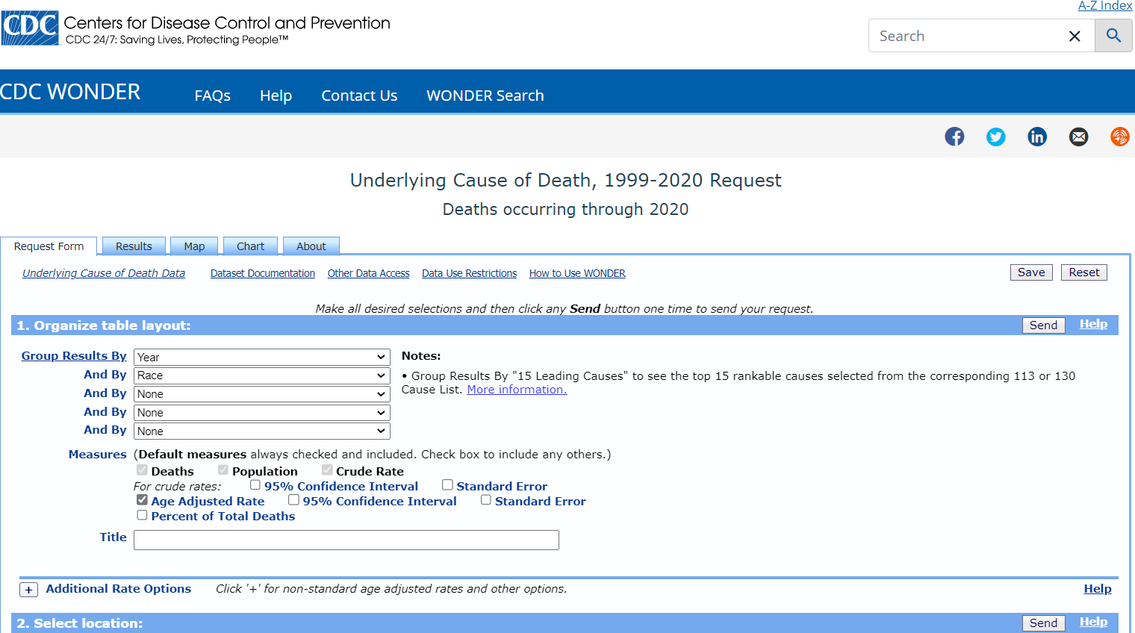
Notes:
Because I am comparing rates from populations that have different age distributions, I need to click “Age Adjusted Rate,” so I can make appropriate comparisons. Age-adjusted rates are also the appropriate estimates to compare rates to other states or to national rates.
I kept the default measures of Deaths, Population and Crude Rate so I can look at counts and denominators too. Sometimes I might want 95% Confidence Intervals so I could see if the rates of my populations overlap, but I’m not doing that today.

Slide 10
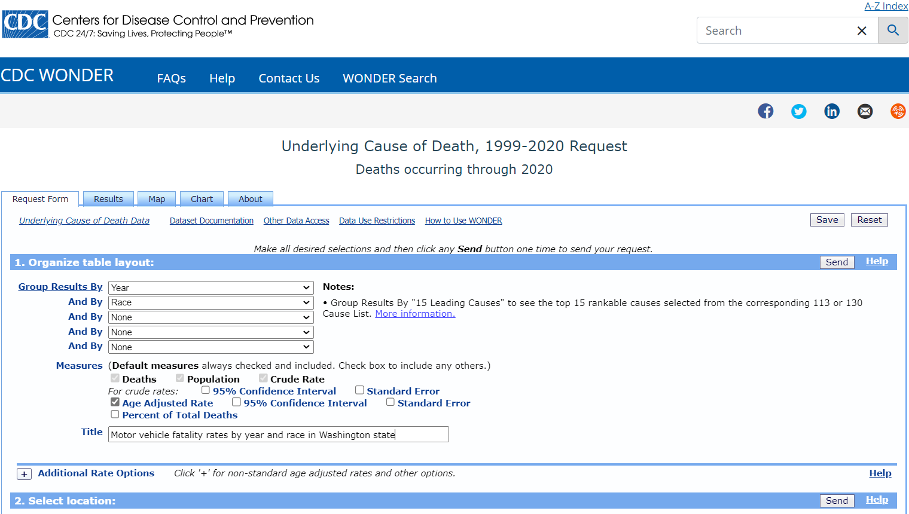
Notes:
We have the option to give our results a title here. It’s a good opportunity to spell out what exactly we are searching for in this system and also this will be seen on your charts if you choose to create charts on this website.

Slide 11
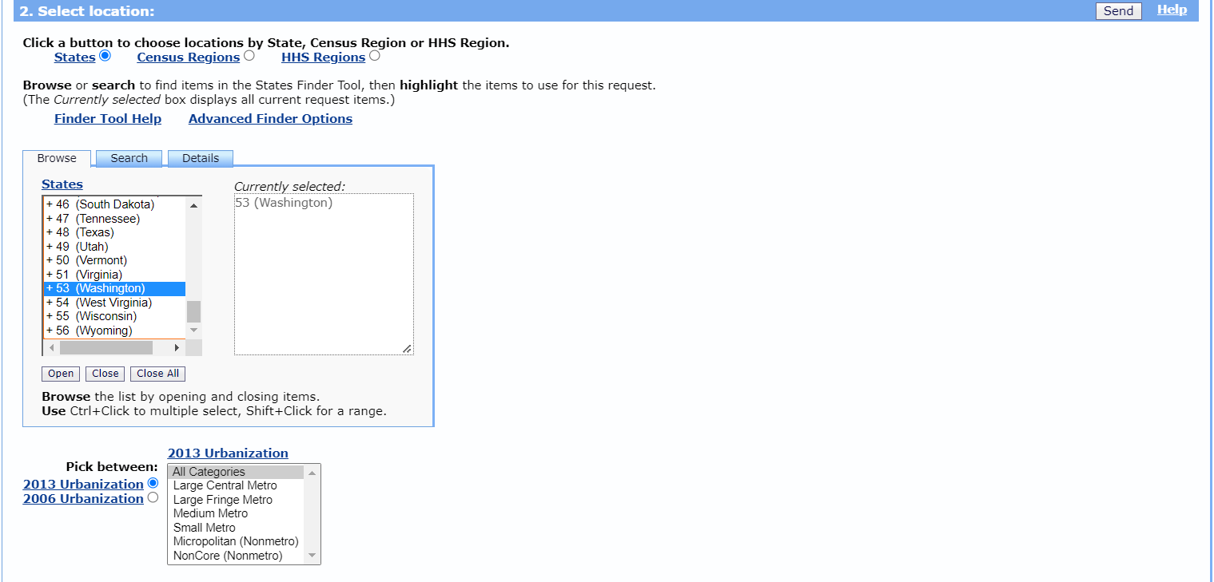
Notes:
I’m interested in state-level data for Washington State, so I scroll and select it here. I could choose multiple states, or a Census Region. If I had picked “County” in the “by group” section above, this would return county-level data for the state or states I select.
In 2.a. you could select urbanization classifications, if you’re interested in comparing metro and nonmetro rates. I’m leaving that section alone, which will give me fatalities in all areas.

Slide 12
Notes:
Here is where I have a chance to pick demographic subsets for my data. Unlike the “group by” fields above, which reports rates for each level of a factor, this section lets me restrict my data to certain groups. I’m going to leave this alone right now so I can see all ages, all genders, all races and Hispanic origins.

Slide 13
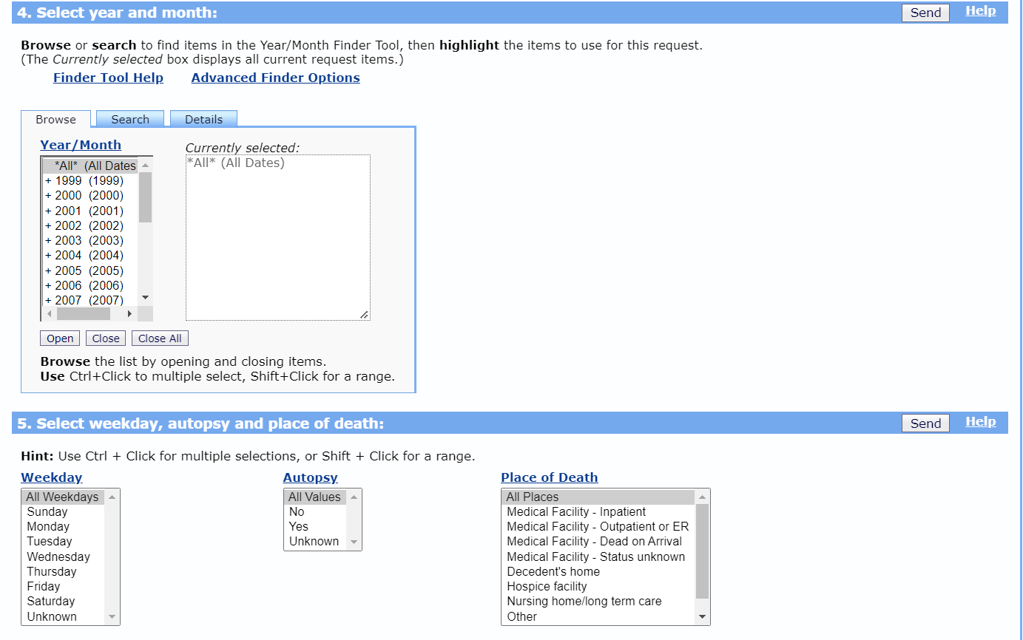
Notes:
Earlier I had selected Year as a “group by” variable, so I will get a rate reported for each year. If I’m not interested in older data, I can select to only report rates for recent years. I can select a single year or multiple years for my report, I am choosing the default selection, which has 1999-2020 data.

Slide 14
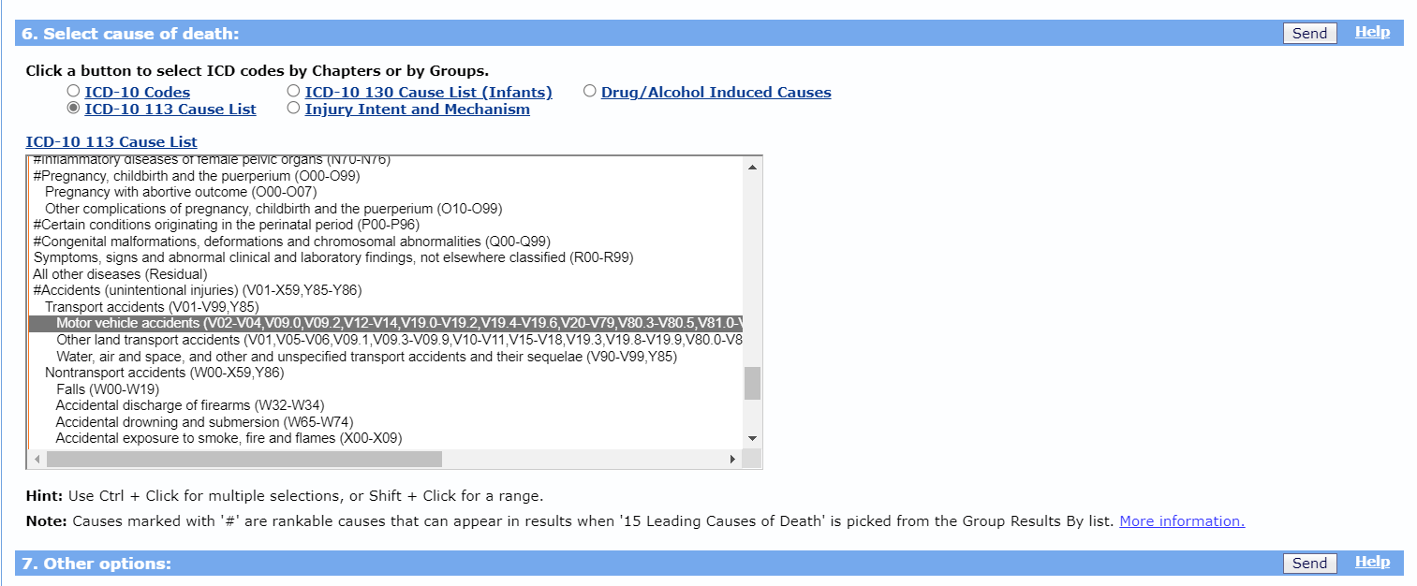
Notes:
Under “Cause of death,” I click “ICD-10 113 cause list” then scroll to “Motor vehicle accidents”. Here in the brackets I can see all the ICD 10 codes used to create this motor vehicle accident group. I picked this because I want unintentional motor vehicle, both traffic and non-traffic deaths. If you click “Injury Intent and Mechanism,” you get two fields – Intent, and Mechanism separately, and motor vehicle traffic is an option under mechanism, but there is no option to choose both traffic and non-traffic.

Slide 15
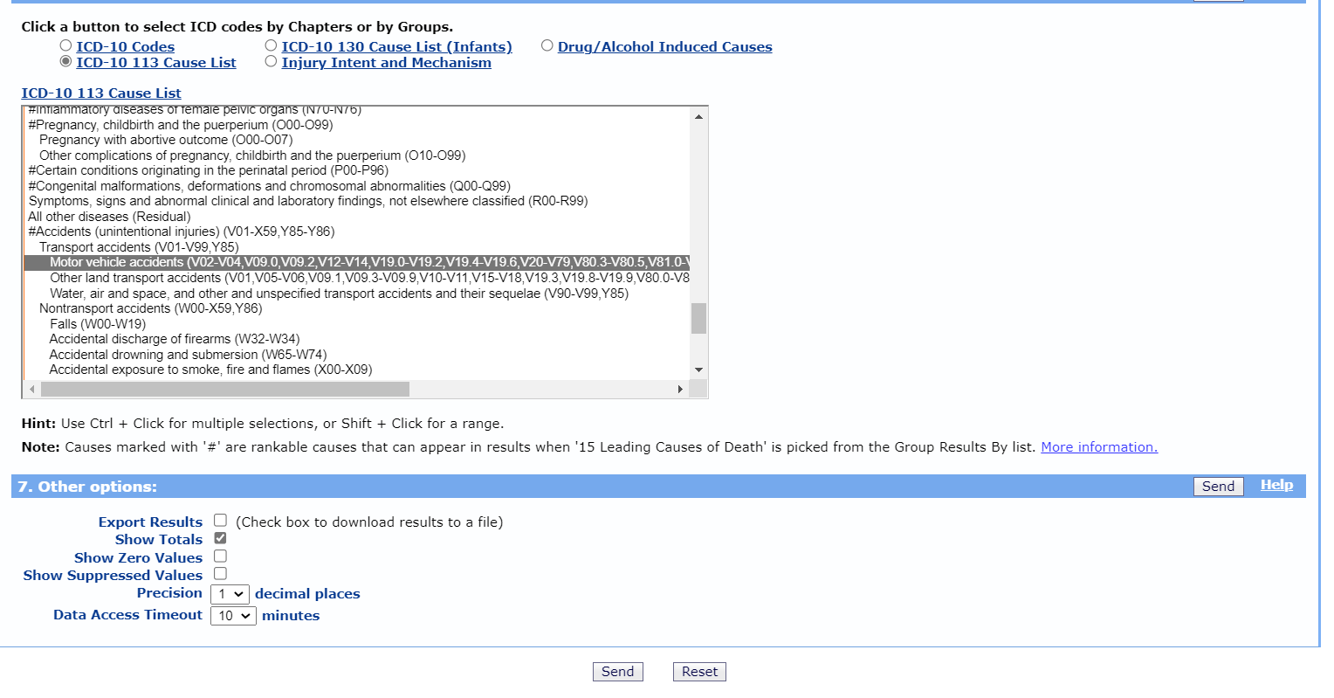
Notes:
You’re ready to click “send.” If you check the “Export Results” box, it downloads the data to a text file, which is great for reading the data into statistical software, but if you’re using Excel to make charts or want to view tables, it’s easier to copy and paste results from the next screen.

Slide 16
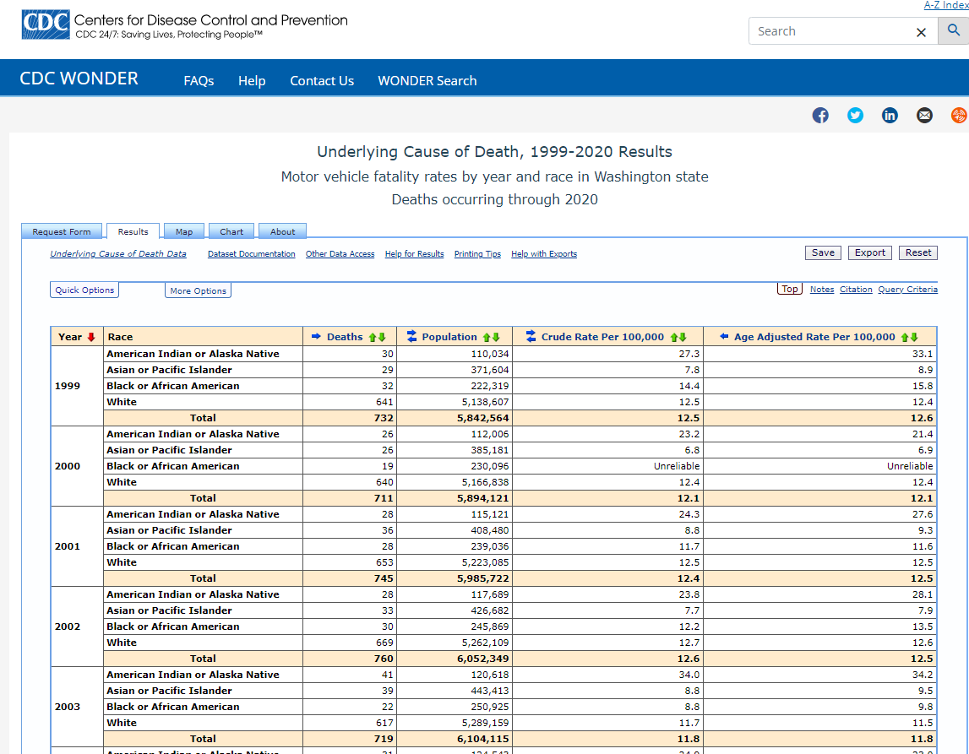
Notes:
Here we see the results of our query. We asked for the data by year and race. We have motor vehicle crash death counts, the populations of each race in Washington State each year, the crude rate, which is just the death count divided by the population. Then we have the age adjusted rate, which is what we want when we are comparing rates across populations.

Slide 17
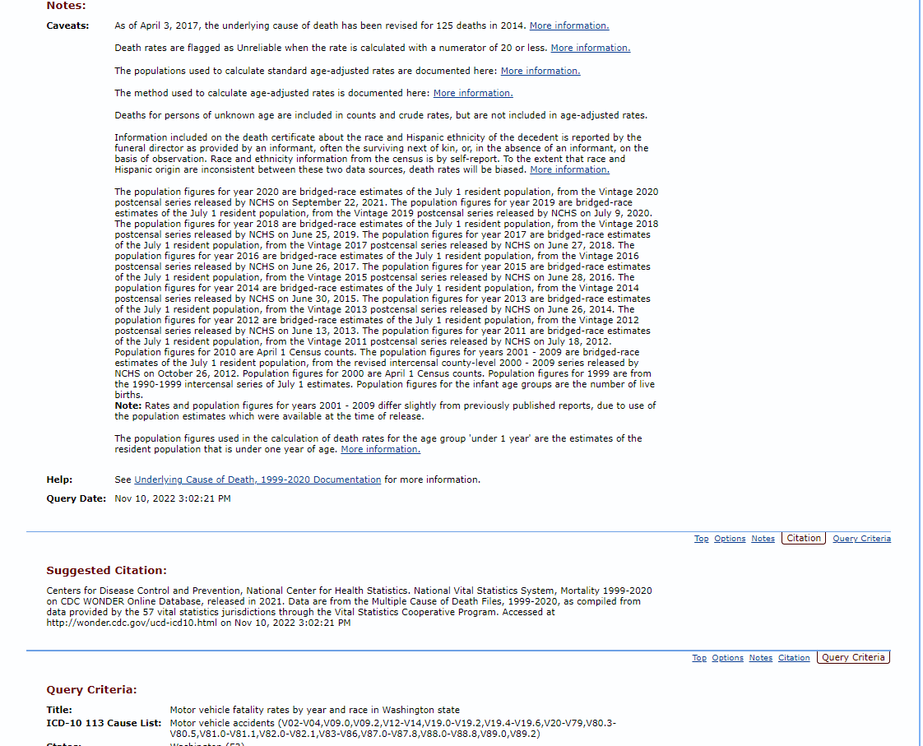
Notes:
If we scroll down, we see Notes about the specifics of our data. They used bridged race population estimates for denominators. It tells you the population they used for calculating age-adjusted rates and how they did it. It also reminds us how race gets reported on death certificate data and that for census data, race is self-reported. They give us a suggested citation. If we use this data for presentations or in our reports we can use this suggested citation. We’re also reminded of our query in ‘Query criteria’.

Slide 18
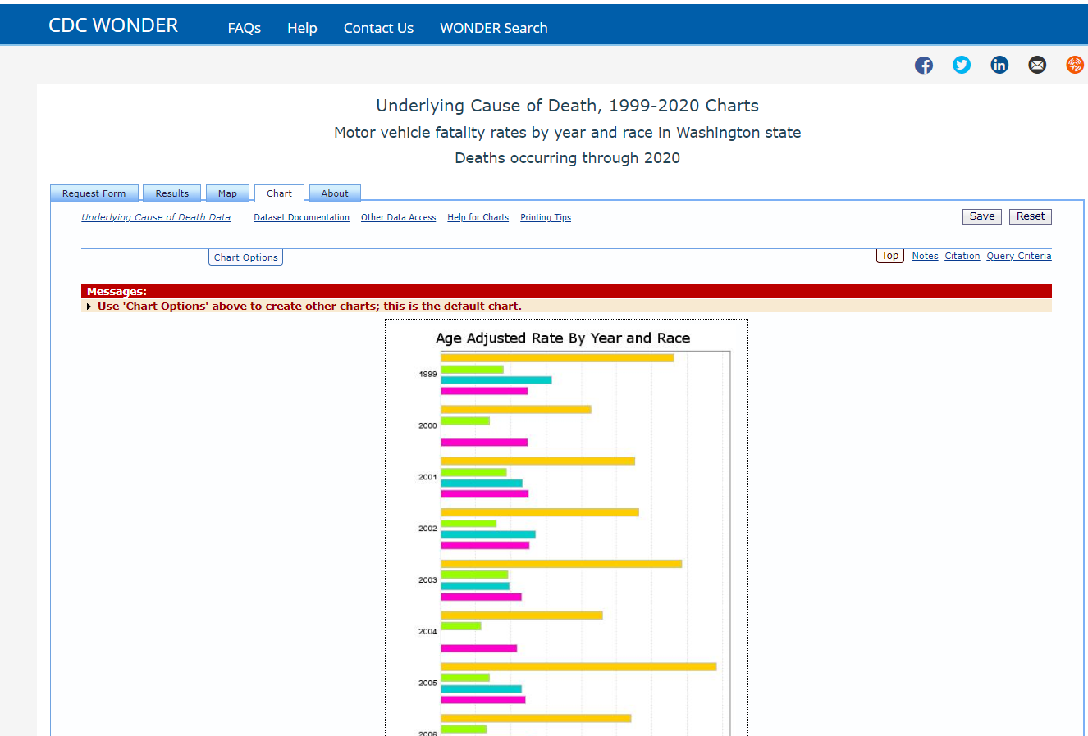
Notes:
Scroll back up to your query results. If you click on the “Chart” tab, you’ll get this image, which you can save. It saves within the CDC WONDER system and gives you a link to the chart. You could also take a screen shot of it and use the picture as you need. If you click on “Chart options,” you have the chance to customize your chart.

Slide 19
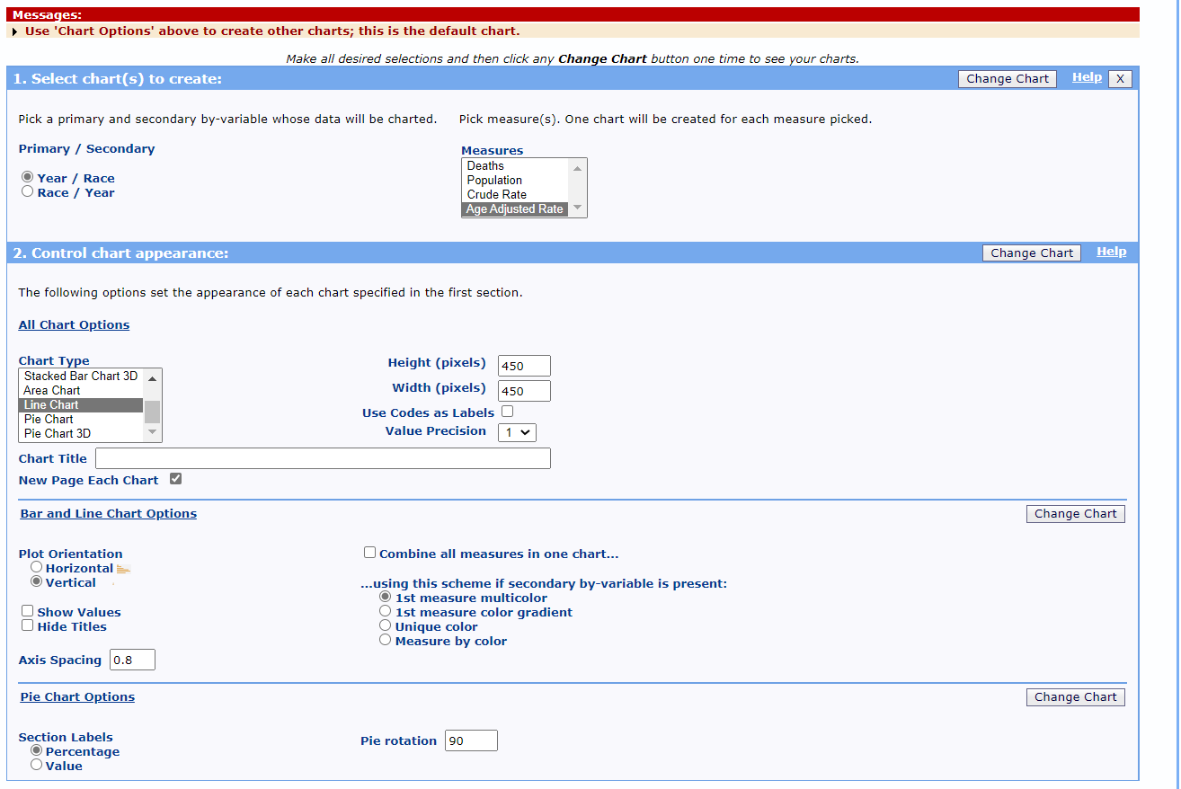
Notes:
We can pick which measure we want to chart, as well as our chart type. We want to graph “Age-adjusted Rate,” as a “Line Chart,” and select the Vertical option. We have another chance to make a Chart Title or subtitle, but the title we already have is good. Now click “Change Chart.” Any of the “Change Chart” buttons will work.

Slide 20
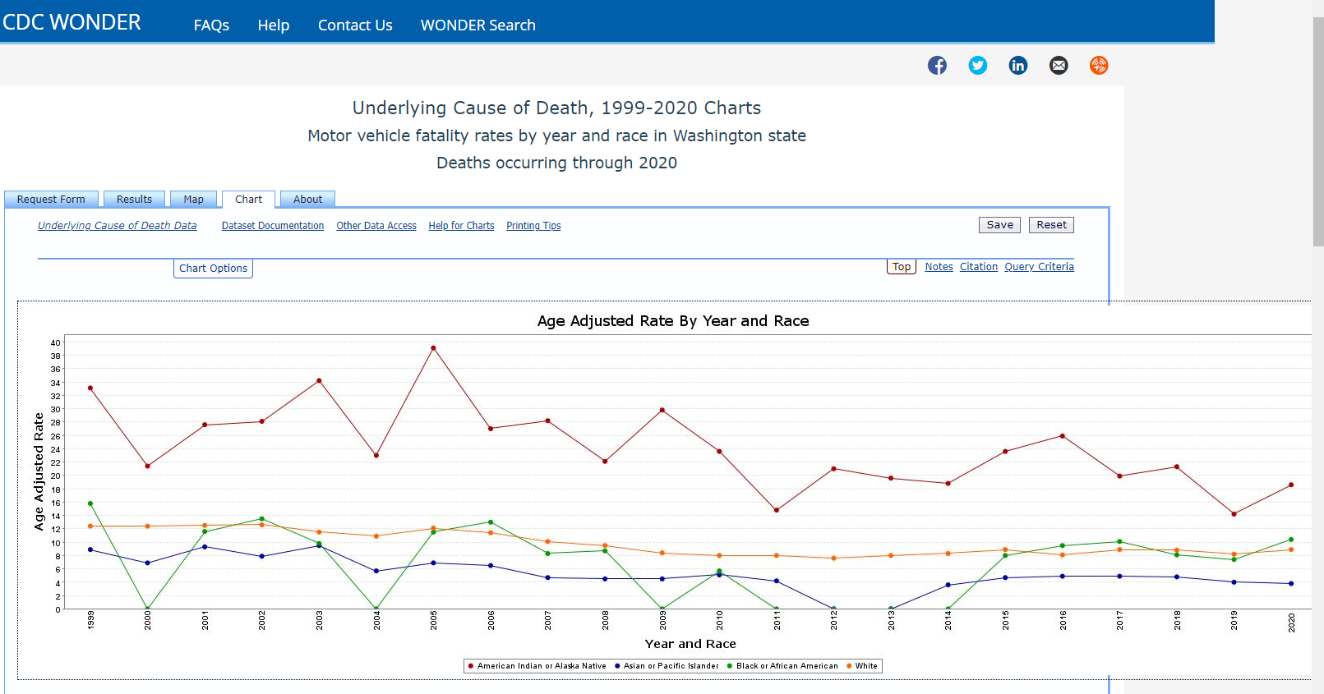
Notes:
The line chart really allows us to see the change over time and the disparity by race. See the distance between the fatality rates? AI/AN have the highest motor vehicle fatality rates of any race in Washington State, by far. Here is the link to this saved chart in the CDC WONDER system: https://wonder.cdc.gov/controller/saved/D76/D313F423
Now I’m going to show you a second way to make a motor vehicle fatality chart. I like to have more control over how I display and share my data, so in this next example, we will run the query a bit differently then use Microsoft Excel to make a chart.

Slide 21
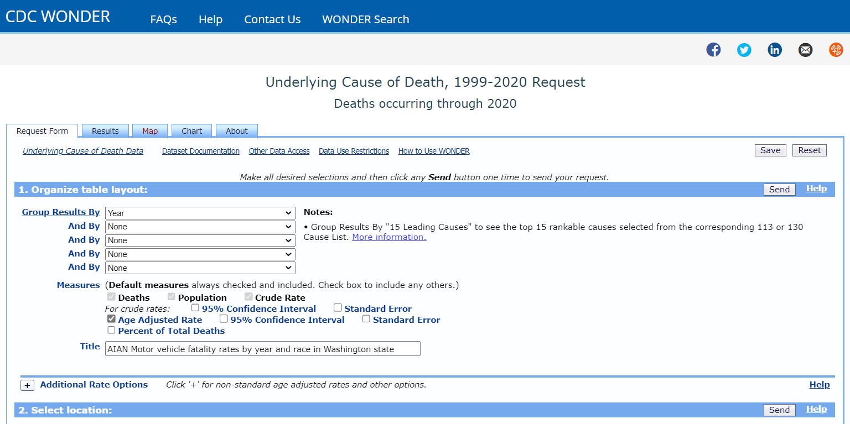
Notes:
I go back to my query page. I keep “Year” as a group variable, but nothing else. In this query, I will request only AI/AN data. I keep “Age Adjusted Rate” and give my data a new title.

Slide 22
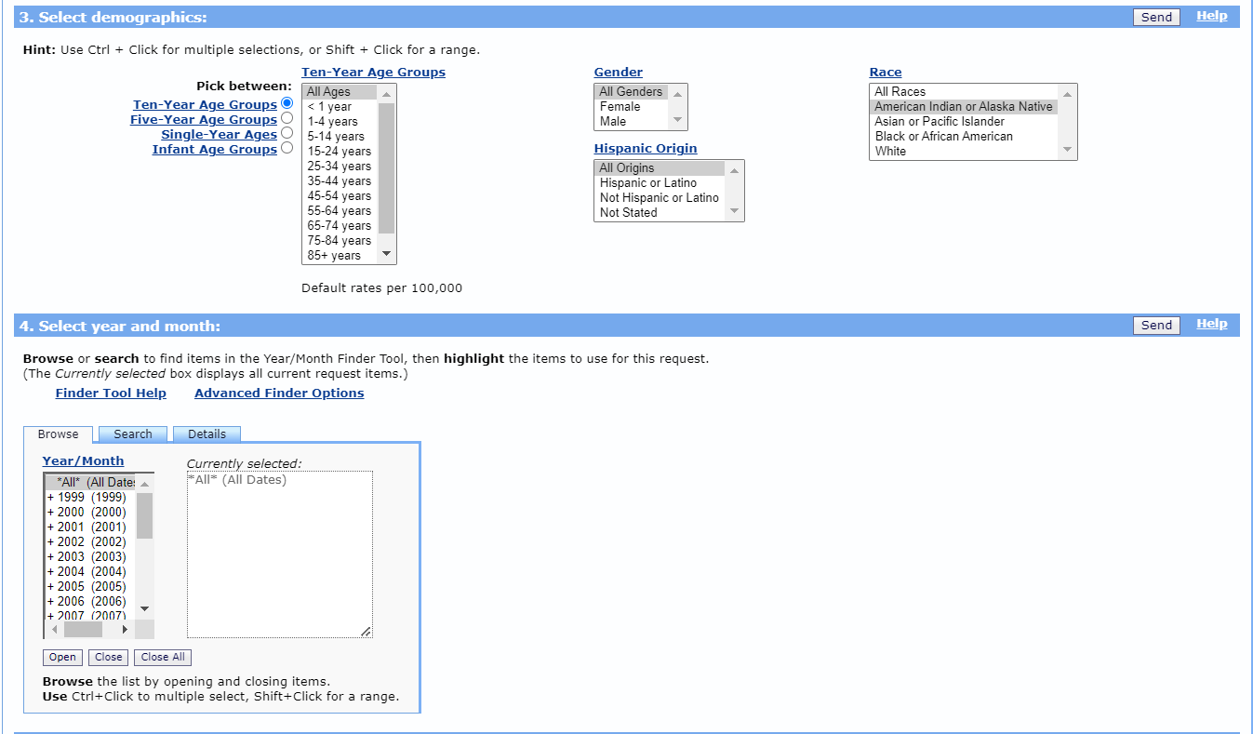
Notes:
Now, I select American Indian or Alaska Native race. This gives me rates for just AI/AN.

Slide 23
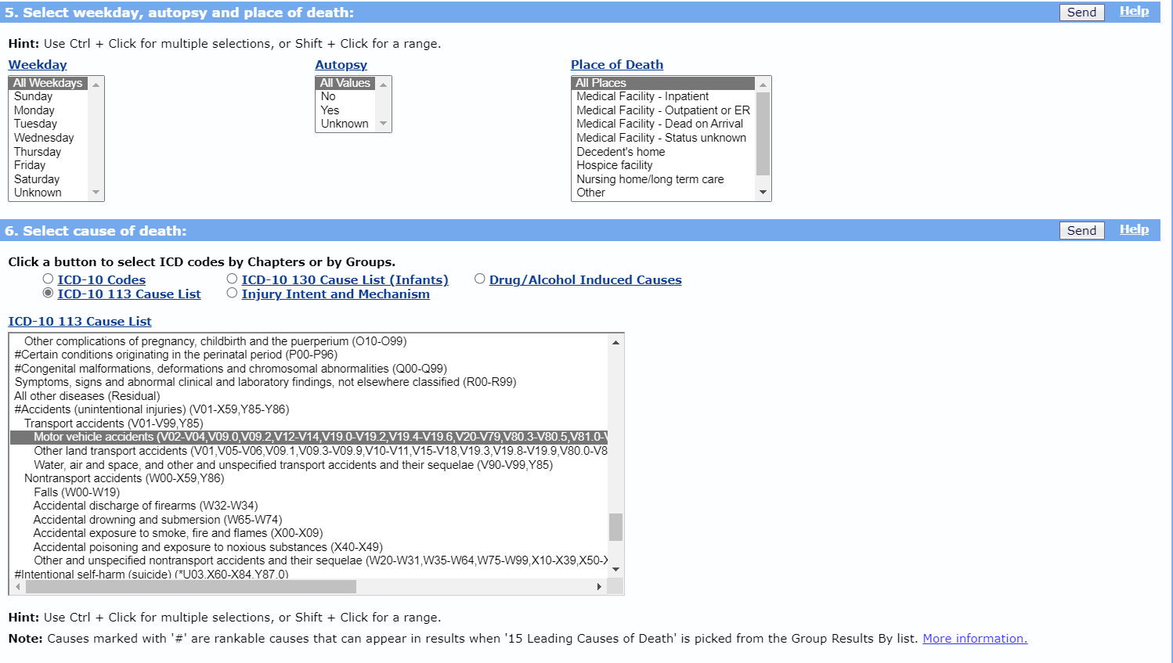
Notes:
I keep “Cause of death” the same. “ICD-10 113 Cause List” ,“Motor vehicle accidents”. All my other previous selections remain same.
Click “Send.”

Slide 24
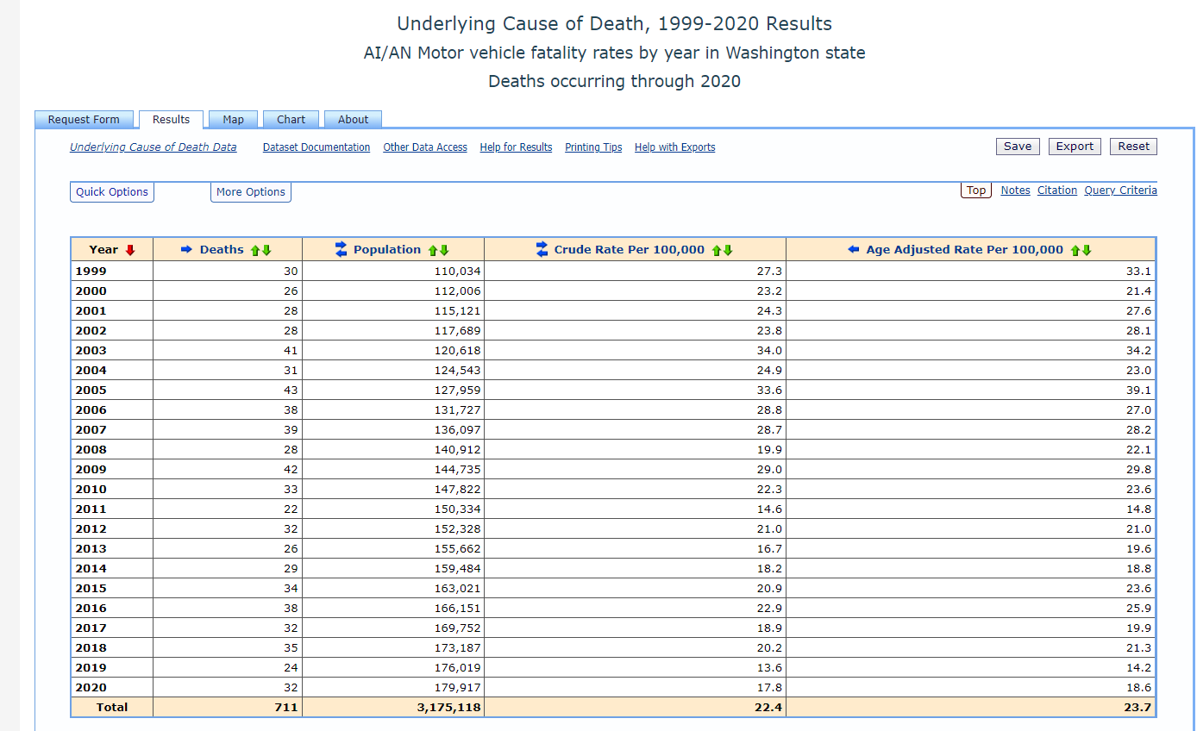
Notes:
Now, I have just AI/AN motor vehicle fatality rates by year.

Slide 25
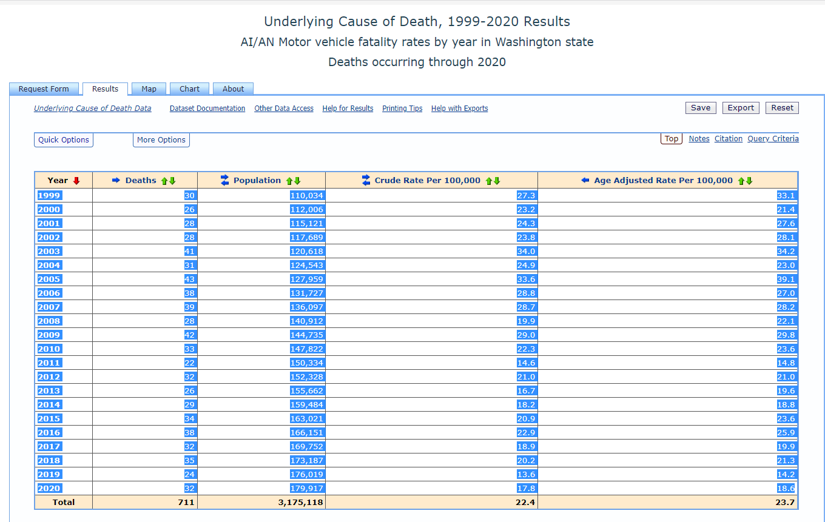
Notes:
I select my numbers. I do not select headers or totals. I hit “copy” or “control C” in Windows.

Slide 26
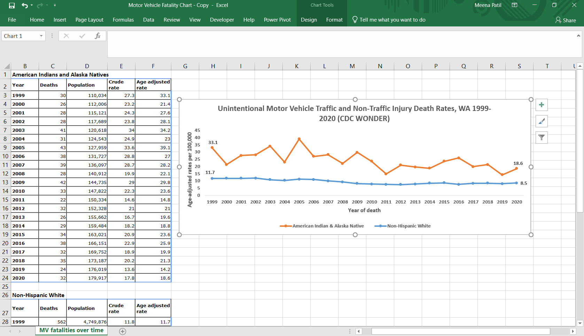
Download the Excel sheet at: https://nativecars.org/section/3-2-explore-existing-data/
Notes:
Then, I paste it into this Excel sheet, where I wrote in; “American Indians and Alaska Natives.” You can download the spreadsheet on the Native CARS website:
https://nativecars.org/section/3-2-explore-existing-data/
To get the non-Hispanic White data, I go back to CDC WONDER, and change my query to “White” under “Race” and “non-Hispanic” under Ethnicity, hit “Send,” then copy the table date and paste under “Non-Hispanic White” in my Excel sheet.
Now, you have complete control and can change colors and display rates however you wish. Be sure to change the title to reflect the data from your query.

Slide 27
Quick click list to make the Excel graph
https://wonder.cdc.gov/
Underlying Cause of Death
1999-2020:Underlying cause of death by bridged race categories
Group Results by Year
Click “Age adjusted”
Select State
Select Years
Select American Indian or Alaska Native
Cause of death: ICD-10 113 Groups
MV accidents
Send
Select and copy table, paste in Excel
For Non-Hispanic White data
Hit “back” on browser to return to query
Group by Year
Click “Age adjusted”
Select State
Select Years
Click “White”
Click “Not Hispanic or Latino”
Cause of death: ICD-10 113 Groups
MV accidents
Send
Select and copy table, paste in Excel
These should still be selected from your last query

