Slide 1
Using the FARS FIRST tool to map fatal crashes

Slide 2
List of clicks to map fatal crashes on Reservations
https://cdan.dot.gov/query
Click on “Occupants” tab
Select years
Select the State
Crash: General Characteristics
Native American Reservations-Yes
Indian Reservation –Check
Person: Person Characteristics
Injured: Incapacitated -Check
Unrestrained/Not helmeted- Check
Build your report –Remove crash date (Month)
Submit
Download the results (in pdf, excel or rtf formats)
To view & modify the map, click:
On “Total” counts
Zoom in on Washington State
All the years (2010-2020)
Bureau of Indian Reservation
Print your final map
Notes:
Click on the link to start building your new FARS query: https://cdan.dot.gov/query

Slide 3
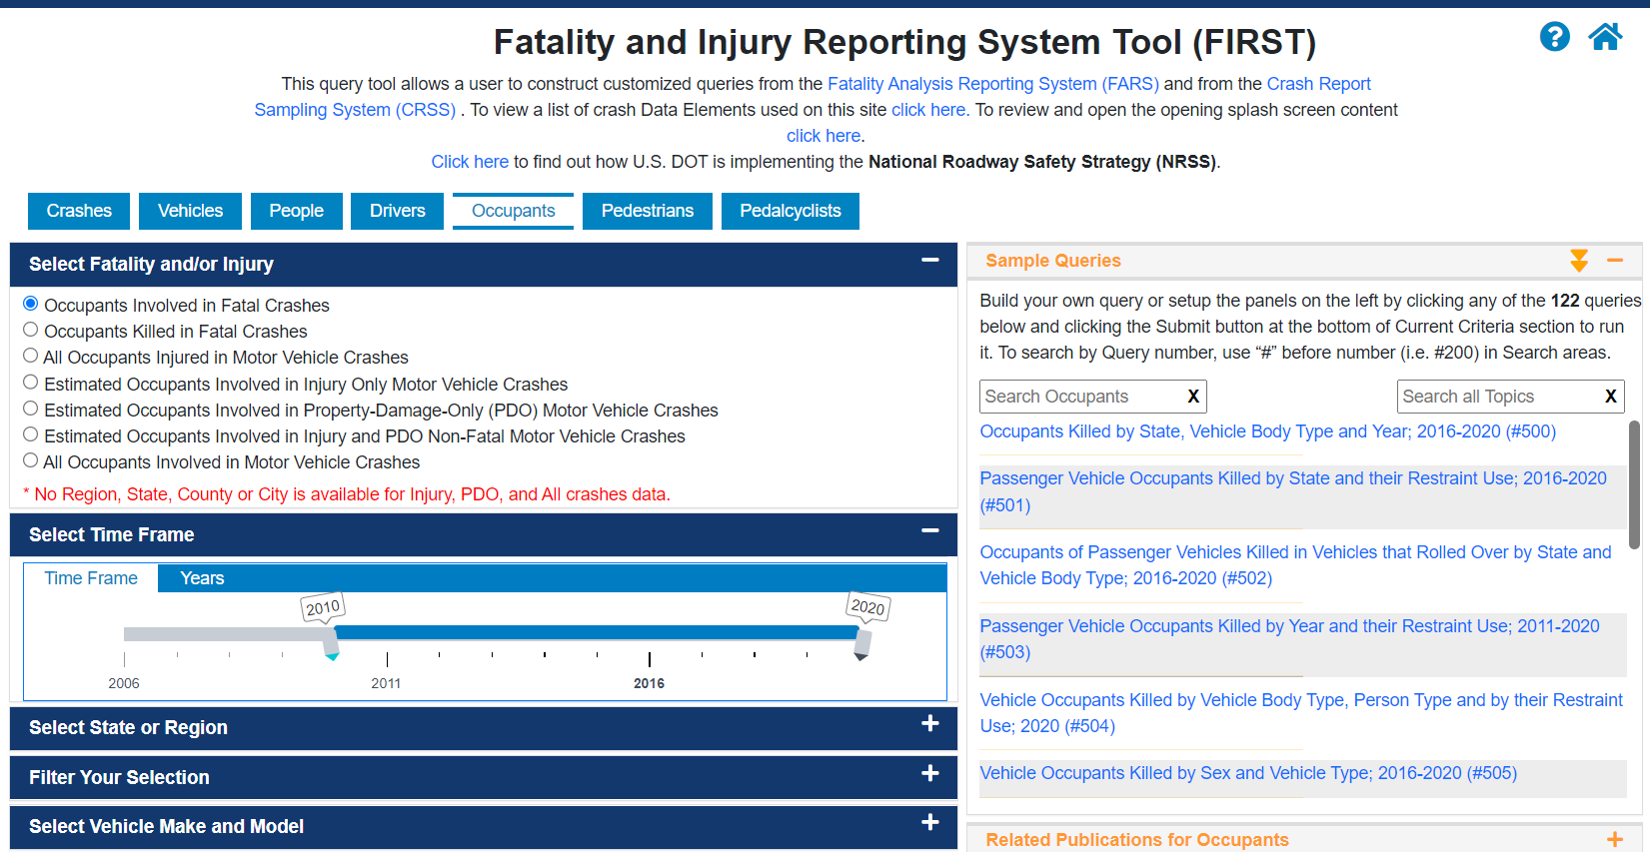
Notes:
Click on https://cdan.dot.gov/query this is the web-page to get to the FARS data query page, here you will find sample queries on the right, which is like a training tutorial to get used to the query system and to get the data you are looking for.
In this tutorial I will show the steps involved in building a map from a new FARS query. Based on your data requirements you can select ‘crashes’ or ‘vehicles’ or ‘Driver’ tab etc. from the options on the top bar. For this tutorial we will map fatal crashes occurring on federally-recognized Tribal Reservations in which occupant of vehicles suffered an incapacitating injury and were not using a restraint system (e.g. seat belt or car seat). To begin we will select “Occupants” tab from the top bar.

Slide 4
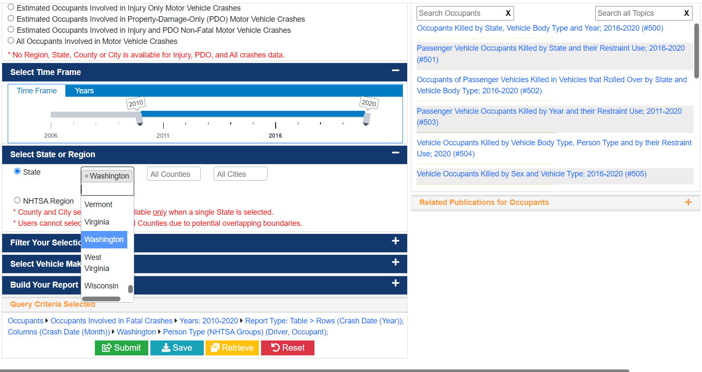
Notes:
Now let us select the time frame. The cursor for year selection can be moved towards left or right to choose our desired years. We will move the left cursor on the year 2010 to choose 2010-2020 data. Next, we will select the state or region; we will chose “Washington” for this query. You can also choose multiple States from this tab by holding down the “Control” key on a PC or “Shift” on a Macintosh and then clicking on the different states you wish to select.

Slide 5
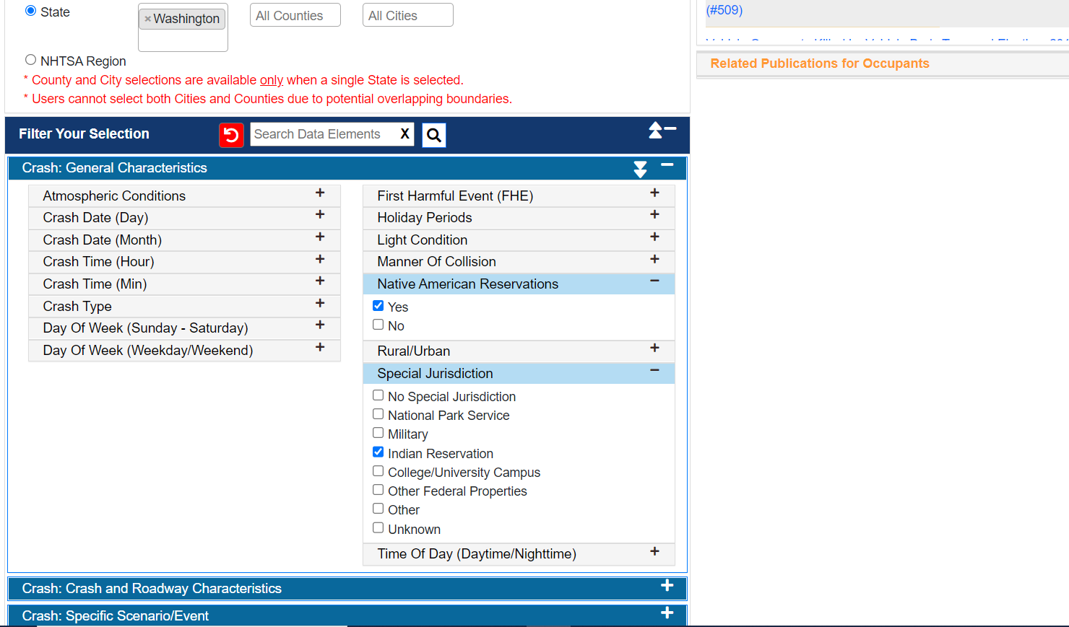
Notes:
Next, in Filter Your Selections section under the ‘Crash: General characteristics’ tab we will make several selections. We will click on the check boxes next to these factors: special jurisdiction, injury severity, and protection system use. Since we would like to get data on motor vehicle fatalities on Native reservations , we will click on’+’ sign on right side of the “Native American Reservation” tab you will see two options we will select “Yes” option. Similarly we will select “Indian Reservation” in Special Jurisdiction tab. If you wish to deselect a factor that we had chosen earlier you can just click on it again to deselect it. If you choose more than one factor, fatal crashes will have to meet all of your selection criteria to be included in the results of your query.

Slide 6
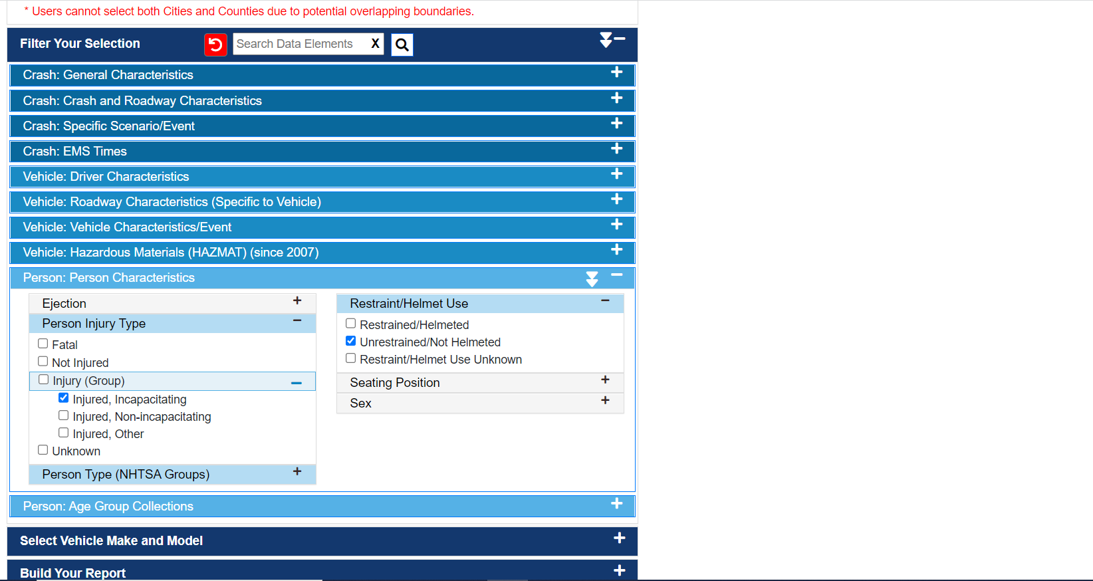
Notes:
To continue on with our example, in the next tab named “Person: Person characteristics” we will select the value “ Injured, Incapacitating” from injury Group, and “Unrestrained/Not Helmeted” from the Restrained/Helmet Use tab.

Slide 7
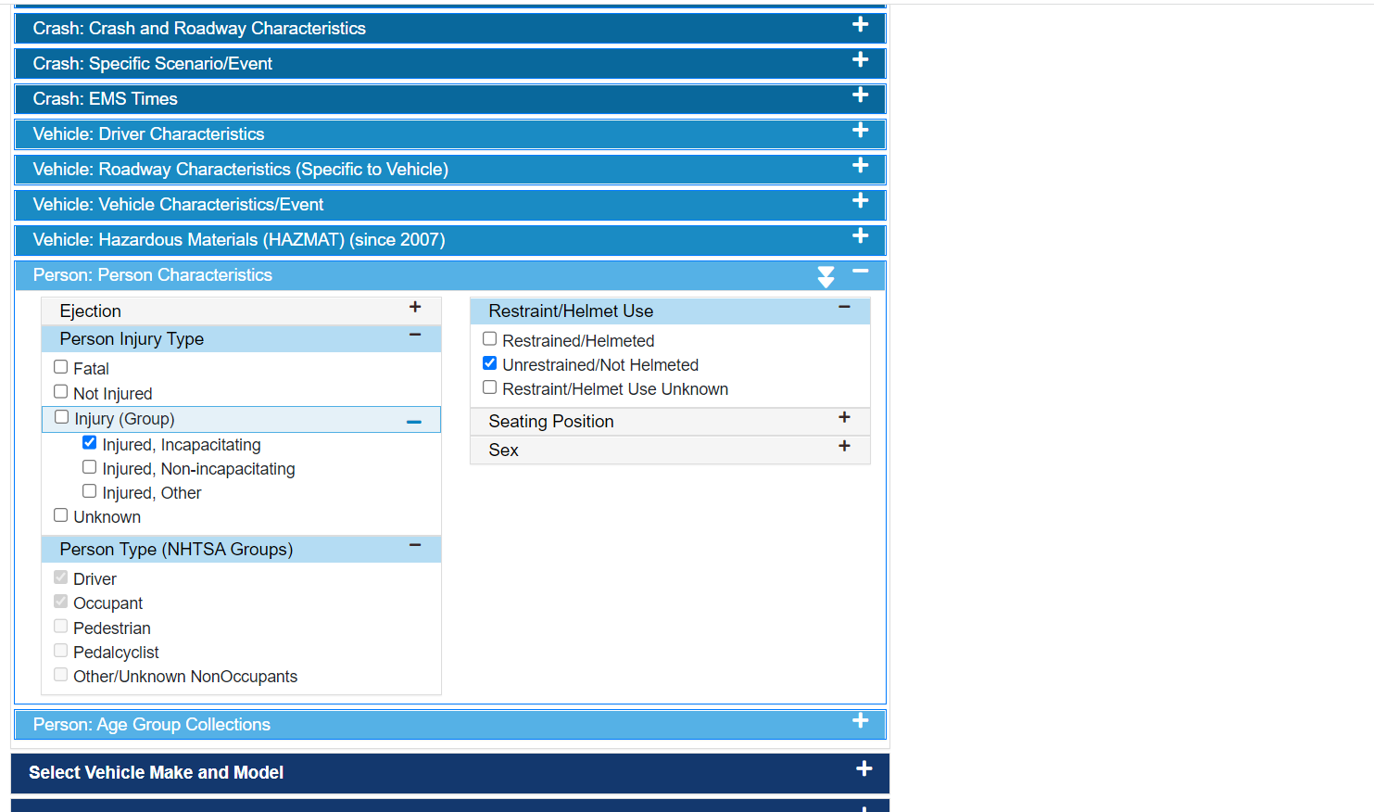
Notes:
As you expand Person Type tab by clicking right on “+” sign you will see Driver and Occupant values are already selected for us this is because at the beginning of this query we selected “Occupant” tab. If we were looking for Pedestrian data from the beginning then only Pedestrian value would have been selected by default in this tab.

Slide 8
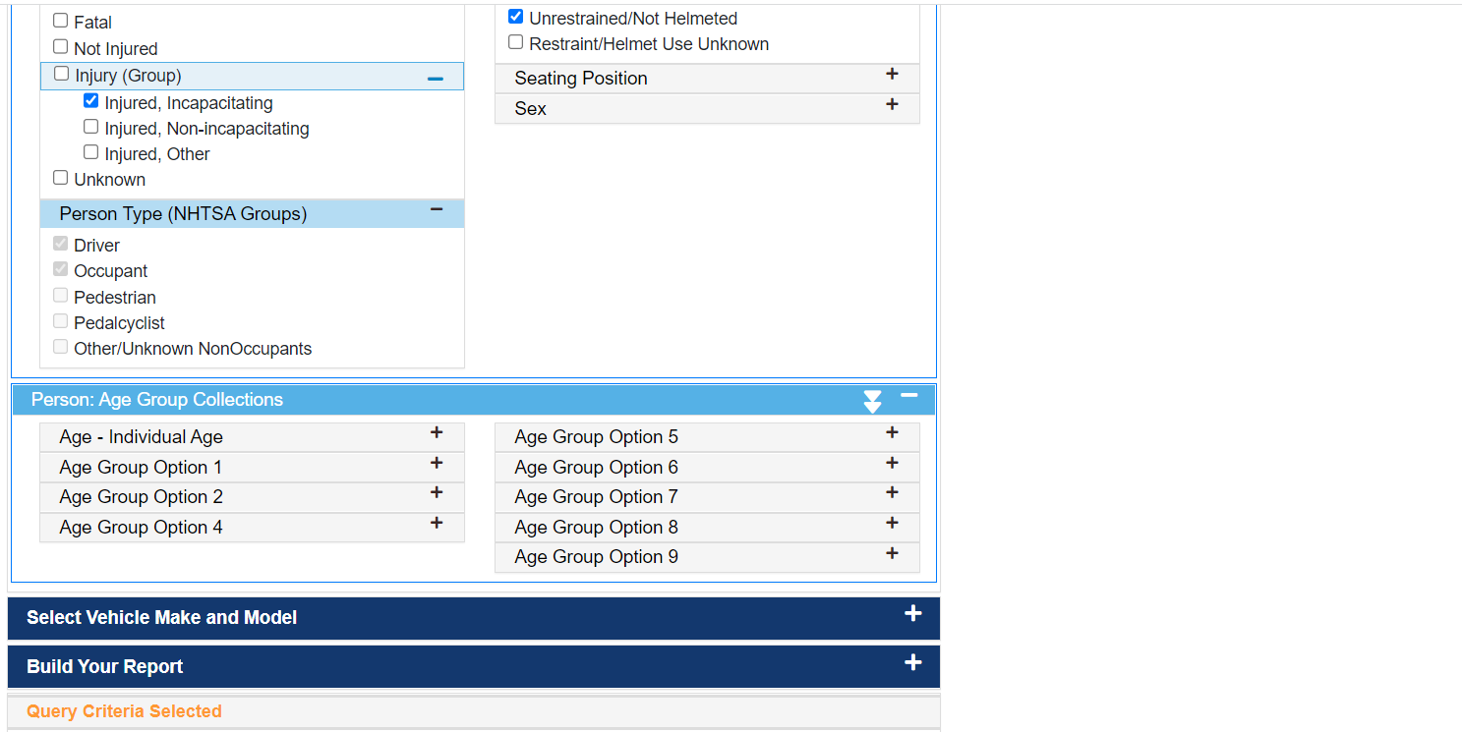
Notes:
In the next tab Person: Age Group Collections you have several options to choose from. It is important to note that if you select a narrow age category such as 0-8 years or something then you may have to select multiple years of data as there is a possibility of data suppression if we don’t have enough fatalities in that category.

Slide 9
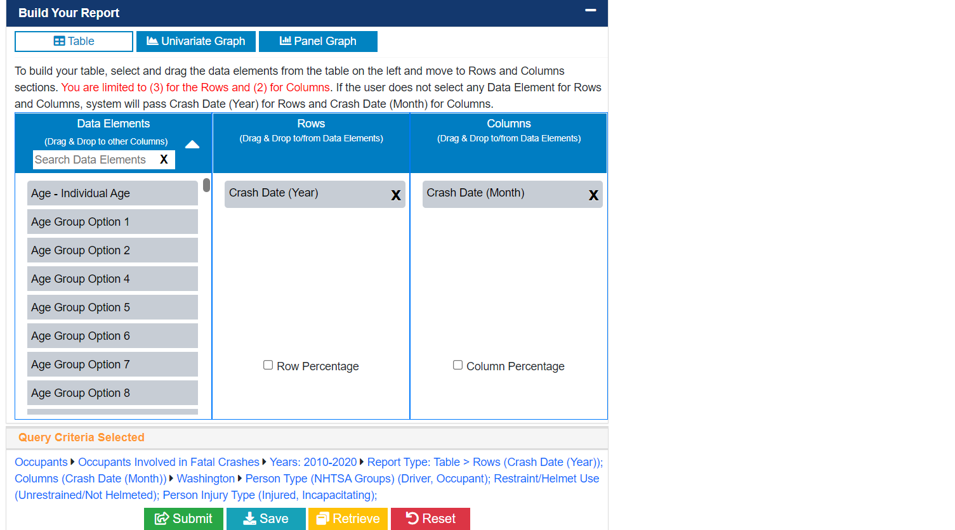
Notes:
In the Build your report tab, you can choose whether you want the data by month and year and also by age groups. This helps you create the data table that you can download at the end of the query selection. If you don’t want the data by crash date but only looking at year then you can click on ‘X’ to delete that option. Here I am deleting the data by “Crash date” selection. To finish your Query and see the results click “ Submit” .

Slide 10
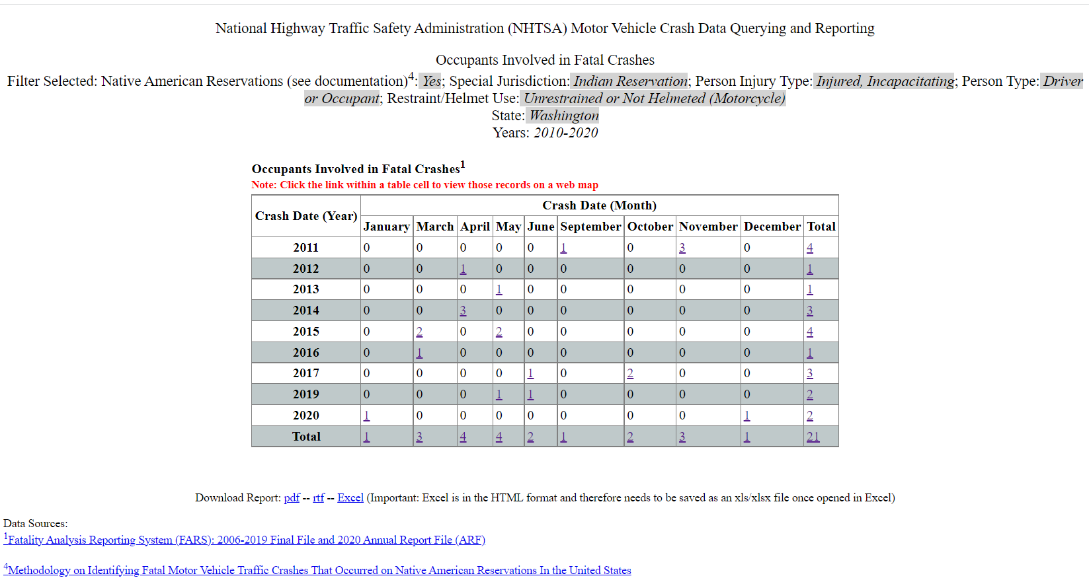
Notes:
Here is the data table with a detailed title showing all your selections and the motor vehicle occupant counts by year from 2010-2020 and the combined total. You can download the report in different formats as pdf, excel or rtf files.
Now click on any count in the table to see it on the map, we will click on total count 21 to see a map that shows the location of each fatal crash according to the factors for which you queried in FARS.

Slide 11
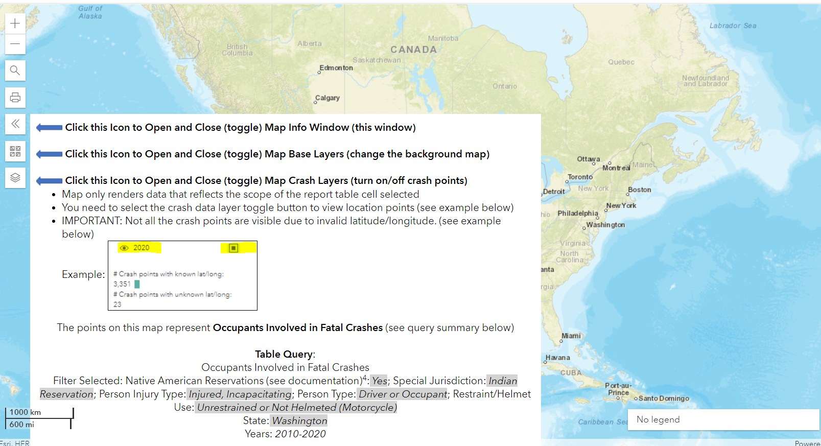
Notes:
On the map you see three arrow marks pointing towards left side, the top one is just to close or open the map info window. The second arrow mark (middle one with four tiles) is to change the background map and the last one is important for us because it allows us to view the crash data as per our requirements. Let us explore more about the map features in the next couple of steps.

Slide 12
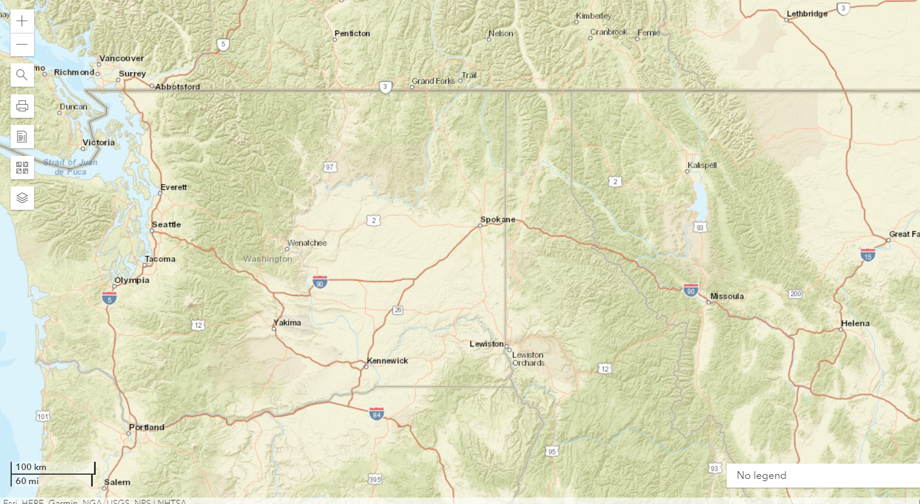
Notes:
You can zoom into an area of interest by using the +/- slide bar on left hand side of map, then click anywhere on the map to grab and move the map to re-center it around the area you wish to display. Here I clicked on the “+” sign to zoom in on Washington state as I will be looking at the crash events in Washington state.

Slide 13
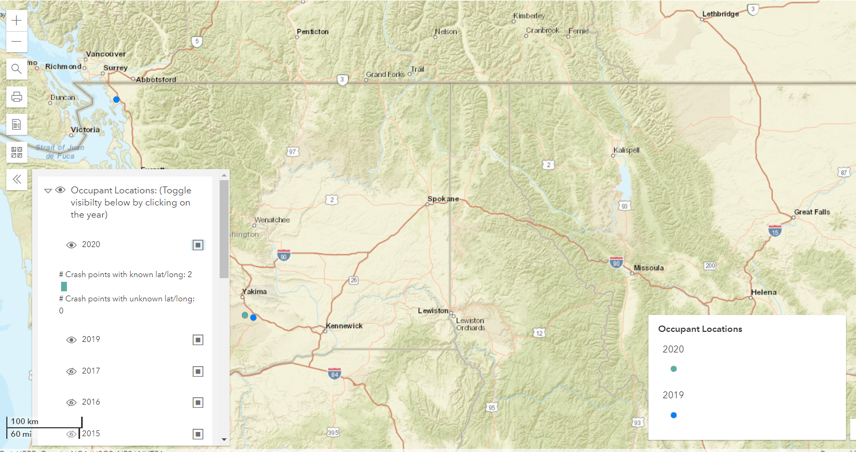
Notes:
Next you click on the tab with Two arrows, here you see years of your selections with a crossed out eye, in our case it is 2010 -2020 in years. Click on eye next to each year to show the crash events on the map, you can select individual year or click on all the years.

Slide 14
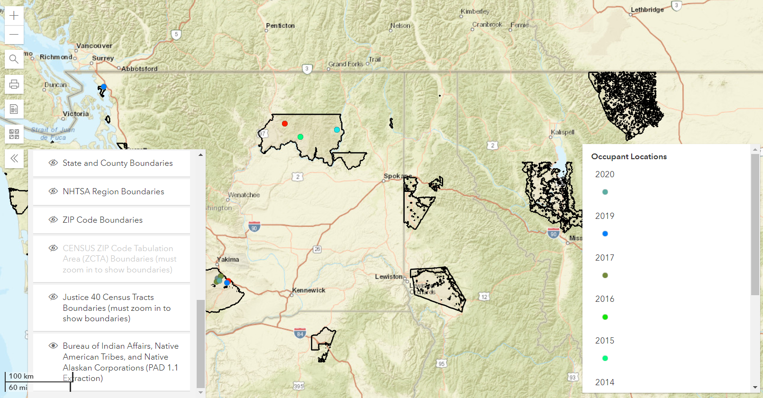
Notes:
As our goal was to observe all the occupant fatalities on reservations, we will use one feature that allows us to add a layer of reservations on the base map. Scroll down the years options you see state and county boundaries and at the end we have Bureau of Indian Affairs tribal layer, click on the crossed out eye.

Slide 15
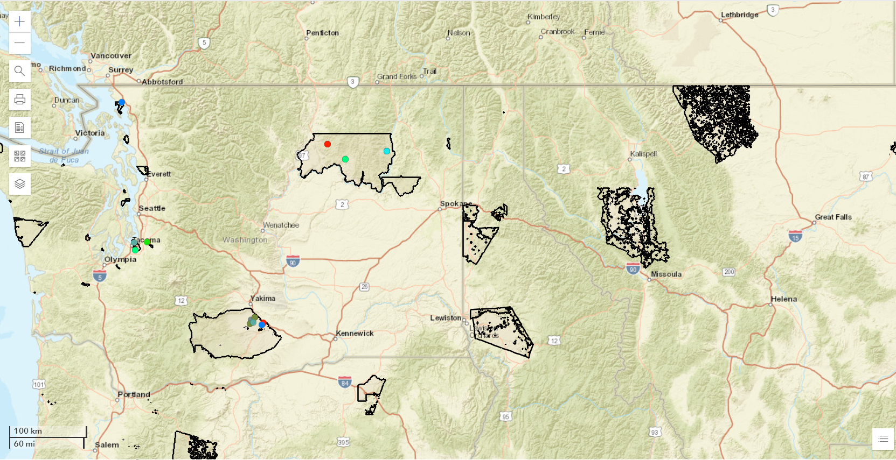
Notes:
Now you see the reservations and the crash events within those reservations on the map. Each colored dot indicates an occupant fatality in that reservation and the color of the dot indicates the year of occurrence, which you can see by clicking on the lower right corner icon. Again, you may notice that the number of vehicles or people in your query results list is greater than the number of crashes on your map. Since there is a chance that more people can suffer a fatal injury in one crash, we expect the vehicles or people to possibly be higher than the number of crashes.
You can print this map by clicking on the printer icon on the top left corner.
For a brief discussion on the limitations of using FARS to create maps, please read the FARS limitations section on Native CARS website.

