Slide 1
Quick steps to access & download data from Web-based Injury Statistics Query and Reporting System (WISQARS)
WISQARSTM is an interactive database system that reports injury-related data, including motor vehicle injuries and deaths. Fatal injury data is available by American Indian/Alaska Native race, by census region, and by age group.
National nonfatal injury data from hospital emergency departments is also available, but not by race.
Website link: https://www.cdc.gov/injury/wisqars/index.html

Slide 2
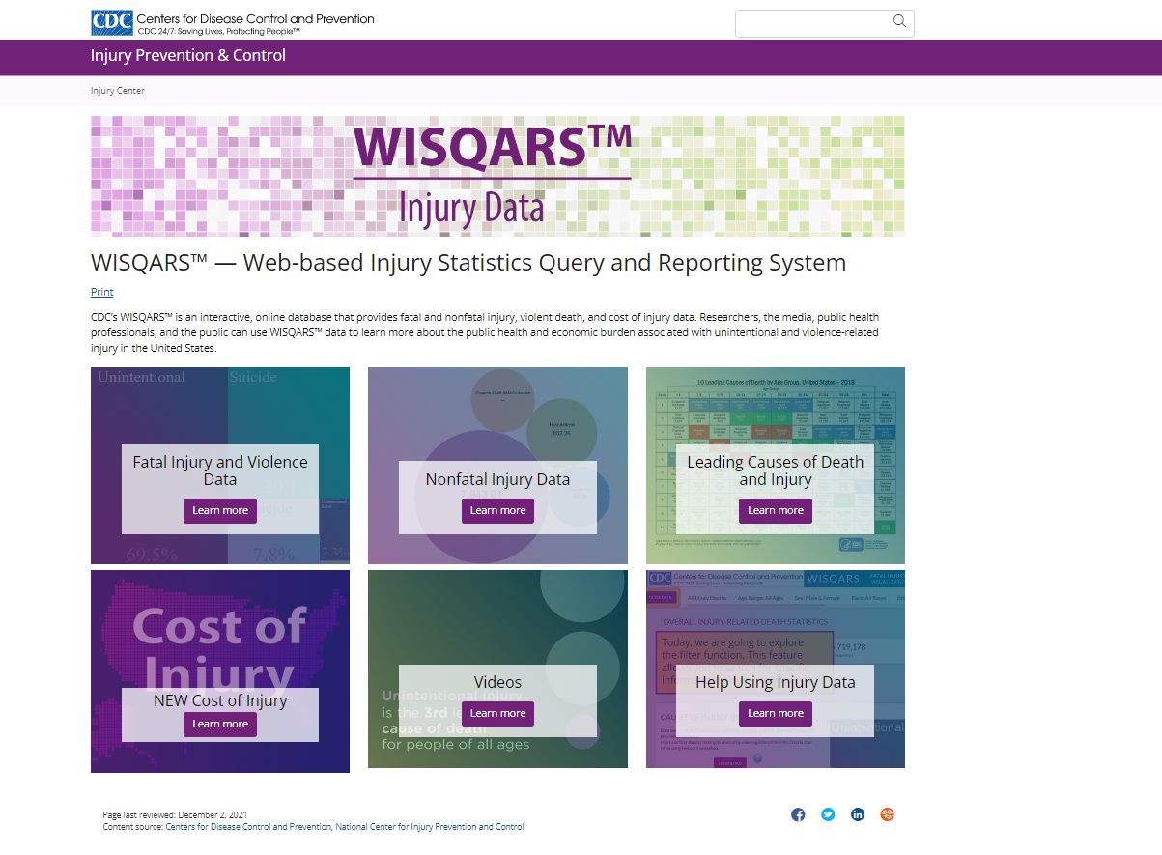
Notes:
Go to the website : https://www.cdc.gov/injury/wisqars/index.html .The home screen will look like this. Click on Fatal injury and Violence Data Box.

Slide 3
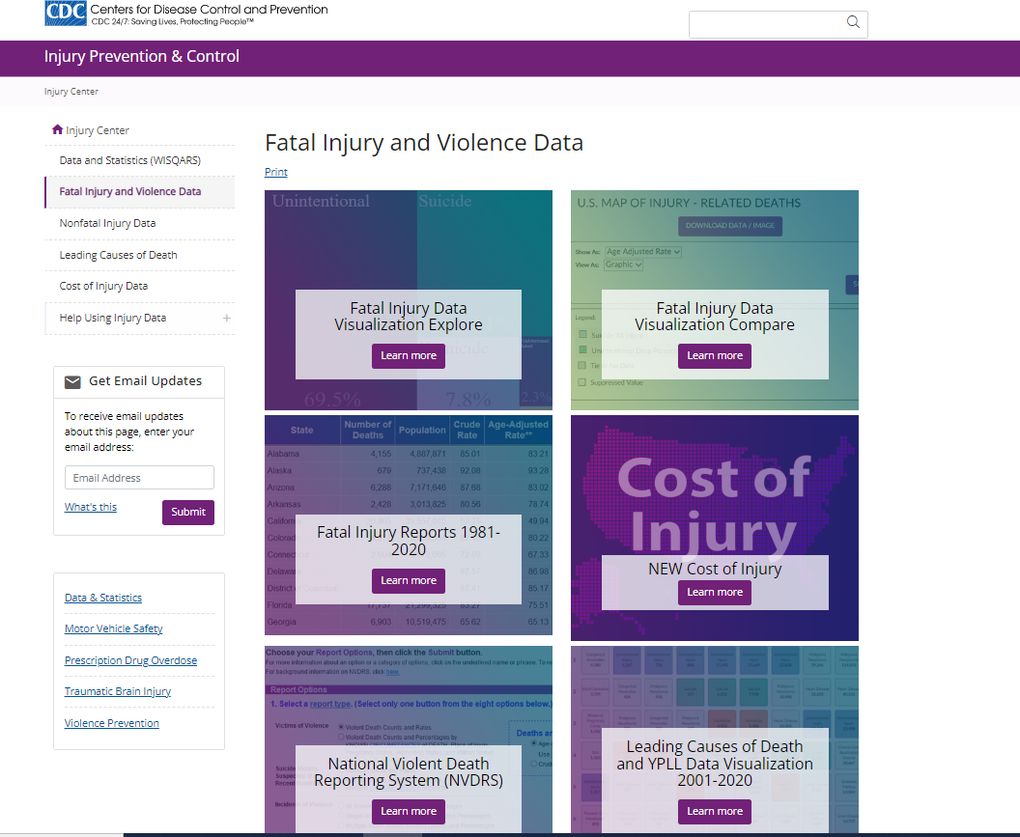
Notes:
On this page you have options to create data visualizations tailored to your needs by clicking on Fatal Injury Data Visualization Explore box. You can also download fatal injury data to create charts on your own using excel or other tools of your choice.
Here I am going to show steps involved in accessing American Indian Motor Vehicle fatalities in Oregon. Click on “Fatal Injury Reports 1981-2020” box. This box shows the currently available data, which here is until 2020.

Slide 4
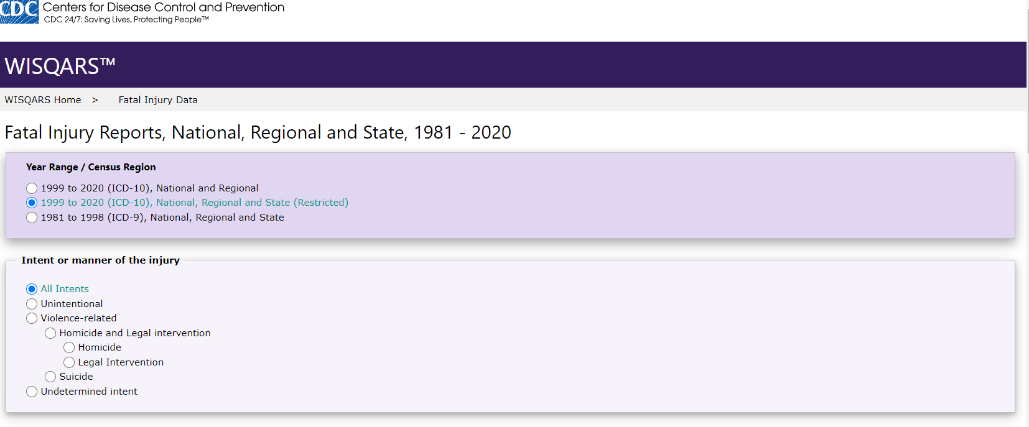
Notes:
Since we are looking for Oregon state data, under “Fatal Injury Reports, National, Regional, and States, 1999-2020” section click on “1999-2020 (ICD-10), National and Regional and State (Restricted)”.

Slide 5
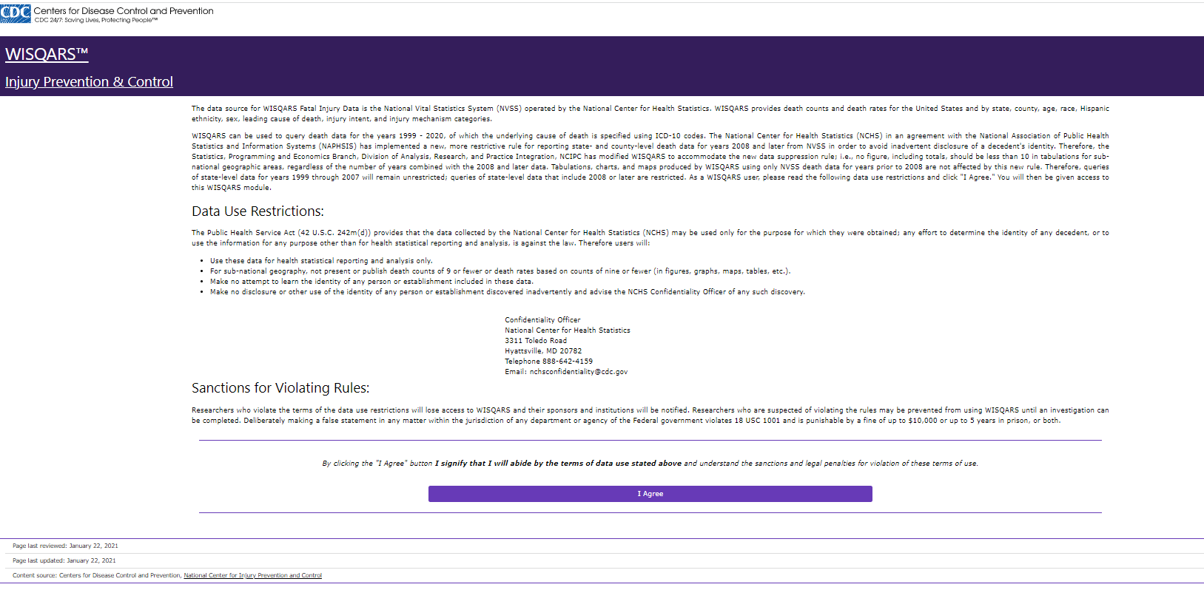
Notes:
Scroll to the bottom and click “I agree” to the terms of use of the data.

Slide 6
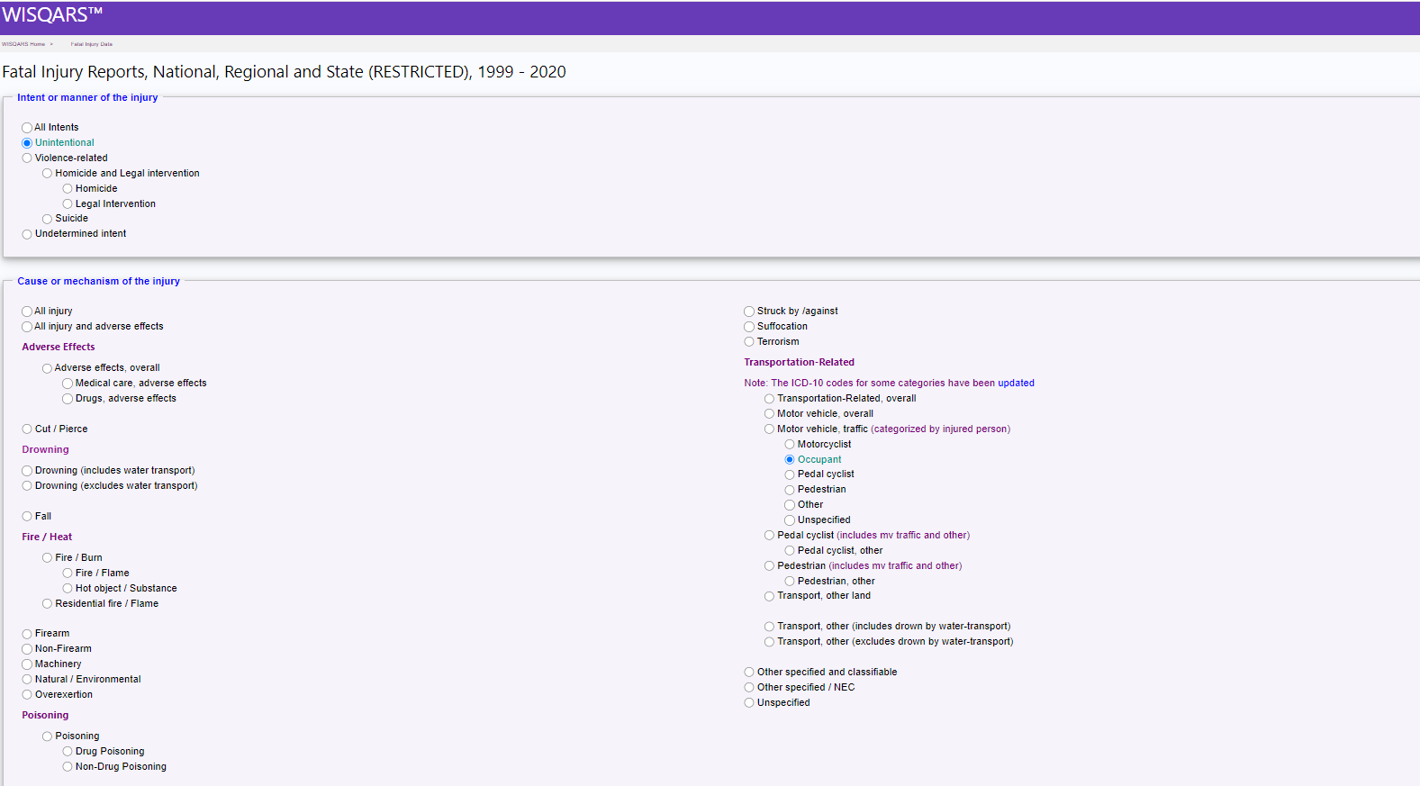
Notes:
In this section you have many options, first you can choose intent or manner of injury, and then have options for various “Cause or Mechanism of injury”. We will focus on “Transportation –Related” section, you can select all motor vehicle traffic or individual categories of traffic fatalities such as occupant or pedestrian etc. We are going to choose “unintentional” option at the top and then click on “occupant” option on the right.

Slide 7
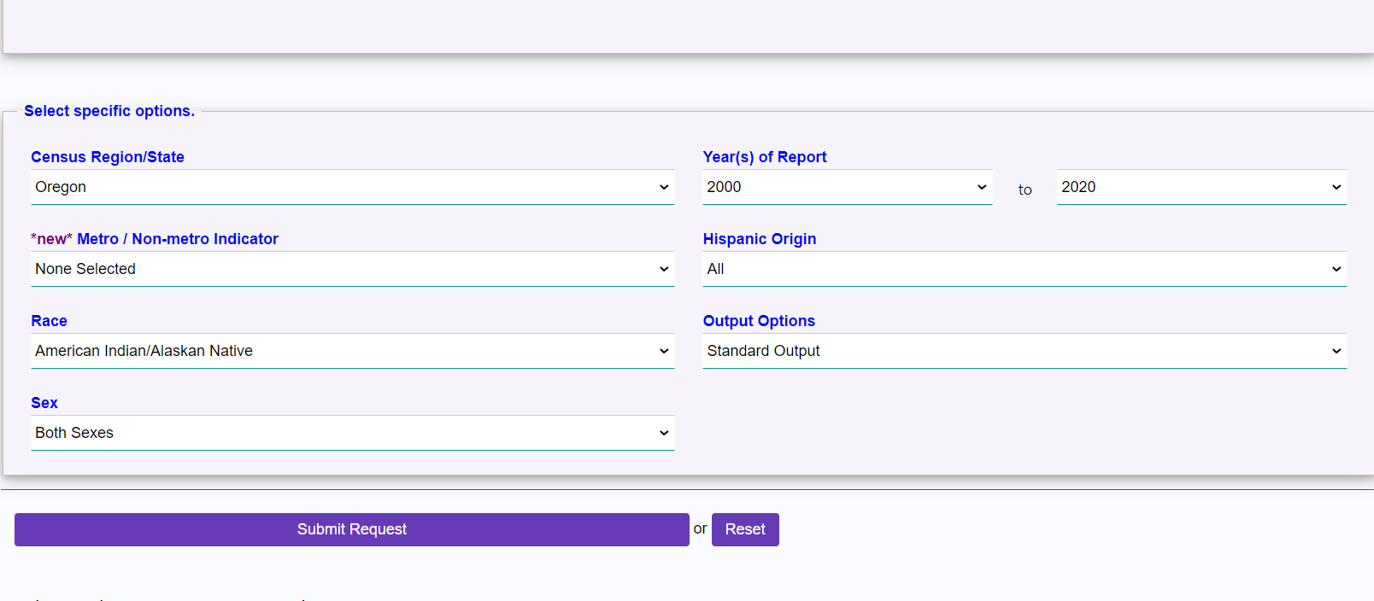
Notes:
Next under “Census Region/State” using the drop down menu choose Oregon. WISQARS does not report numbers less than 10 to protect the identity of the deceased. Luckily, motor vehicle fatalities are a rare enough event that you will need multiple years of data to find more than 10 fatalities, especially if you restrict it to young children. Using the drop down menu for “Year(s) of Report” select 2000-2020. Next select American Indian/Alaska Natives under “Race” option.

Slide 8
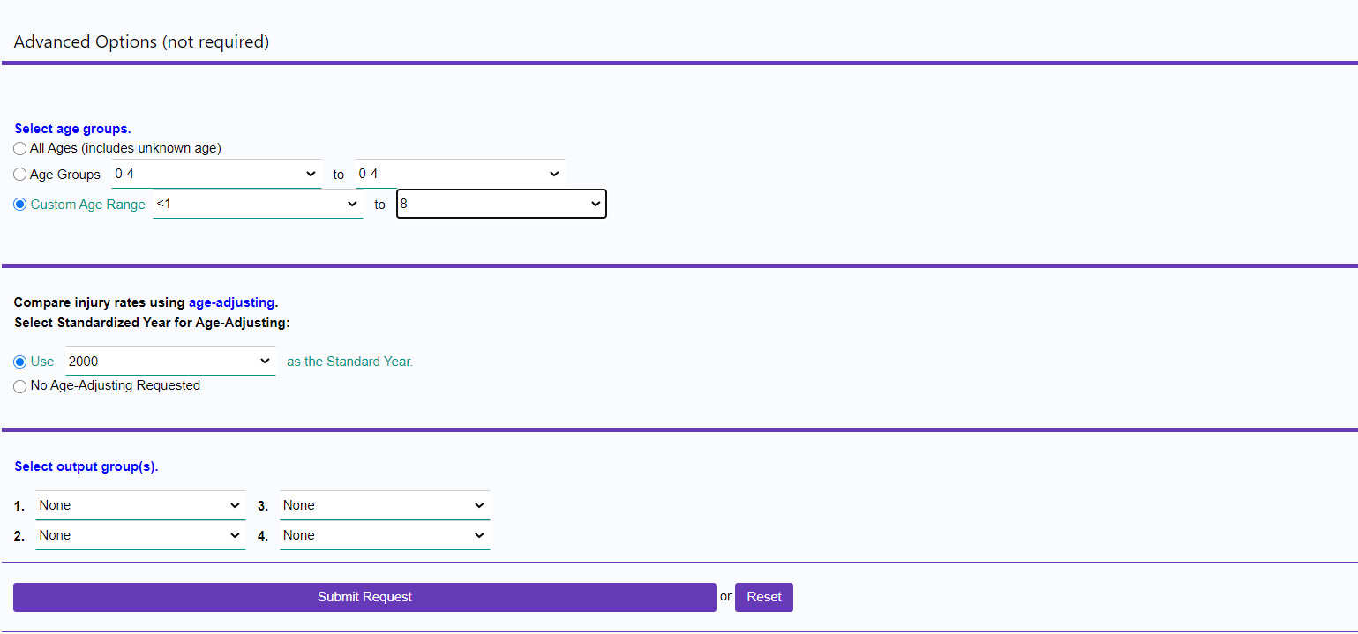
Notes:
Here we have several options for age categories; all ages or default age groups or custom ranges. For child motor vehicle fatalities, under “Custom Age Range” select the age range of interest. To match the minimum recommended ages to use child safety seats, select “<1” to “8.”
Because we are requesting a specific age group, it does not matter if you click “No Age-Adjusting Requested” or “Use 2000 as the standard year.” The results will be the same.
Click “Submit Request.”

Slide 9
Notes:
This box shows 13 American Indian children ages 0-8 who were occupants died in unintentional motor vehicle crashes in the state of Oregon between 2000-2020. In addition, shows total AI/AN population during that same time period and the crude Rate per 100,000 population, which is estimated as total occupant deaths divided by total population calculated for 100,000 populations.

Slide 10
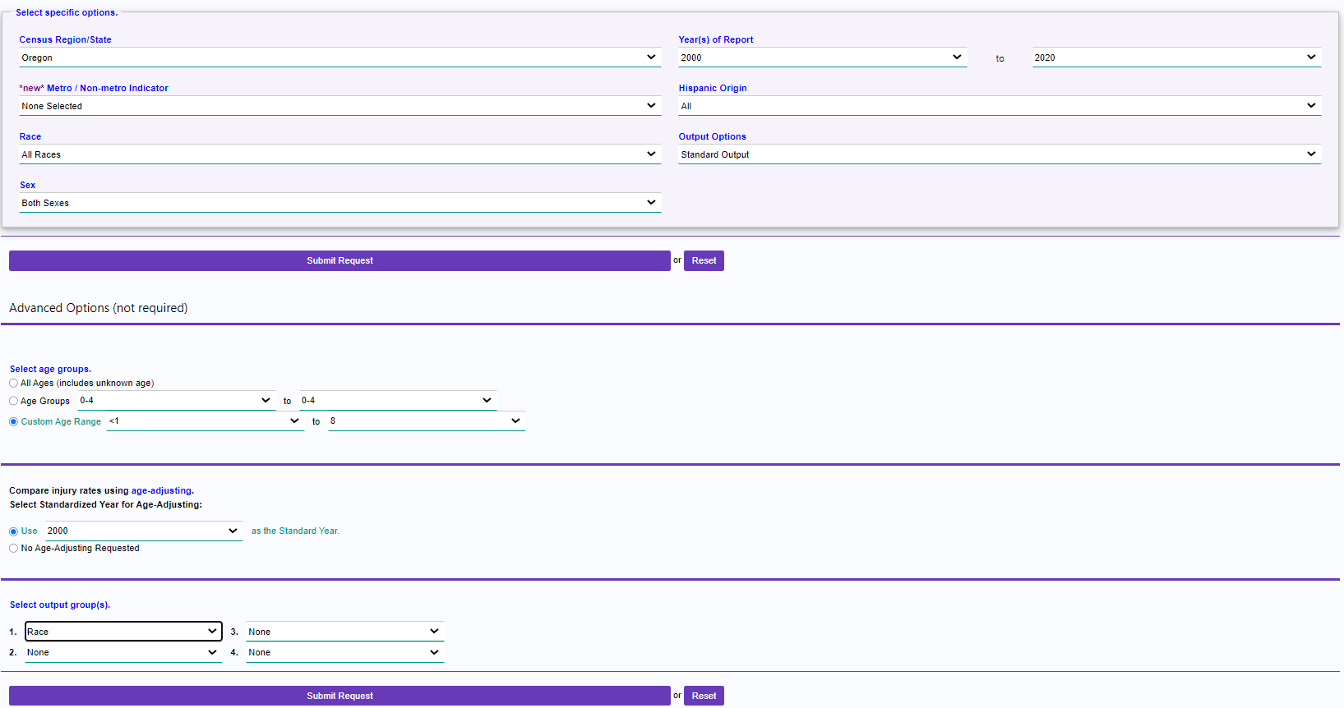
Notes:
To compare motor vehicle fatalities across race, in the “Select specific options” section, select your region or state, the years of report, and under “Race” select “All Races.”
Under “Advanced Options,” select your age range of interest. If you are making comparisons for all ages across races, use age adjusting. Because we are requesting data for a specific age group in this example, age-adjusting is irrelevant. Under “Select output groups” select “Race.” Click “Submit Request”

Slide 11
Notes:
In this example, we compared unintentional motor vehicle traffic occupant deaths over a twenty year period for children age 0-8 of all races in Oregon. You can see that 13 AI/AN children and 86 White children died from motor vehicle crashes during this time period. Look at the crude rate in the right-hand column and notice that this is around five times the rate of the white population. Since the death counts are fewer than 10 for Black and Asians they are suppressed. You can download the data in excel using the link at on the left side.
The Centers for Disease Control and Prevention have published a fact sheet on motor vehicle injuries among American Indians and Alaska Natives using WISQARS data. It’s a great reference if you’re looking for motor vehicle fatality statistics and risk factors for American Indians nationwide. Click here for the Tribal Road Safety fact sheet: https://www.cdc.gov/transportationsafety/native/factsheet.html

